Slide 1
STATE OF THE INSURANCE MARKET 2018
(THIS INFORATION HAS BEEN CONSOLIDATED FROM VARIOUS INDUSTRY SOURCES)
October 2017
Presented by:
INSERT YOUR NAME HERE
Alliant Insurance Services
Notes:
Annually, we make this presentation available to our clients. It’s CALLED the State of the Market, and some slides do directly review what is currently happening with US Commercial Insurance. But more importantly we like to focus on 1) Emerging (or Evolving) Risks, and 2) trouble spots - - things to look out for in coming year(s) – and our expectations for your renewals.

Slide 2
Presentation Overview
Highlights
Property/Casualty Industry Performance
Impact of Natural Catastrophes
Cyber Security & Data Breaches
New & Evolving Risks
  Drones, Self-Driving Cars, Impersonation Fraud, Hate Speech
Looking Ahead…
2
Notes:
P&C Industry performance is the best indicator we have looking forward to your renewals. But past performance is obviously not the ONLY indicators. Although the insurance industry has been a very large stable beast, it is clearly NOT like the analogy of a ‘battleship’ - - large, impactful Natural Catastrophes can make it change on a dime. In addition, large repeated jury verdicts, and well as societal trends can rapidly change underwriters aversion to YOUR risk!

Slide 3
Highlights
Munich Re estimates insured losses from Hurricane Harvey will be $30 billion; the Miami Harold estimates insured losses from Irma will be $17.5 billion to $27 billion; and AIR Worldwide estimates insured losses from Hurricane Maria will be $45 billion to $85 billion. The insured losses from these CAT storms could reach $150 billion.
Key Industry Metrics
  The P&C Combined Ratio was 99.6% as of 3/31/17.
  Policyholder surplus was $700.9B as of 3/31/17 -- A record high.
  Net income after taxes dropped to $7.7 billion in first-quarter 2017 from $13.4 billion in first-quarter 2016—a 42.2 percent decline.
Weather extremes (Hurricanes Harvey, Irma and Maria, flooding in Florida, Louisiana, Texas and California), catastrophic losses (Northern California fires and earthquakes in Mexico) and investment earnings are areas of concern for carriers.
3
Notes:
The commercial insurance market has been generally very healthy as natural disaster losses had been below the average for the past decade. The 2017 hurricane season will bring significant insurable losses to the industry. This following 2016, which had the highest insured CAT losses ($50B) in the past 4-years.
“Hurricanes, earthquakes rack up huge bill for insurers” according to a recent Advisen headline.

Slide 4
Property/Casualty Industry Performance

Slide 5
Commercial Insurance Prices in the U.S. Remain Flat During the Second Quarter
Commercial insurance prices were again nearly flat during the second quarter of 2017, according to Willis Towers Watson's most recent Commercial Lines Insurance Pricing Survey (CLIPS) data.
Three lines -- Workers Compensation, Property, Directors & Officers Liability -- indicated modest price decreases.
The outlier in this year’s results continues to be Commercial Auto Liability, where meaningful price increases are again reported and appear to be accelerating somewhat.
Price changes for most other lines fell in the low single digits, but these trends may quickly change for all lines of coverage, especially Property if more large loss events occur before the end of this year.
Source: Willis Towers Watson Commercial Lines Insurance Pricing Survey
5
Notes:
CLIPS is a source for benchmarks regarding historical changes in commercial P&C prices and loss costs that was started in 2005, collecting data back to 2003.
While rates overall have been stable and property has seen modest decreases, we could see a firming of the property market as a result of 3rd quarter CAT losses.

Slide 6
P/C Industry Net Income After Taxes*,
1st Quarters of Each Year, 2007-2017
$ Billions, 2017 dollars
$56.8 B
Due to the delay in reporting this information we review the most recent quarter(s), but for these 3 years the figures have been annualized for a better comparison.
$55.5 B
$42.6 B
In the first quarters of the year, net income varied.
2017 was the second-lowest profit in the last 11 years.
*adjusted for inflation using the BLS CPI calculator, to 2016 dollars
Sources: A.M. Best; ISO, a Verisk Analytics company; Insurance Information Institute.
6
Notes:
JERSEY CITY, N.J., June 26, 2017 — The private U.S. property/casualty insurance industry saw its net income after taxes drop to $7.7 billion in first-quarter 2017 from $13.4 billion in first-quarter 2016—a 42.2 percent decline—and its overall profitability as measured by its annualized rate of return on average policyholders’ surplus fall to 4.4 percent from 7.9 percent, according to ISO, a Verisk Analytics (Nasdaq:VRSK) business, and the Property Casualty Insurers Association of America (PCI).

Slide 7
Property/Casualty Insurance Industry Investment Income: 2000–2016:Q1
($ Billions)
Investment earnings are still below their 2007 ‘pre-crisis’ peak
Due to persistently low interest rates, investment income fell in 2012, 2013 and 2014 but showed a small (1.9%) increase in 2015—another drop in 2016 seems likely
1 Investment gains consist primarily of interest and stock dividends.
*2014 figure is estimated based on annualized data through Q3.
Sources: ISO; Insurance Information Institute
7
Notes:
First-Quarter 2017: Annualized quarterly investment yield 3.0%, compared to 3.6% average annualized quarterly yield for the last 10 years. (Verisk)
NOTES FROM LAST YEAR: This Chart has always bothered me, but I still like to show it. Remember, interest rates WERE 8%+ back in the 1980’s. They were pretty low this whole time, but REALLY dropped in 2008-09. So WHY are carriers still making what looks to be a pretty good return? There are a number of reasons, but a key one is that in 2007 P&C Assets were $1.3 trillion, and in 2015 they were $1.5 trillion. So the return on investments is down significantly.

Slide 8
Policyholder Surplus, Quarterly,
2006:Q4–2017:Q1
Surplus as of 3/31/17 stood at $709.0B
($ Billions)
2007:Q3
Pre-Crisis Peak
Drop due to near- record 2011 CAT losses
Surplus grew by 4.8% over 3/31/2016
The industry now has $1 of surplus for every $0.75 of NPW,
the strongest claims-paying status in its history.
2010:Q1 data includes $22.5B of paid-in capital from a holding company parent for one insurer’s investment in a non-insurance business.
Sources: ISO, A.M .Best.
The P/C insurance industry is, in 2017,
in very strong financial condition.
8
Notes:
Policyholder surplus = amount of money insurance companies have to pay claims. We would expect a substantial drop in policyholder surplus as a result of Q3 CAT losses.

Slide 9
Net Premium Growth (All P/C Lines) - -
Annual Change, 2007-2016
Premium Growth Has Followed Economic Growth and Inflation.
SOURCES: A.M. Best (2007-2013), ISO (2014-16), Federal Reserve Bank of St. Louis (FRED), Insurance Information Institute.
9
Notes:
The U.S. economy posted a stunning drop of 0.1 percent in the fourth quarter, defying expectations for slow growth and possibly providing incentive for more Federal Reserve stimulus.
The economy shrank from October through December for the first time since the recession ended, hurt by the biggest cut in defense spending in 40 years, fewer exports and sluggish growth in company stockpiles.
The Commerce Department said Wednesday that the economy contracted at an annual rate of 0.1 percent in the fourth quarter. That's a sharp slowdown from the 3.1 percent growth rate in the July-September quarter.
The surprise contraction could raise fears about the economy's ability to handle tax increases that took effect in January and looming spending cuts.
Still, the weakness may be because of one-time factors. Government spending cuts and slower inventory growth subtracted a total of 2.6 percentage points from growth.

Slide 10
P/C Insurance Industry
Combined Ratio, 2001-2017*
Heavy Use of Reinsurance Lowered Net Losses.
Higher CAT Losses, Shrinking Reserve Releases, Toll of Soft Market
A return to more usual underwriting loss.
Best Combined Ratio Since 1949 (87.6)
3 Consecutive Years of U/W Profits; 1st time since 1971-73
**Excludes Mortgage & Financial Guaranty insurers 2008-2014.
Including M&FG, 2008=105.1, 2009=100.7, 2010=102.4, 2011=108.1; 2012:=103.2; 2013: = 96.1; 2014: = 97.0.
Sources: A.M. Best; ISO, a Verisk Analytics company; I.I.I.
10
Notes:
Combined Ratio - Essentially for every premium dollar collected the insurance industry is paying out nearly one dollar in expenses and claims.

Slide 11
Workers Comp Private Carrier
Combined Ratio, 2001-2016*
3 Consecutive Years of U/W Profits; 1st Time in At Least 30 Years.
I.I.I. Estimate
*Projected.
SOURCES: NCCI, Insurance Information Institute (2016 projection).
11
Notes:
The Work Comp market will remain relatively stable compared to the overall P&C market, due to the impact of property cat claims.

Slide 12
Cyber Security & Data Breaches

Slide 13



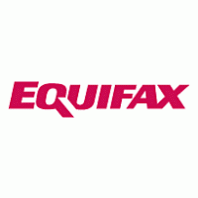




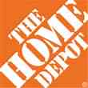
Large Data Breaches in Headlines
2014 / 110 Million / $236 Million
2015 / 80 Million / $115 Million
2007 / 90 Million / $1.7 Billion
2017 / 143 Million / $125 Million
2014 / 1.2 Million / $2 Million
2015 / 130 Million / $140 Million
2013 / 3 Billion / $350 Million
2014 / 56 Million / $62 Million
2014 / 18 Million / $1 Billion+
Year / # Record / Estimated Cost
13
Notes:
The average cost of cyber crime in 2017 is $11.7M per organization globally, up 62% over the past 5-years.
By now almost everyone has had their data exposed. “Herd immunity” may be all that’s protecting each of us individually – there’s so much data out there the chances that the crooks will target us is lessened.

Slide 14
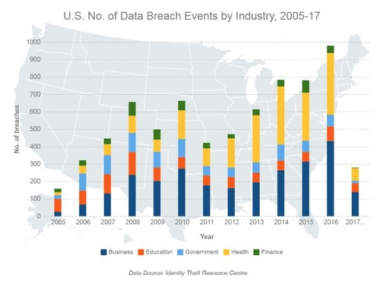
U.S. number of Data Breach Events by Industry, 2005-17
14
Notes:
While 2017 represents a partial year you can see that data breaches continue to soar.

Slide 15
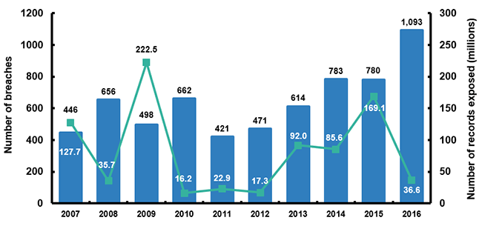
Data Breaches 2007-2016, by Number of Breaches and Records Exposed
The Identity Theft Resource Center says there have been 956 breaches in 2017 so far (as of August 30) with 19.3 million records exposed. The business sector accounted for 57 percent of the 2017 breaches. These figures do not include the many attacks that go unreported. In addition, many attacks go undetected.
Source: Identity Theft Resource Center
15
Notes:
Drilling down on the numbers on this slide.
THIS CHART NEEDS KEY – NOT CLEAR THAT THE BAR IS NUMBER OF RECORDS AND THE LINE IS NUMBER OF BREACHES

Slide 16
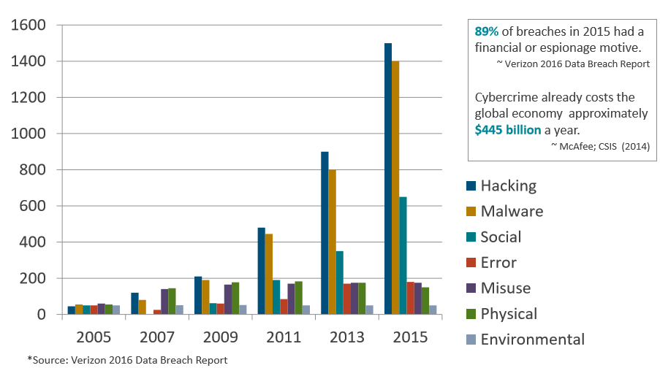
Data Breaches and Cyber Attacks are Increasing in Costs and Frequency
16
Notes:
As cyber breaches and the costs associated with them continue to escalate, so do cyber insurance premiums. Cyber insurance premiums are estimated to be $7.5 billion in 20202, an increase from $3.0 billion in 2015. Awareness is also contributing to this increase as more organizations are buying cyber insurance.

Slide 17
Impact of Natural Catastrophes

Slide 18
U.S. Insured Catastrophe Losses
2012 was the 3rd Most Expensive Year Ever for Insured Cat Losses.
2013/14/15 Were Welcome Respites from 2011/12, Which Were
Among the Costliest Years for Insured Disaster Losses in U.S. History.
Longer-term Trend is for More – Not Fewer – Costly Events.
*2016 is first nine months
Note: 2001 figure includes $20.3B for 9/11 losses reported through 12/31/01 ($25.9B 2011 dollars). Includes only business and personal property claims, business interruption and auto claims. Non-prop/BI losses = $12.2B ($15.6B in 2011 dollars).
Sources: Property Claims Service, a Verisk Analytics business; Insurance Information Institute.
18
Notes:
Katrina still ranks as #1 costliest CAT loss in US history, but the jury is still out on Harvey, Irma and Maria. Hurricane Maria estimates are between $45B - $85B. 2016 was the costliest year in the past 4-years. 2017 will be likely be the worst year ever in the U.S. 13 of the 20 Most Expensive Events in US History Have Occurred Since 2004. Could climate change be responsible?

Slide 19
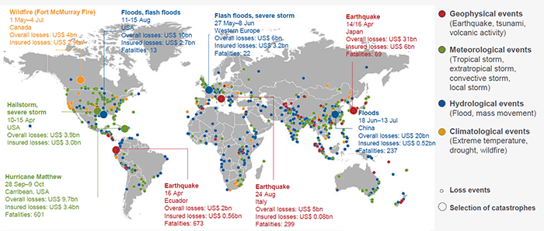
Loss Events Worldwide 2016
Overall Losses From Worldwide Natural Catastrophes in 2016 Totaled $175 Billion, Up From $103 Billion in 2015
Source: © 2017 Munich Re, Geo Risks Research, NatCatSERVICE. As of February 2017.
19
Notes:
2017 has the potential to surpass $200 Billion in insured losses. In a global economy, natural catastrophes have an impact on the property & casualty industry as a whole.
Insurers have begun reporting losses due to third-quarter catastrophes, but all report that they remain confident that they can handle the amounts, which range from the low millions to over $3 billion (Advisen). Lloyds of London expects they will pay $4.5 billion in losses from Hurricanes Harvey and Irma alone following a 16% drop in profits in the first half of 2017.

Slide 20
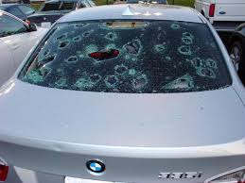
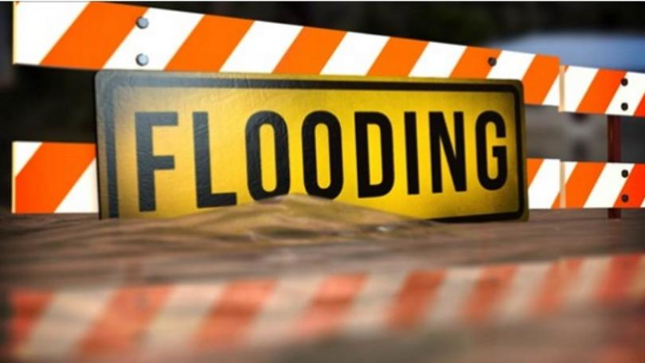
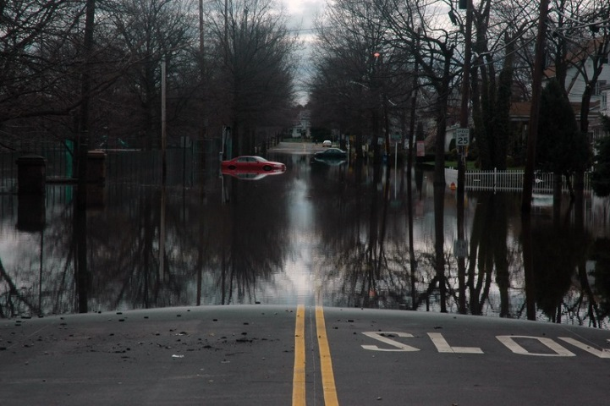
Severe Weather
Hail
Hurricanes & Floods
Earthquakes
20
Notes:
Remember when we talked about some of the commercial insurance industry’s concerns? Extreme weather is towards the top of the list.

Slide 21
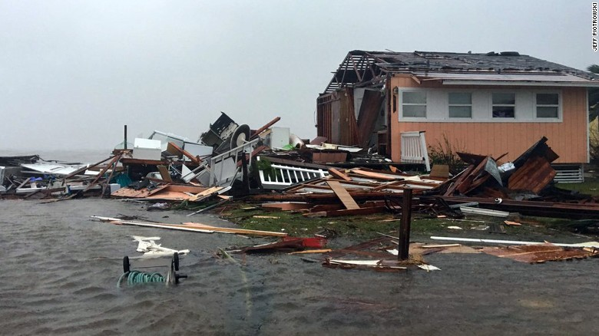
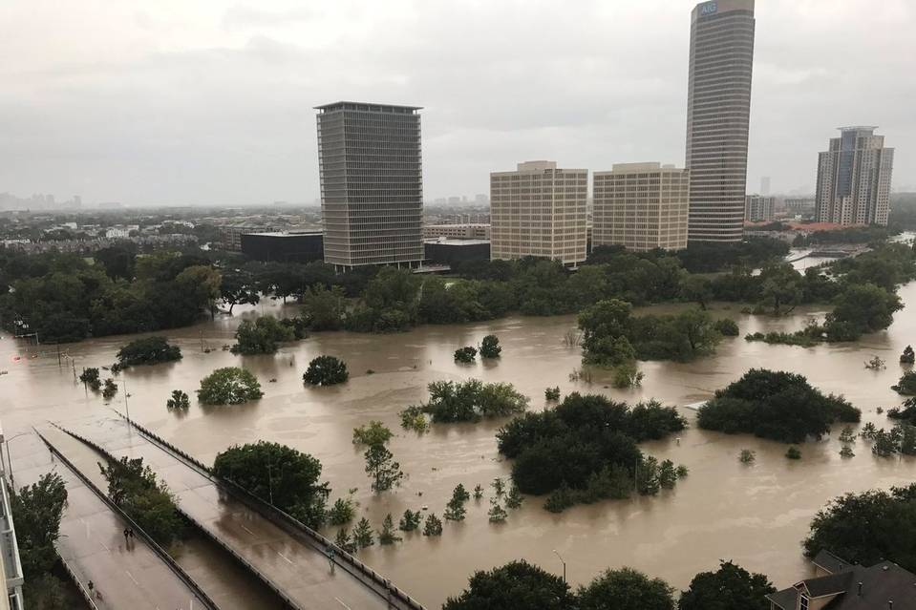
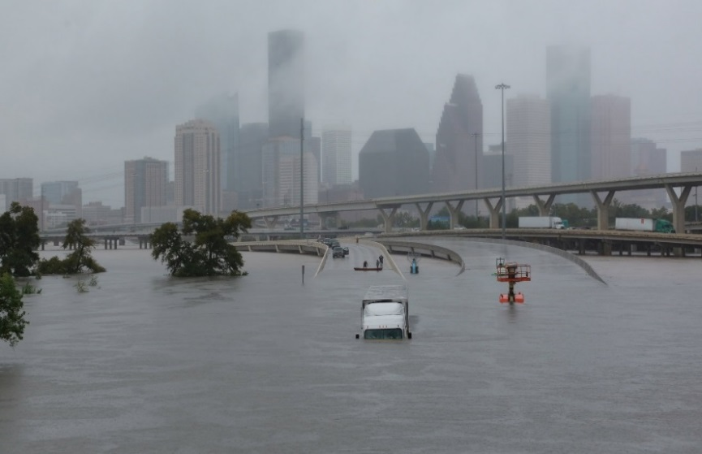
Hurricanes
Hurricane Harvey
Texas, August 2017
When we hear “Hurricane”, we often think about the cost of losses and how they will impact our insurance premiums. Life for many is disrupted and sometime even lost. The impact on businesses can be devastating. The hurricanes will cost Southwest Airlines $100M in revenue.
21
Notes:
When we think of hurricanes, we often think about the insured losses and how it will impact our insurance premiums. Life for many is disrupted and even lost, and the impact on businesses can be devastating. The hurricanes will cost Southwest Airlines $100M in lost revenue (CNN Money).

Slide 22
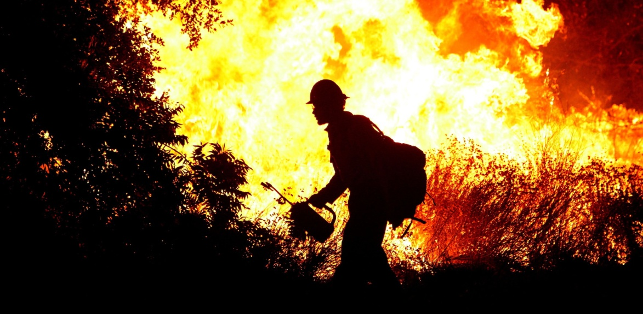
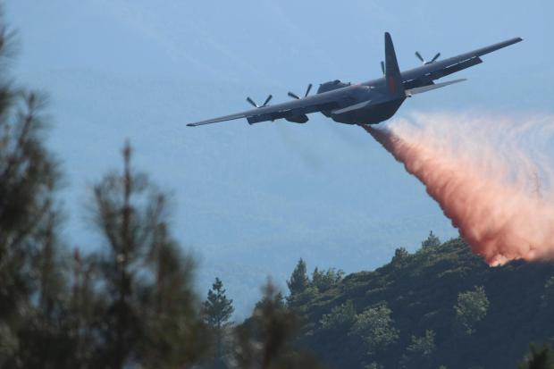
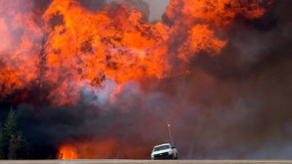
Wildfires
Santa Rosa, CA - - estimated $1.2 Billion
PG&E power lines have been blamed for the fires. PG&E carriers $800M in wild fire liability insurance. Total damage is expected to be considerably higher than the insurance PG&E carries, as a result, PG&E’s stock has taken a nose dive.
22
Notes:
Northern California fires are the fourth largest FEMA disaster this year in the United States. The Santa Rosa fires were the worst in CA history.

Slide 23
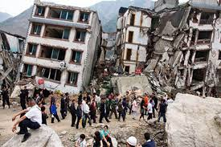
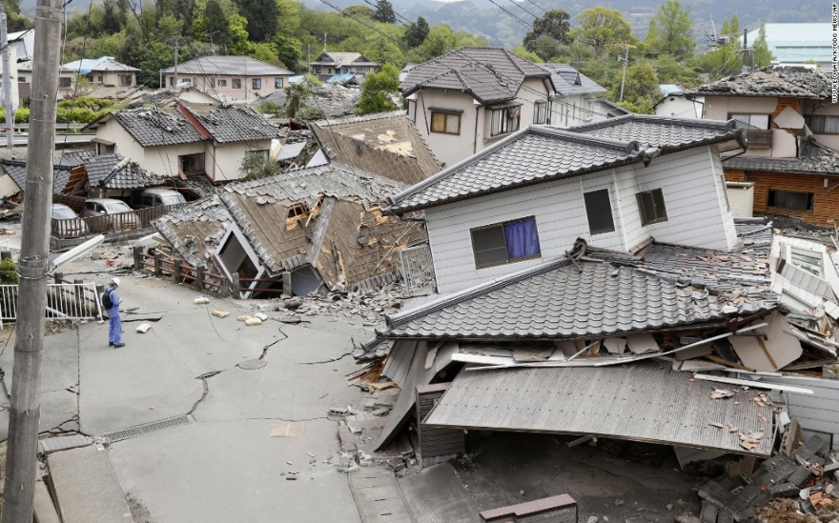
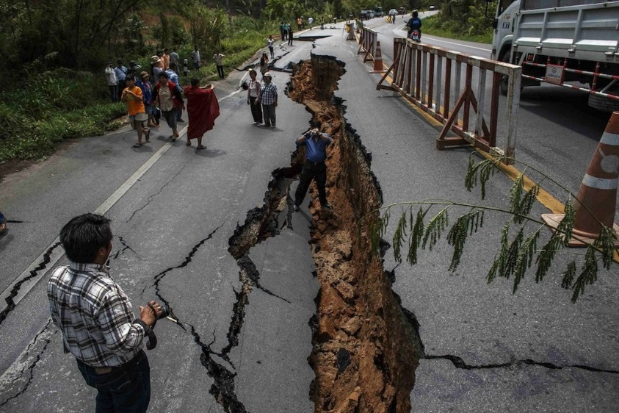
Earthquakes
Mexico suffered two deadly earthquakes last month --
An 8.1-magnitude quake on Sept. 7 that killed around 100 people in the southern states of Oaxaca and Chiapas and,
A 7.1-magnitude quake on Sept. 19 that left 369 people dead in Mexico City and central states.
23
Notes:
Mexico will receive $150 million from a catastrophe bond taken out in August against earthquakes and will use the money to partly fund reconstruction efforts, the Finance Ministry said.

Slide 24
Emergency Readiness

Slide 25
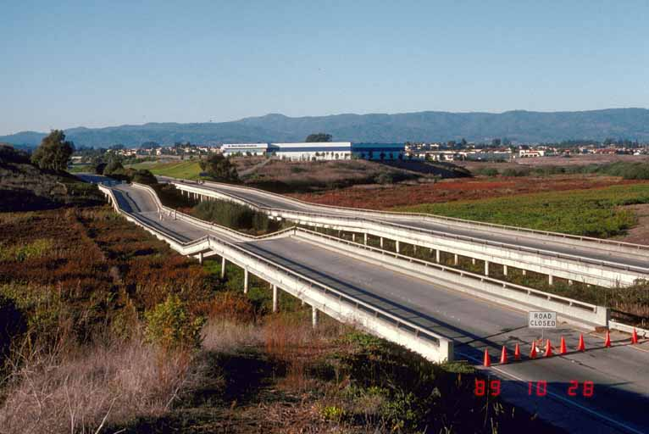
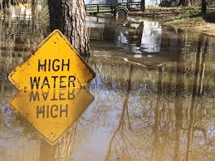
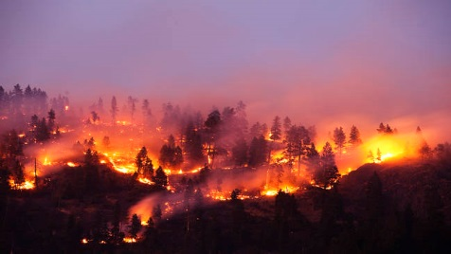
Preparedness – Expect the Unexpected
Ready For Anything?
Lately, every day we wake up wondering what’s next.
A number of natural catastrophic events have shown that we might not be as prepared for the challenges faced as we might think.
Don’t think “That could never happen to here”, because it can. Be sure that your crisis management plans take into account the truly unexpected for your area.
25
Notes:
If the past couple of months have taught us anything, it’s taught us to be prepared for anything. Hurricanes, earthquakes, wild fires and the list goes on. Was Ireland prepared for Ophelia? The first time in modern history that a hurricane changed course and headed for the UK.

Slide 26

The First 72 Hours
- What needs to happen
First, contact members of the team that you will need for the situation:
  Staff & supporting agencies
  Restoration contractor
  Broker
  Adjuster
Preserve/protect property from further damage to the extent possible.
Protect property & people from potential liability claim situations.
Consider obtaining an Emergency Proclamation so you can secure the contracts needed to start repairs quickly.
26
Notes:
Emergency response begins with planning ahead of time.

Slide 27

The First 72 Hours
- What needs to happen (Continued)
There are variations between jurisdictions as to what constitutes an emergency. You will need to know your locality’s definition to trigger services.
On-site meetings with key players.
Agree to an action plan.
Set up regular meeting schedule; plan for on-site, via conference call or both.
No surprises. Adjusters hate surprises.
Dealing with mold in the first 72 hours.
27

Slide 28
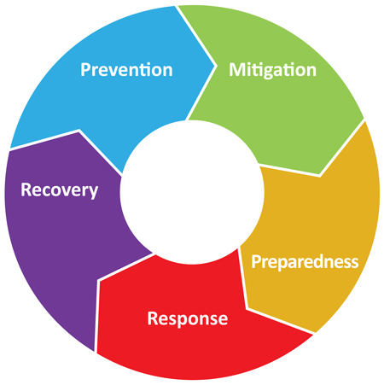
The First 72 Hours
- What needs to happen (Continued)
Valuable papers-need to stabilize conditions.
Insurance adjustment team - who will it be comprised of
      Adjuster
      Forensic Accountant
      Engineers
      Construction cost estimators
      Other specialized trades
Insured’s team
      Selected restoration contractor/agreed rates
      Forensic Accountant
      Construction Cost Estimator, if needed
      Structural Engineer
      Industrial Hygienist
    Temporary housing decisions & approvals
28

Slide 29
New & Evolving Risks

Slide 30
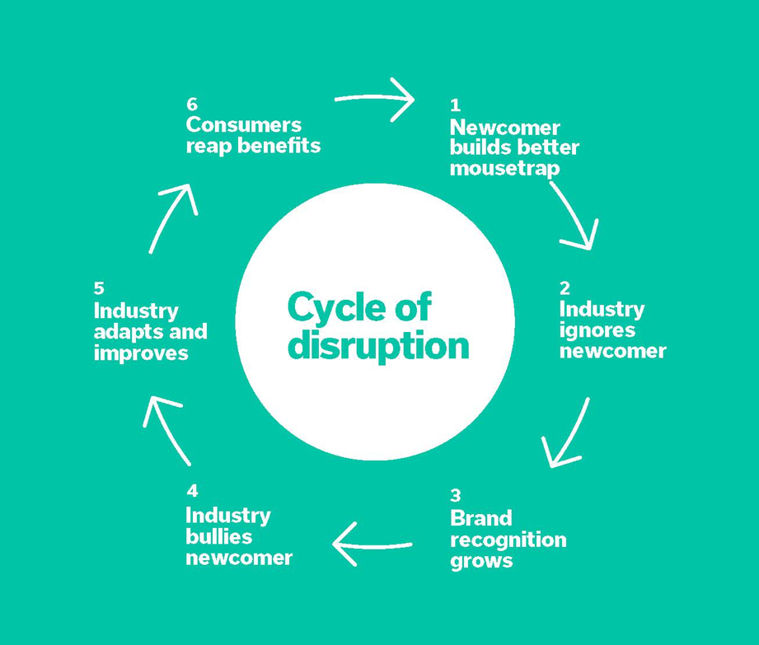
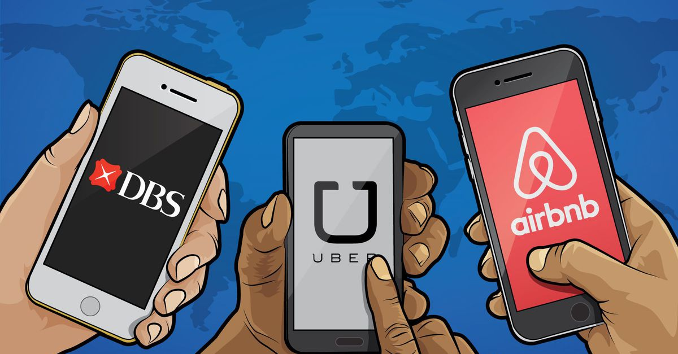
^{NEW:} Disruption
People are sometimes confused about the difference between innovation and disruption. It's not exactly black and white.
Think of it this way: Disruptors are innovators, but not all innovators are disruptors.
Innovation and disruption are similar in that they are both makers and builders.
So How is this an Emerging Risk?
30
Notes:
Do we have examples here?

Slide 31
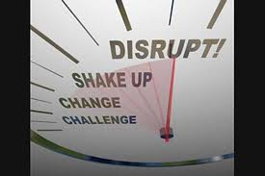
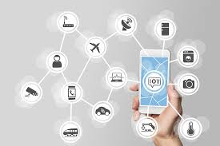
^{NEW:} Disruption (continued)
Disruption takes a left turn by uprooting and changing how we think, behave, do business, learn and go about our day-to-day.
Think of:
Charlottesville, Virginia riots
Fake News
Russian Facebook Impacts
UC Berkeley Republican Speakers
All of these impact our public agencies costs, and more importantly have a direct social impact that will forever be altered.
31

Slide 32
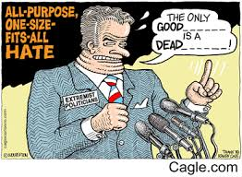
NEW: Hate Speech
Definition of Hate Speech
  Noun
  Speech that is intended to offend, insult, intimidate, or threaten an individual or group based on a trait or attribute, such as sexual orientation, religion, color, gender, or disability.
32
Notes:
How will this impact your organization? Will it lead to more workplace violence, employment related matters at your agency? Will it lead to more civil unrest? Questions we don’t necessarily have the answers to, but we need to been thinking about it.

Slide 33
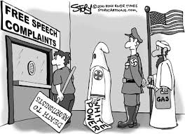
^{NEW:} Hate Speech (continued)
Hate speech is spoken words that are offensive, insulting, and/or threatening to an individual or group based on a particular attribute of that person or persons being targeted.
Targeted attributes include such traits as ethnic background, sexual orientation, race, or disability, though there are other target attributes.
In the U.S., another term for hate speech is “fighting words,” as such talk is likely to provoke an otherwise reasonable person into acting rashly against speaker doing the provoking.
33
Notes:
Compare definition of hate speech with assault. “Hate speech” is protected by the First Amendment unless and until it becomes an assault.
An assault is carried out by a threat of bodily harm coupled with an apparent, present ability to cause the harm. It is both a crime and a tort and, therefore, may result in either criminal and/or civil liability.
If the Klu Klux Klan files for a parade permit in your city get legal advice!

Slide 34
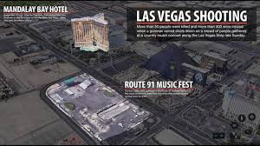
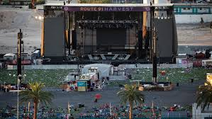
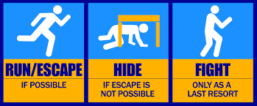
EVOLVING: Active Shooter
The United States Department of Homeland Security defines the active shooter as "an individual actively engaged in killing or attempting to kill people in a conﬁned and populated area; in most cases, active shooters use firearms(s) [sic] and there is no pattern or method to their selection of victims."
34
Notes:
The insurance market is catching up. There are a handful of active shooter/workplace violence/crisis event insurance products on the market that cover property damage, third party liability, crisis management and funeral expenses. Contact your Alliant broker for more information.
Police tactics have also changed – they are now trained to engage the shooter asap, as soon as they arrive on site, rather than set up a perimeter with SWAT team.

Slide 35
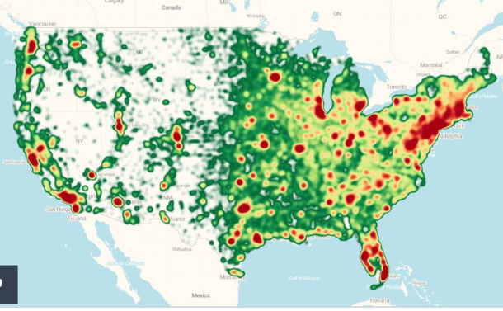
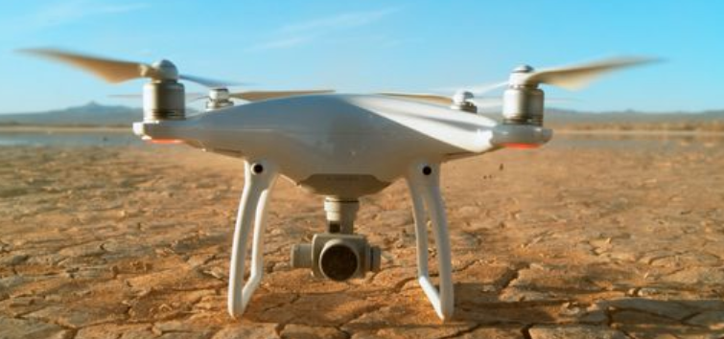
EVOLVING: It’s a Bird, It’s a Plane . . . .
Drones have overtaken the skies in ways - and volumes - never imagine. There are now over 325,000 registered Drones in the US - - more than the number licensed private aircraft. It’s estimated that there are an equal number of unlicensed Drones in the air today.
The FAA receives over 100 reports each month from aircraft that have visual sighting of Drones while flying.
Notes:
This is the way of the future. ASK THE AUDIENCE IF THEIR ENTITY OWNS A DRONE AND WHAT THE INTENDED USE IS. We know many police and fire departments have purchased drones and many more will.

Slide 36
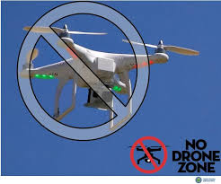
Drones & Emergency Operations
  The FAA warns unauthorized drone operators that they may be subject to significant fines if they interfere with emergency response operations.
  Flying a drone without authorization in or near the disaster area may violate federal, state, or local laws and ordinances, even if a Temporary Flight Restriction (TFR) is not in place.
  Allow first responders to save lives and property without interference.
36
Notes:
Several near misses have been reported. A plane fighting the Northern California fires had to abort a water drop to avoid a collision with a drone taking aerial photos of the fires.

Slide 37
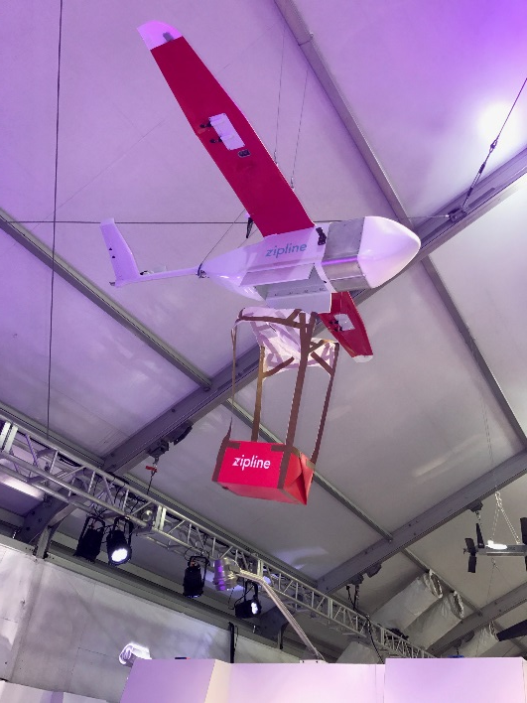
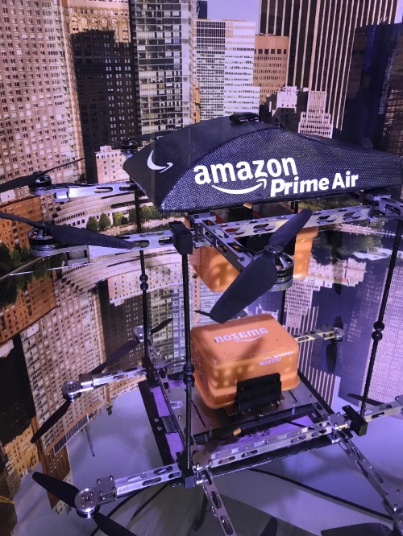
Risks Related To Public Entity Use Of Drones
Accidents resulting in personal injury or property damage
  Pilot error/Inadequate training
  Drone malfunction/maintenance
  Failure to supervise/protect against dangers
  Workers' compensation
Trespass – either into airspace or onto property itself
Privacy and civil rights violations
Cyber Risks
  Breach of drone technology
  Inadequate maintenance and storage of collected data and information
Regulatory violations
37

Slide 38
Risk Management Considerations
Establishing a Drone use policy
Operator(s) experience
Intended use
Interaction between operator & observer
Weather & environmental issues
Video capabilities
Ensuring drone airworthiness
Pre-flight and/or post-flight checks
Drone maintenance
38

Slide 39

UAS Rules for Government Entities
Government entities or organizations (e.g. law enforcement agencies, public universities, state governments, local municipalities) have 2 options for flying UAS:
Fly under the small UAS rule – follow all rules under 14 CFR part 107, including aircraft and pilot requirements
-OR-
Obtain a blanket public Certificate of Waiver or Authorization (COA) – permits nationwide flights in Class G airspace at or below 400 feet, self-certification of the UAS pilot, and the option to obtain emergency COAs (e-COAs) under special circumstances
39
Notes:
Must comply with UAS part 107 for coverage to apply in some cases – check with your Alliant broker and/or pool management.

Slide 40
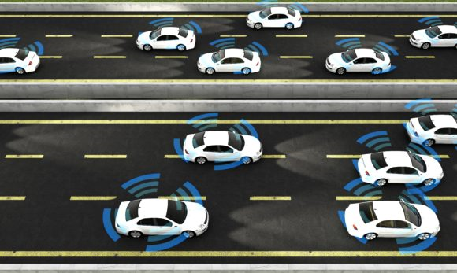
Evolving: Autonomous Vehicles
Looking At The Future
Market expecting massive growth as a result of Autonomous Vehicles ($81B projected opportunity – between now and 2025).
Long Term Outlook – decline in premium as auto becomes a better risk.
  Safer Conditions = reduced accidents
  Policy to Support Manufacturers
“Autonomous-vehicle technology will drive a significant shift in risk from human error to malicious third party, software, hardware and infrastructure risk,” said Chen Liu, co-author of the report and a research assistant at Stevens Institute of Technology. “Understanding and proactively responding to this anticipated enterprise transformation is imperative.”
Insurance Journal – May 19, 2017
40
Notes:
The future is here. Uber, Google, others have self-driving cars on the road today.
Ford Motor Company Executive Chairman William Ford puts it this way: “In the next few years smart cars will be doing things you can hardly imagine today.” Accordingly, Ford is “changing the way the world moves. We are rapidly becoming both an auto company and a mobility company . . . . The mobility revolution is here.”

Slide 41
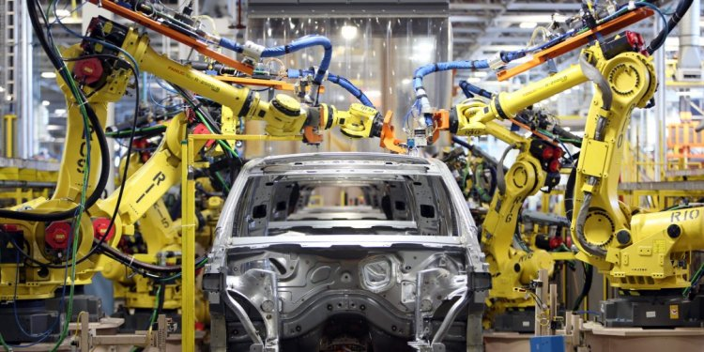
MITIGATING RISK
Evolving Autonomous Vehicles (continued)
Mitigating Risk
Shift in liability: Operator Manufacturer of Self-Driving Technology
What level of automation was in play during accident?
Public liability aside:
  Costly suits (i.e. defense)
  Reputational damage
Coverage needed for Emerging Risk
  Product Liability (Incl. Software/Hardware)
  Cyber Liability
  Public Infrastructure
41
Notes:
Auto claims will turn in to product liability and/or software E&O. How do we know someone didn’t hack in to your vehicle to cause an accident?

Slide 42
EXPANDING: Employee Theft;
Let’s Do the Numbers
42
Notes:
Employee theft accounts for $400B annually in lost revenues to employers, according to the Association of Certified Fraud Examiners. Of course, we’re not talking about any of you in the room.

Slide 43
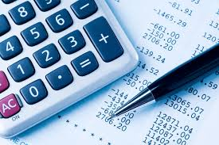
EXPANDING: Impersonation Fraud Coverage
We will also pay for loss of “funds” resulting directly from a “fraudulent instruction” directing a financial institution to transfer, pay or deliver “funds” from your “transfer account”.
Notwithstanding the above requirement that the loss of “funds results directly from a “fraudulent instruction,” we will also pay for the loss of “funds” resulting from your receipt of a fraudulent phone call or email from a purported vendor, which advises you that the vendor’s bank account information has been changed and you suffer a loss of “funds,” because you issued a payment or payments to this fraudulent bank account, based upon your confirmation controls, you believed the fraudulent instruction to change the vendor’s bank account information to be valid.
Notes:
Claim example: Contractor calls a city’s accounting department and instructs them to wire the next progress payment to the contractor’s new bank account. The City wires the payment, in excess of $800,000. Once the City realizes what has happened, $165,000 had been siphoned from the account.

Slide 44
Toward the Future

Slide 45

Looking Ahead
Looking ahead, expectations are that property rates will firm. It’s too early to tell how the market will react to the recent natural disasters, but buyers of property insurance should budget conservatively. We could see rate increases in the 5%-10% range and bigger increases for insureds with losses.
Some casualty lines of coverage may see modest decreases, while others such as law enforcement liability, commercial automobile liability and employment practices liability (EPL) may see price increases.
45
Notes:
Based on what we know today, these are our market expectations for 2018. The recent catastrophic losses are not expected to impact the casualty lines of coverage and expectations are that rates will be flat to slightly down into 2018 - barring an increase in claims severity and/or any industry changing events.
Certain lines of coverage and risks will continue to see pricing pressure, including school liability due to abuse claims. Law enforcement liability continues to increase as well, due to high-profile shootings and public reaction.

Slide 46
STATE OF THE INSURANCE MARKET 2018
Thank You
Please contact us if you would like a copy of this presentation.
(THIS INFORATION HAS BEEN CONSOLIDATED FROM VARIOUS INDUSTRY SOURCES)
Questions?

