Slide 1


AORMA: What’s Covered and What’s Not
AOA Conference
Monday, February 9, 2015
3:30 PM to 4:45 PM
Presented by:
Mimi Long
Alliant
mlong@alliant.com
415-403-1423 Office
415-609-5166 Mobile
Melissa Diaz
Alliant
mdiaz@alliant.com
415-403-1444 Office
858-245-5835 Mobile

Slide 2


CSURMA AORMA Overview
California State University Risk Management Authority (CSURMA) – joint powers authority created to provide insurance and risk management services for CSU Campuses and Auxiliary Organizations, including insurance and self-insurance.
  Auxiliary Organizations Risk Management Alliance (AORMA) - operates within CSURMA to offer tailored coverage for CSU Auxiliary Organizations, including lower deductibles and other special coverage requirements.
Notes:
ADD PICTURES

Slide 3
CSURMA AORMA Overview
Mission Statement
The California State University Risk Management Authority (CSURMA) is a joint power authority composed of CSU and its Auxiliary Organizations joined to protect member resources by providing broad coverage and quality risk management services that stabilize risk cost in a reliable, economical and beneficial manner.
Broad Coverage
Quality Risk Management Services
Stabilize Risk Cost
Notes:
ADD PICTURES

Slide 4
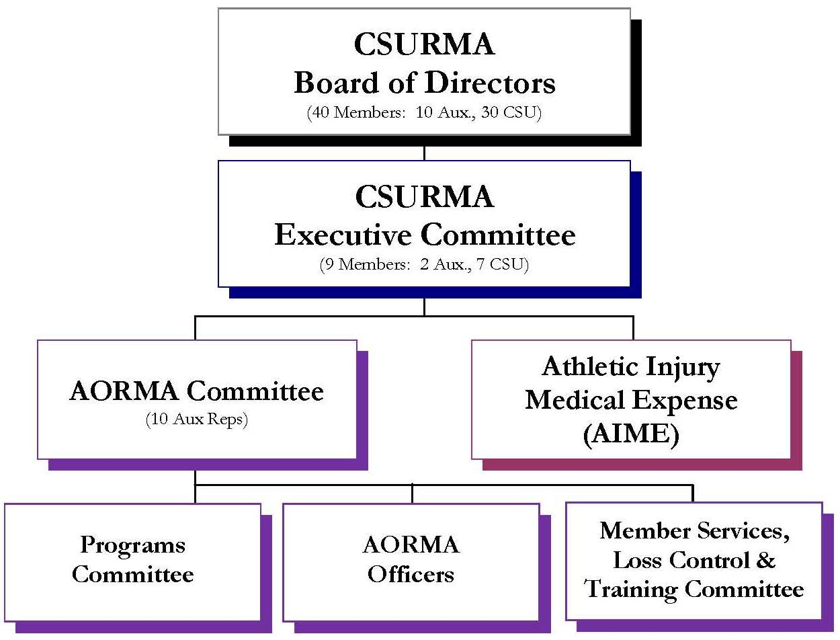
CSURMA AORMA Overview
Notes:
ADD PICTURES

Slide 5
CSURMA AORMA Overview
How does CSURMA manage its Broad Coverages and Quality Risk Management Services?
JPA Administration
(Alliant)
Works directly with CSU ORM
Meeting Agendas
Insurance Brokerage
(Alliant)
Risk Financing Model Development
Designs and
Reviews all Coverage Wording
Claims Administration (Various)
Liability (Carl Warren and Company)
Meeting Minutes
Program Manuals
Website
Annual Budget
Dividend Calculations
Program Cost Allocations
Policies and Procedures
Resolutions
Loss Control Contracts
Actuarial Reviews
Plus 29 additional tasks
Program Development
Evaluates the Financial Status of all Excess Insurers
Purchases Excess Insurance for CSURMA’s Coverage Programs
Workers’ Compensation (Sedgwick)
Pollution (Alliant and ACE)
Cyber (Alliant and Beazley)
Property (Alliant)
PAI (HSR)
Unemployment Insurance (Employers Edge)
Underwriting Information
Notes:
ADD PICTURES

Slide 6




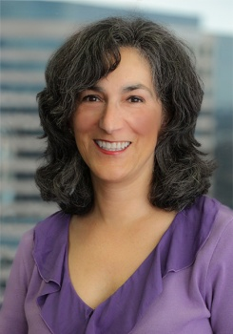
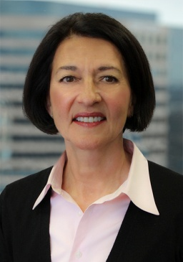


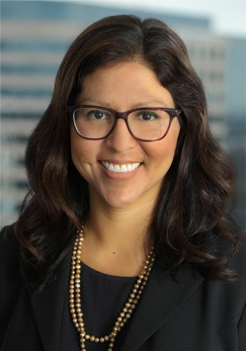
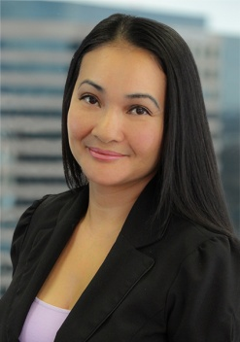

Program Administrators
Daniel Howell
Program Director
D: (415) 403-1426
M: (415) 309-1243
dhowell@alliant.com
Robert Leong
Campus Programs
D: (415) 403-1441
M: (619) 405-9549
rleong@alliant.com
Mimi Long
AORMA Programs
D: (415) 403-1423
M: (415) 609-5166
mlong@alliant.com
Robert Frey
Claims Manager
D: (415) 403-1445
M: (415) 518-8490
rfrey@alliant.com
Jacki Graf
WC Claims Consultant
D: (415) 403-1438
jgraf@alliant.com
Stacey Weeks
AIME, Foreign Travel
(415) 403-1448
sweeks@alliant.com
Van Rin
Program Administrator
(415) 403-1408
vrin@alliant.com
Hsan Htein
Program Administrator
(415) 403-1452
hhtein@alliant.com
Melissa Diaz
JPA Administrator
(415) 403-1444
mdiaz@alliant.com
Tevea Him
JPA Administrator
(415) 403-1416
thim@alliant.com
Yung Lam
JPA Administrator
(415) 403-1461
ylam@alliant.com

Slide 7
Coverage Programs Available to Auxiliary Organizations
Non-Owned Aviation
Property Insurance Program
Pollution Legal Liability
Special Liability Insurance Program (SLIP)
Liability Insurance Program
Crime Insurance Program
Cyber Liability Program
Builder’s Risk Insurance Program
Club Sports / Intramurals Program
Coverage Programs
Special Events Insurance Program
Foreign Travel Insurance Program (FTIP)
Identity Fraud Expense Reimbursement
Participant Accident Insurance (PAI) Program
Student Travel Accident
Athletic Injury Medical Expense Program (AIME)
Workers’ Compensation Program
Inland Marine Insurance Program
Rocketry Insurance
Unemployment Insurance Program (UIP)
Auto Physical Damage (APD) Program
Auto Liability
Vendors / Contractors Liability Program

Slide 8
AORMA - Liability Insurance Program
AORMA Liability Insurance Program
Fiduciary Liability
General Liability
Abuse or Molestation
Directors and Officers Liability
Publishers’ Liability
Broadcasters’ Liability
Liquor Liability
Employment Practices Liability
Outside Directors’ Liability
Watercraft Liability
(up to 50 Ft)
Unmanned Aerial Vehicle Liability
Employee Benefits Liability
Miscellaneous Professional Liability
Emotional Distress / Mental Anguish
Auto Liability

Slide 9

AORMA … is this covered?
Let’s begin!!!
Notes:
ADD PICTURES

Slide 10

AORMA … is this covered?
Presentation disclaimer!
Coverage is determined based on the facts of each situation in accordance with all of the terms, conditions and exclusions within a coverage program
Notes:
ADD PICTURES

Slide 11
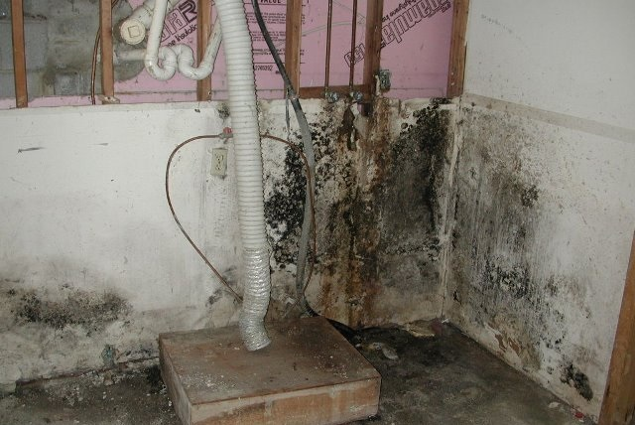
AORMA … is this covered?
Mold
Notes:
ADD PICTURES

Slide 12
AORMA … is this covered?
Mold
Yes …
The Public/Educational Entity Pollution Liability Insurance Policy provides coverage for claims, remediation costs and legal defense expense arising out of fungi or legionella pneumophila. ($2,500,000 limit / $50,000 deductible)
The AORMA Liability Program provides coverage for injuries to third-parties caused by mold. ($600,000 limit / $0 deductible)
Notes:
If no laws exist that govern the remediation of the mold in the jurisdiction of covered location, necessary remediation costs may be established by securing a recommendation from a Certified Industrial Hygienist

Slide 13
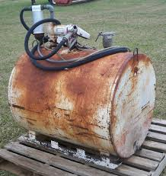
AORMA … is this covered?
Pollution
Notes:
ADD PICTURES

Slide 14
AORMA … is this covered?
Pollution
Yes …
The AORMA Liability Program provides limited third-party liability coverage for damages caused by a sudden and accidental release of pollutants if discovered within seven days. (No sublimit)
The Public/Educational Entity Pollution Liability Insurance Policy provides coverage to the CSU and its auxiliary organizations for claims, remediation costs and legal defense expenses with respect to pollution conditions at a location scheduled on the member’s property schedule or arising from the member’s operations. ($5,000,000 limit / $50,000 deductible)
Notes:
Lead Based Paint and Asbestos – Third party claims only. Remediation from soil or groundwater only.

Slide 15
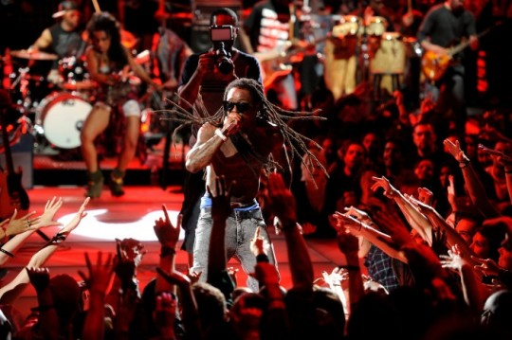
AORMA … is this covered?
Special Events
Notes:
ADD PICTURES

Slide 16
AORMA … is this covered?
Special Events
Yes …
Coverage for the negligence of the Auxiliary Organization or its directors, officers, employees and volunteers which causes injuries to third-parties is included in the AORMA Liability Program.
Additional Coverage Recommendation - A separate Special Events policy should be purchased if;
The event will attract a large number of attendees who are not normally on campus
If tickets to the event are being sold
If alcohol is available for purchase or is being served at the event
Notes:
ADD PICTURES

Slide 17
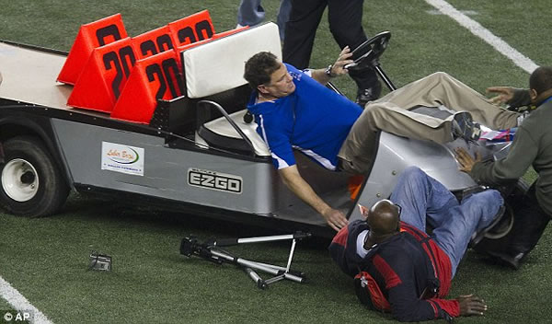

AORMA … is this covered?
Mobile Equipment
Notes:
ADD PICTURES

Slide 18
AORMA … is this covered?
Mobile Equipment
Yes …
Injuries to third-parties arising out of owned mobile equipment is automatically covered under the AORMA Liability Program.
The AORMA Property Program applies to damage to mobile equipment. A $5,000 deductible applies.
Additional Coverage Recommended:
Auto Physical Damage for the mobile equipment – each item must be scheduled on the policy. A $1,000 deductible applies.
Notes:
ADD PICTURES

Slide 19
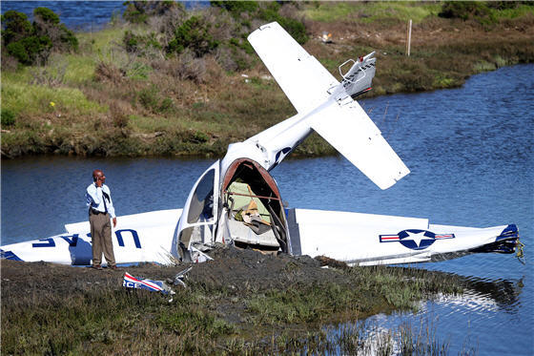
AORMA … is this covered?
Aviation Activities
Notes:
ADD PICTURES

Slide 20
AORMA … is this covered?
Aviation Activities
No … Coverage is not included within the AORMA Liability Program and aircraft are not considered covered property within the AORMA Property Program.
Exception:
The Non-Owned Aviation Program does provided the following limited coverage:
Limit: Single limit including passengers $50,000,000
Territory: United States of America (excluding Alaska) Canada or Mexico
Description of Aircraft: Any non-owned aircraft with total seating capacity, including crew seats, of 40 or less
Coverage: This policy will pay on behalf of the CSU and its Auxiliary Organizations claims that must legally be paid because of an event involving a non-owned aircraft which results in bodily injury or property damage to third parties are passengers
Notes:
ADD PICTURES

Slide 21

AORMA … is this covered?
Employee’s Personal Property
Notes:
ADD PICTURES

Slide 22
AORMA … is this covered?
Employee’s Personal Property
No …
Exception:
If an employee’s personal effects are damaged as a part of a covered loss, the Member can elect to provide coverage to those damaged items.
Notes:
ADD PICTURES

Slide 23


AORMA … is this covered?
Day Care and Camps for Minors
Notes:
ADD PICTURES

Slide 24
AORMA … is this covered?
Day Care and Camps for Minors
Yes … The AORMA Liability Program does provide coverage.
Additional Coverage Requirement:
AORMA Policy and Procedure L-6 requires that the member purchase a Participant Accident Insurance (PAI) policy for all child care and camp operation involving minors
Additional Coverage Recommendation:
PAI with a minimum limit of $10,000 for all activities involving minors
Consider increasing the PAI limit to $20,000
Notes:
ADD PICTURES

Slide 25
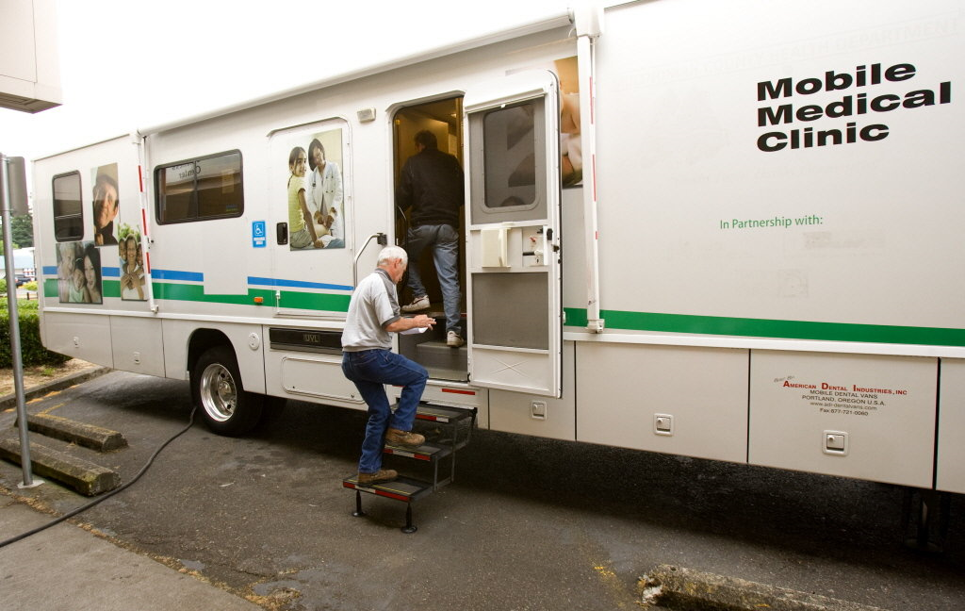
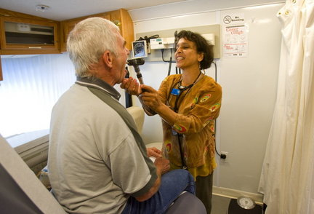

AORMA … is this covered?
Mobile Medical Clinic and its Healthcare Professionals
Notes:
ADD PICTURES

Slide 26
AORMA … is this covered?
Mobile Medical Clinic and its Healthcare Professionals
Yes and No … The AORMA Liability Program provides coverage for your employees who are nurses (but not physicians) and any medical services clinic that does not perform invasive surgery of any kind.
Additional Coverage Recommended:
Medical Malpractice insurance for physicians
Auto Physical Damage for the mobile medical vehicle
Notes:
ADD PICTURES

Slide 27
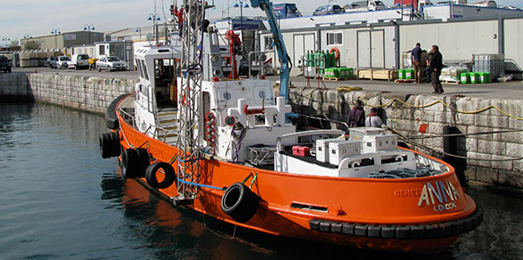
AORMA … is this covered?
Watercraft and Related Operations
Notes:
ADD PICTURES

Slide 28
AORMA … is this covered?
Watercraft and Related Operations
Yes and No …
The AORMA Liability Program provides watercraft liability for vessel under 50 feet.
The AORMA Property Program provides automatic coverage for watercraft 27 feet or smaller. Larger watercraft over 27 feet must be scheduled on the AORMA Property Program policy.
Required Additional Coverage:
Any watercraft over 50 feet must purchase a separate Ocean Marine insurance policy which covers the Hull and provides the necessary Protection and Indemnity.
Notes:
ADD PICTURES

Slide 29
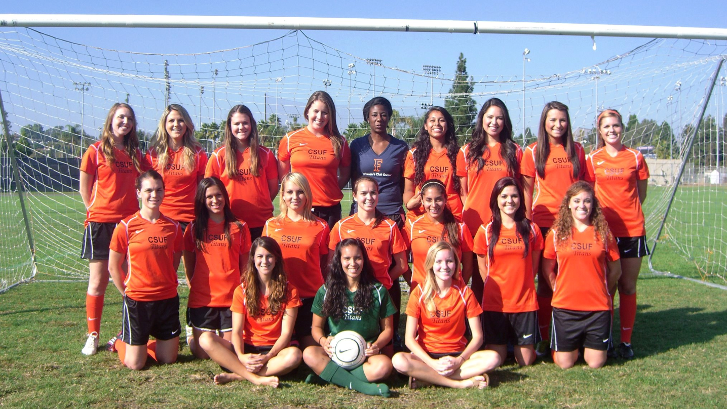
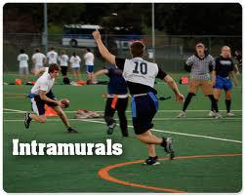
AORMA … is this covered?
Club Sports and Intramurals
Notes:
ADD PICTURES

Slide 30
AORMA … is this covered?
Club Sports and Intramurals
No …
The AORMA Liability Program is intended to cover the Member’s negligence only; it does not extend to club sports or intramurals.
Additional Coverage Recommended:
The Club Sports Insurance Program provides $5,000,000 in catastrophic injury coverage as well as general liability coverage in the amount of $1,000,000
- Or -
A Participant Accident Insurance policy can be purchased to provide medical expense coverage. Coverage limits start at $10,000.
Notes:
ADD PICTURES

Slide 31

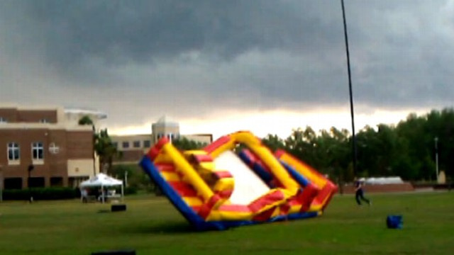
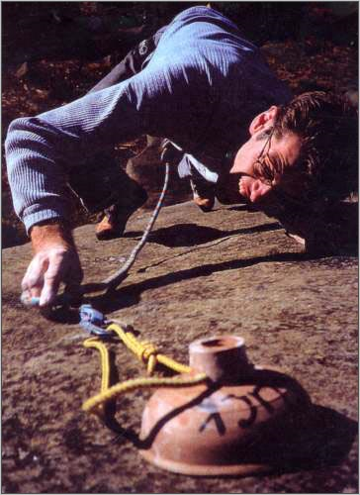

AORMA … is this covered?
High Hazard Activities
Notes:
ADD PICTURES

Slide 32
AORMA … is this covered?
High Hazard Activities
Yes …
Recommendation:
Complete a risk assessment prior to finalizing activity
Require a signed Waiver from each Participant
Obtain legal counsel approval of agreement wording with outside suppliers, contractors and vendors
Verify that agreement includes the recommended insurance requirement in contract language
Obtain certificate of insurance and the additional insured endorsement
Additional Coverage Recommended - A separate Special Events policy should be purchased if;
The event will attract a large number of attendees who are not normally on campus
If tickets to the event are being sold
If alcohol is available for purchase or is being served at the event
Notes:
ADD PICTURES

Slide 33
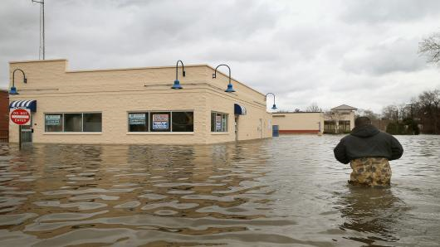
AORMA … is this covered?
Flood
Notes:
ADD PICTURES

Slide 34
AORMA … is this covered?
Flood
Yes …
The AORMA Property Program includes coverage for floods (limit $50,000,000) Subject to the follow member deductibles:
$250,000 Flood Zone A & V
$100,000 All Other Zones
Notes:
ADD PICTURES

Slide 35

AORMA … is this covered?
Data and Privacy Information Breach
Notes:
ADD PICTURES

Slide 36
AORMA … is this covered?
Data and Privacy Information Breach
Yes …
The AORMA Property Program includes the following coverage:
Notification Costs (Letter, Stamp)
Credit or Identify Monitoring (if under 18 years old)
Call Center Services
Computer Forensics
Crisis Management/Public Relations Firm
Privacy Counsel (to instruct on how to follow Federal, State and International Notification Requirements)
PCI Fines & Penalties
Regulatory Fines & Penalties
Cyber Extortion
Media Content Liability
Data Protection & Business Interruption
Notes:
Malware or Phishing, Human Error, Third Party, Stolen Laptops/Thumb Drives, Rogue Students/Employees

Slide 37
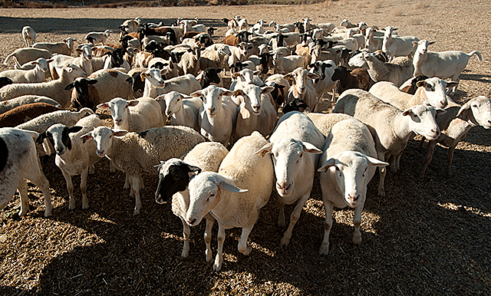
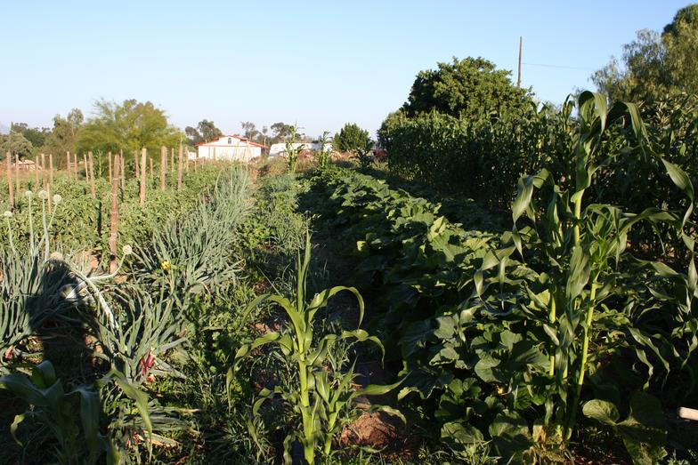
AORMA … is this covered?
Animals / Growing Crops
Notes:
ADD PICTURES

Slide 38
AORMA … is this covered?
Animals / Growing Crops
Animals – Yes …
Growing Crops – No …
Growing crops are excluded from the AORMA Property Program.
Animals are covered from a covered cause of loss.
Additional Coverage Recommended:
Crop Insurance
Notes:
Coverage for animals depends on the cause of loss. Must be from a covered cause of loss. $50,000 per animal. May be more if animal is scheduled.

Slide 39

AORMA … is this covered?
Fine Arts
Notes:
ADD PICTURES

Slide 40
AORMA … is this covered?
Fine Arts
Yes …
Your scheduled and unscheduled fine art is covered under the AORMA Property Program
The $5,000 program deductible applies
Recommendation:
In order to establish a loss value, each piece should have a current appraisal
The Inland Marine Program is available should a member want to purchase coverage with a $1,000 deductible
Notes:
ADD PICTURES

Slide 41
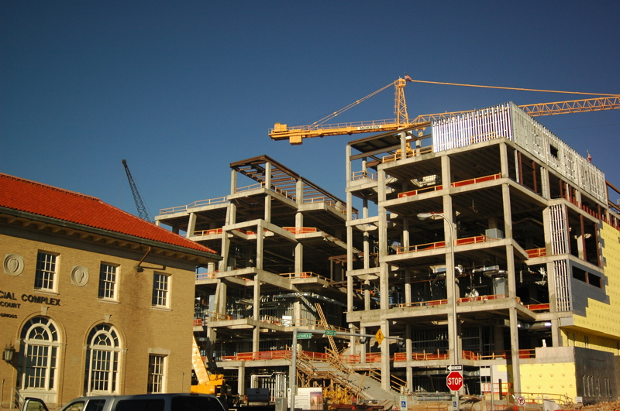
AORMA … is this covered?
Building Construction or Renovation
Notes:
ADD PICTURES

Slide 42
AORMA … is this covered?
Building Construction or Renovation
Yes …
The AORMA Property Program provides automatic coverage for real property construction projects not exceeding $25,000,000. The member’s standard property rate applies
Also, the CSU Builders Risk Insurance Program (BRIP) is available for Auxiliary funded construction projects. All construction program within BRIP are run through CPDC. Separate approval may be required. The BRIP program has a $25,000 deductible.
Notes:
ADD PICTURES

Slide 43

AORMA … is this covered?
Employee Driving Personal Vehicle on Auxiliary Organization Business
Notes:
ADD PICTURES

Slide 44
AORMA … is this covered?
Employee Driving Personal Vehicle on Auxiliary Organization Business
Yes and No … Auto Liability Insurance always follows the vehicle. The Auto Insurance Policy for the vehicle being driven will provide the primary coverage. AORMA’s Liability Program will provide excess coverage.
The California Insurance Code Section 11580.9 stipulates that where two or more auto liability insurance policies apply to the same loss, the policy in which the auto is described or rated as an owned auto shall be the primary insurance.
Notes:
ADD PICTURES

Slide 45
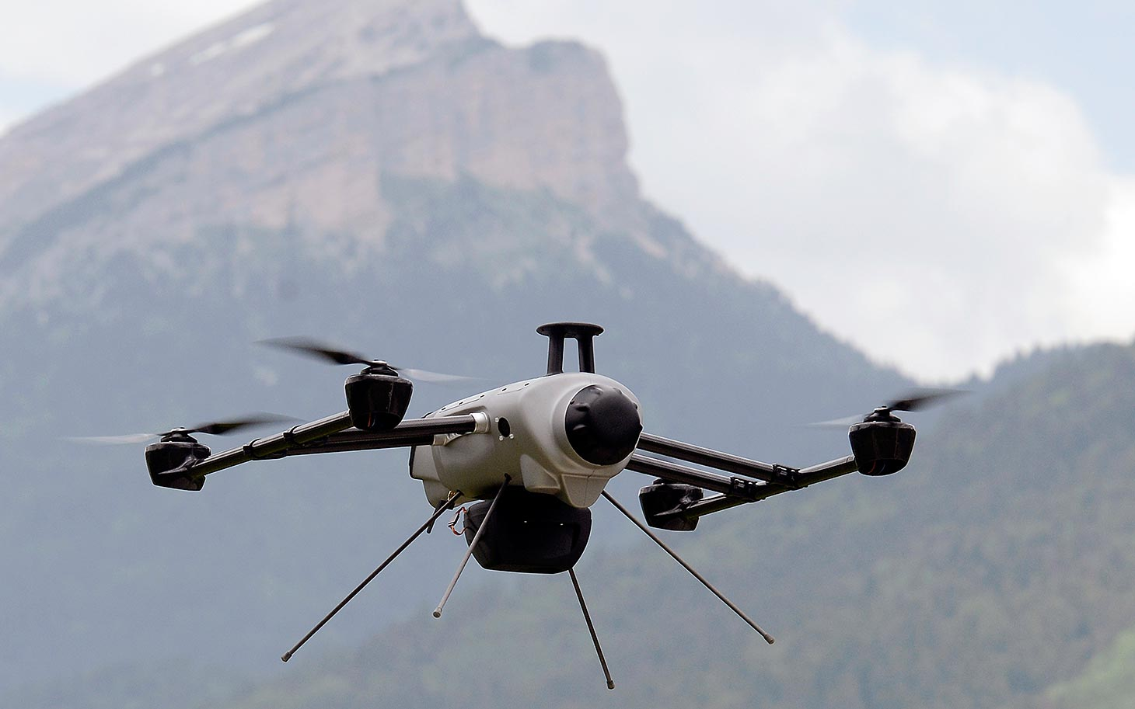
AORMA … is this covered?
Drones / Unmanned Aerial Vehicles
Notes:
ADD PICTURES

Slide 46
AORMA … is this covered?
Drones / Unmanned Aerial Vehicles
Yes …
The AORMA Liability Program was amended to include coverage for Drones.
Additional Information:
All UAV are subject to FAA rules and regulations
To operate a UAV a FAA Certificate of Authorization (COA) must be received (no public university exception)
Non-commercial purposes
Auxiliary organizations are considered civil operators and subject to different and more stringent set of rules
Notes:
ADD PICTURES

Slide 47
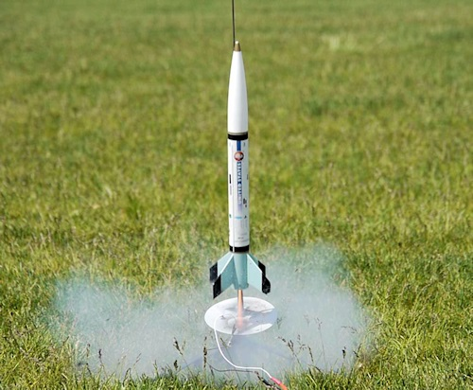
AORMA … is this covered?
Rocketry
Notes:
ADD PICTURES

Slide 48
AORMA … is this covered?
Rocketry
Yes …
A $5,000,000 rocketry insurance policy has been purchased for all of the CSU Campuses and Auxiliary Organizations
Launch sites must be scheduled on the policy. Seven launch sites in the Mojave Desert are currently scheduled.
Notes:
ADD PICTURES

Slide 49
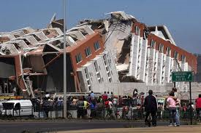
AORMA … is this covered?
Earthquake
Notes:
ADD PICTURES

Slide 50
AORMA … is this covered?
Earthquake
No …
Earthquake is not covered under the AORMA Property Program, except for the following sub-limits:
$5,000,000 for vehicles, contractors equipment and fine arts, subject to the follow deductibles:
$50,000 Fine arts (must have appraisal)
$10,000 Per vehicle or contractors equipment
$100,000 Maximum for all vehicles and contractors equipment
Notes:
ADD PICTURES

Slide 51

Conclusion and Questions
This presentation and much more can be downloaded at: www.CSURMA.org
www.csurma.org

