Slide 1
Firefighting and the First Amendment
By: Jill Vander Borght & Jina oh, Senior Assistant City Attorneys

Slide 2
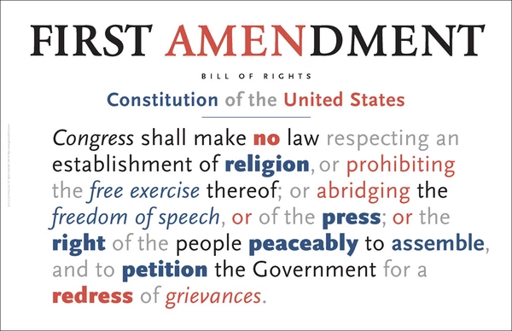

Slide 3
Videotaping / Recording in Public
GENERAL RULE:
Individuals have the right to record video of a public official engaged in the performance of their official duties…
IF
Those duties are visible from public places.

Slide 4
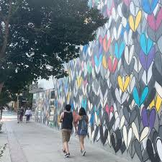
Anywhere that a member of the public can legally access / generally open to people.
Public spaces?

Slide 5
1st Amendment Crusaders / Audits / General Interest
What is it?
Why do they do it?

Slide 6
Do emergency responders have a right to limit photographs and video at the scene of a fire or accident?
Short answer: Probably not
If in public, or viewable from a public space.
Except…

Slide 7
Penal Code § 148.2 / aka How to Respond to First Amendment Intrusions Under Pressure.
Every person who willfully commits any of the following acts at the burning of a building or at any other time and place where any fireman or firemen or emergency rescue personnel are discharging or attempting to discharge an official duty, is guilty of a misdemeanor:
1. Resists or interferes with the lawful efforts of any fireman or firemen or emergency rescue personnel in the discharge or attempt to discharge an official duty.
2. Disobeys the lawful orders of any fireman or public officer.
3. Engages in any disorderly conduct which delays or prevents a fire from being timely extinguished.
4. Forbids or prevents others from assisting in extinguishing a fire or exhorts another person, as to whom he has no legal right or obligation to protect or control, from assisting in extinguishing a fire.

Slide 8
Exceptions:
(1) Private property – cannot trespass to obtain pictures
(2) Perimeter / Safety

Slide 9
What to say:
You are interfering with emergency response personnel working on this emergency. Back up.
Please clear a 10’ perimeter.
Please step back, cross the street, and move out of the way.
Please move. Be specific.

Slide 10

What about at the fire station?

Slide 11
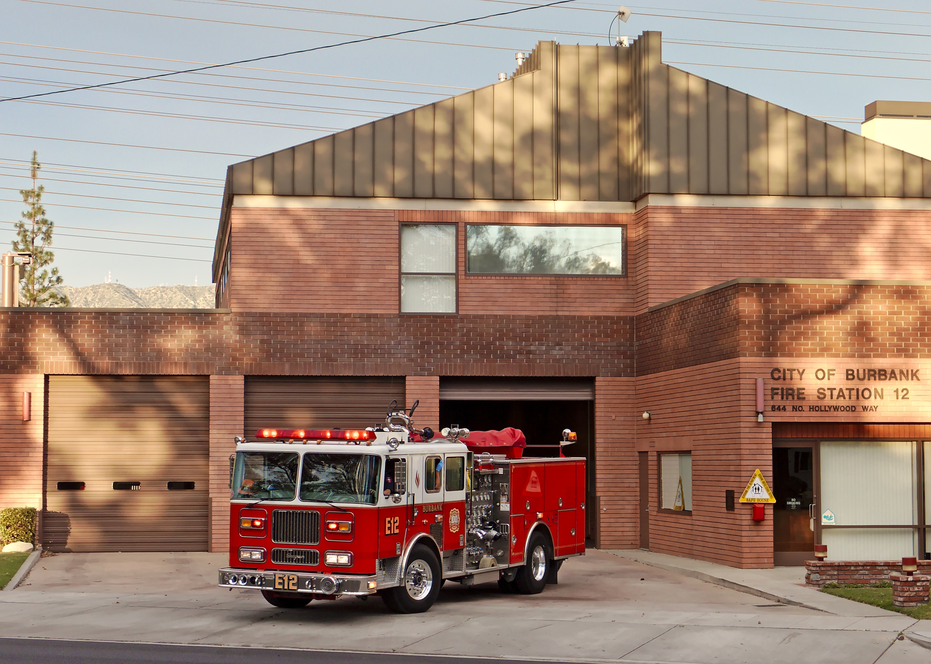
Is a fire station public?
It is a public building, like prisons, schools, and courthouses.
But, the public does not typically have a right to roam freely within them simply because they are owned by a municipality.

Slide 12
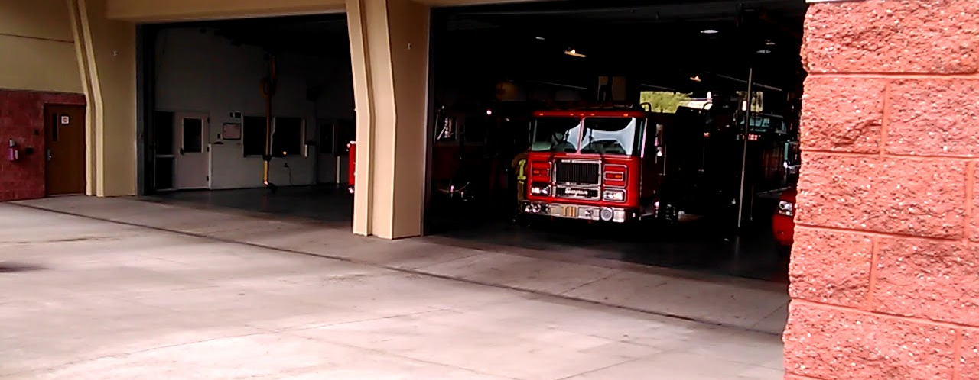
No part of a fire station is open to the public unless you choose to invite them in. Policy?
Fire safety day / Homeless residents / Kids

Slide 13
What about HIPPA?

Slide 14
Hypotheticals:
ONE
TWO
THREE
Does it matter whether the photo/videographer is a credentialed member of the news media or a busybody with a cellphone?
A first amendment crusader appears on the scene of an auto accident where fire personnel have arrived before police. He asks if he can interview you. What do you consider?
A bystander uses her iPhone to record video at the scene of an accident where a palm tree has fallen onto an auto and caused catastrophic injuries to one of the passengers?
What about HIPAA?
What about the criminal evidence?

Slide 15
Questions?

