Slide 1


AORMA: The Big Picture
Monday, January 11, 2016
10:45 am – 12:00 pm
Presented by:
Zachary Gifford
Director Systemwide Risk Management
CSU Chancellor’s Office

Slide 2


CSURMA History and Overview
California State University Risk Management Authority (CSURMA) – joint powers authority created to provide insurance and risk management services for CSU Campuses and Auxiliary Organizations, including insurance and self-insurance.
  Auxiliary Organizations Risk Management Alliance (AORMA) - operates within CSURMA to offer tailored coverage for CSU Auxiliary Organizations, including lower deductibles and other special coverage requirements.
Notes:
ADD PICTURES

Slide 3
CSURMA AORMA Overview
Mission Statement
The California State University Risk Management Authority (CSURMA) is a joint power authority composed of CSU and its Auxiliary Organizations joined to protect member resources by providing broad coverage and quality risk management services that stabilize risk cost in a reliable, economical and beneficial manner.
Broad Coverage
Quality Risk Management Services
Stabilize Risk Cost
Notes:
ADD PICTURES

Slide 4
How does the work get done?
CSURMA Board or Directors
CSURMA Executive Committee
CSU Accounting
CSU Systemwide Professional Development
CSU Office of General Counsel
AORMA Committee
CSU Systemwide Risk Management
Alliant Insurance Services
Third Party Claims Administrators
Misc Vendors
JPA Administration
Insurance Brokerage
Systemwide Risk Management / CSU Office of General Counsel
Carl Warren & Company
Sedgwick CMS
KPMG
AON Actuarial
Praesidium
... and others
... and others
Notes:
ADD PICTURES

Slide 5
CSURMA Structure
CSURMA
AORMA Programs
AOA
Auxiliary Organizations
The Whole Enchilada
Notes:
Because we are self insured we can create programs and they are always changing

Slide 6

Hot Topic …
Concussive Injuries ouch !&#$@
Best Practices in University-Wide Concussive Management
Creation of Training Modules in Systemwide LMS
Notes:
Because we are self insured we can create programs and they are always changing

Slide 7


Hot Topic …
Keeping Minors Safe !!!
On-Line Self-Assessments and Training through Praesidium
Your Primary Contact at Praesidium is:
Aaron Lundberg, LMSW
Vice President of Account Services | Praesidium, Inc.
817.801.7773 Office | 817.307.3725 Mobile
817.261.7864 Fax
Email: ALundberg@PraesidiumInc.com
Notes:
Because we are self insured we can create programs and they are always changing

Slide 8

Hot Topic …
Workers’ Compensation . . . good things are happening!
Benchmarking through CWCI
Claims Closure Initiative (Double Play)
CSU / UC Summit
Notes:
Because we are self insured we can create programs and they are always changing

Slide 9

Hot Topic …
Master Student Placement Agreements
MOU – Employment of University Students who have an intern credential
MOU – Unpaid internship placements to university students
MOU – Student teacher placements to university students
Notes:
Because we are self insured we can create programs and they are always changing

Slide 10
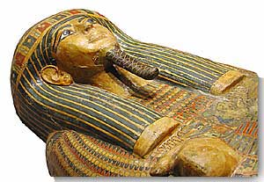
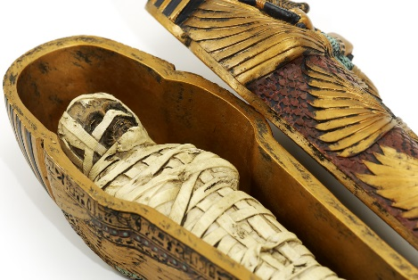
Hot Topic …
Fine Arts, Archives and Artifacts Program (FAAAP)
Program Limit | $25,ooo,ooo
Transit Limit | $2,500,000
Per Item Limit | $100,000
 | (higher limits available for scheduled items
Deductible | $0
 | (except EQ)

Slide 11
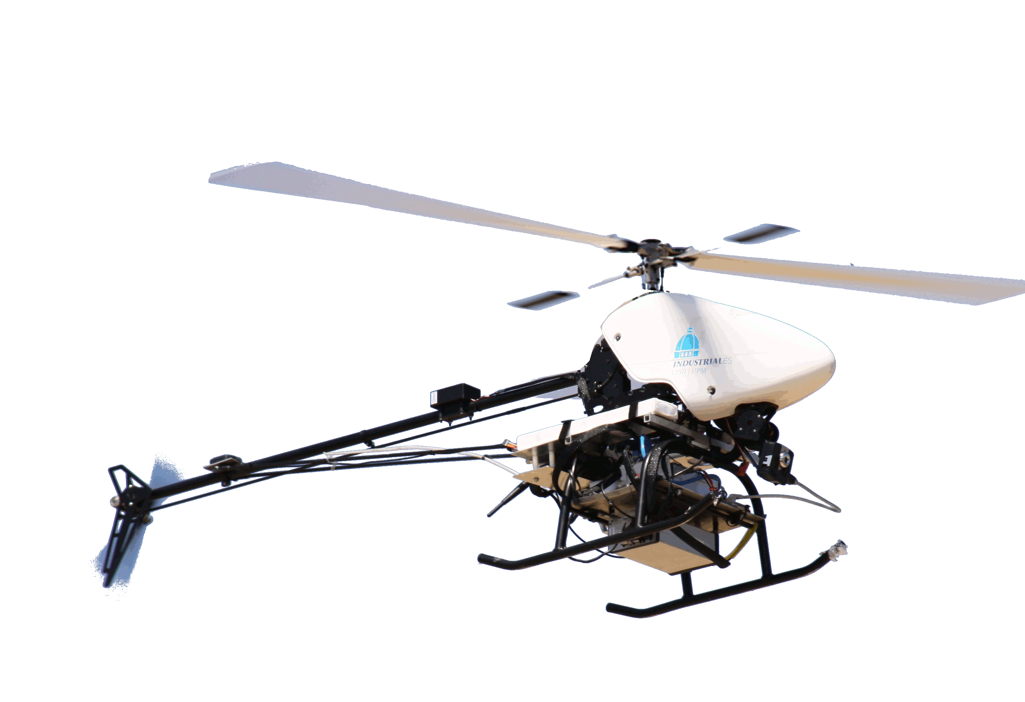
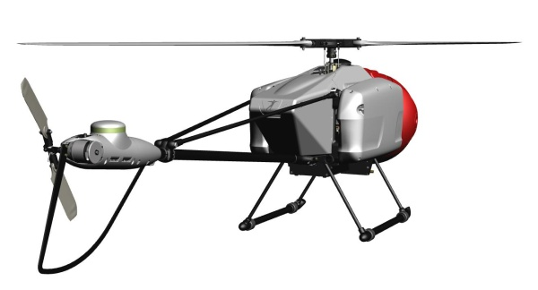
Hot Topic …
Unmanned Aerial Vehicles (UAV)
Liability Coverage Limit | $25,ooo,ooo
Weight Limitation | Must be 100 lbs or less. UAV’s over 100 lbs require a separate aviation policy
Hull Coverage | Excluded, but available for purchase

Slide 12
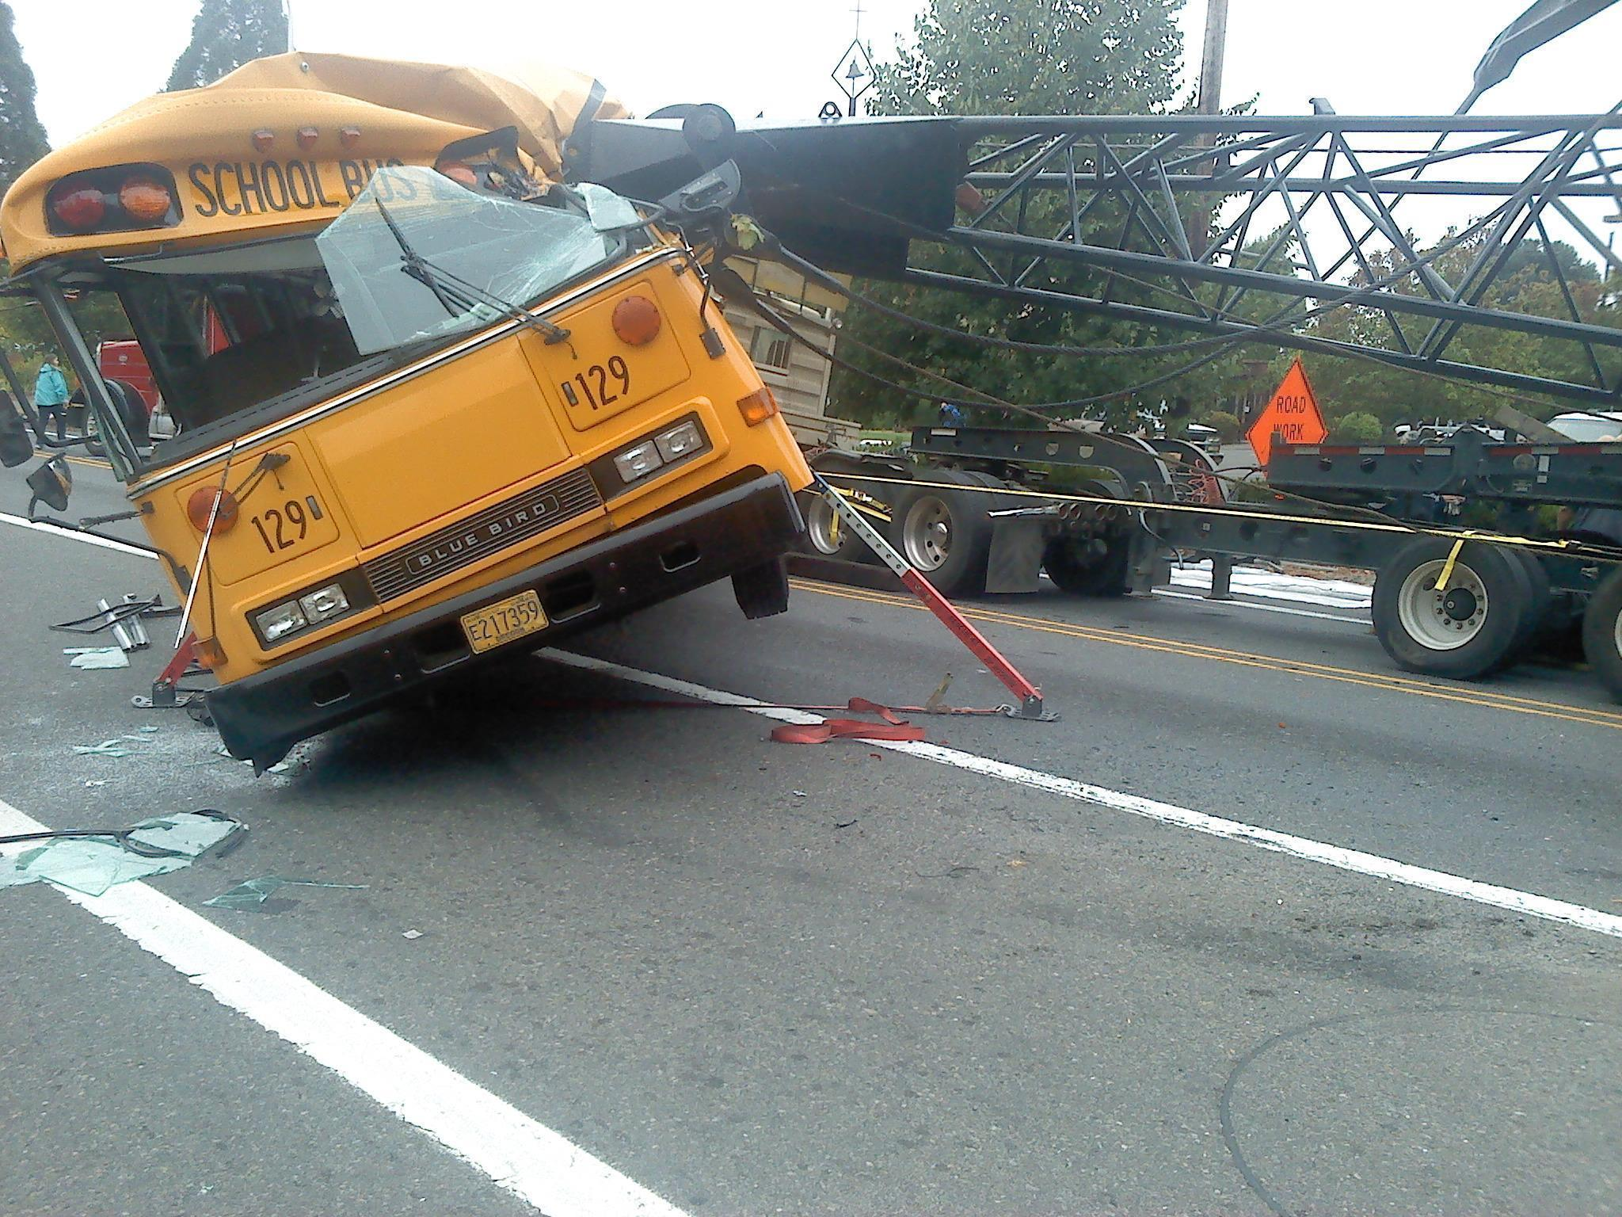
Hot Topic …
Crisis ThreeSixty … major disaster!
$0 deductible
$100,000 crisis expenses
$50,000 crisis management firm
Advancement of crisis management costs

Slide 13
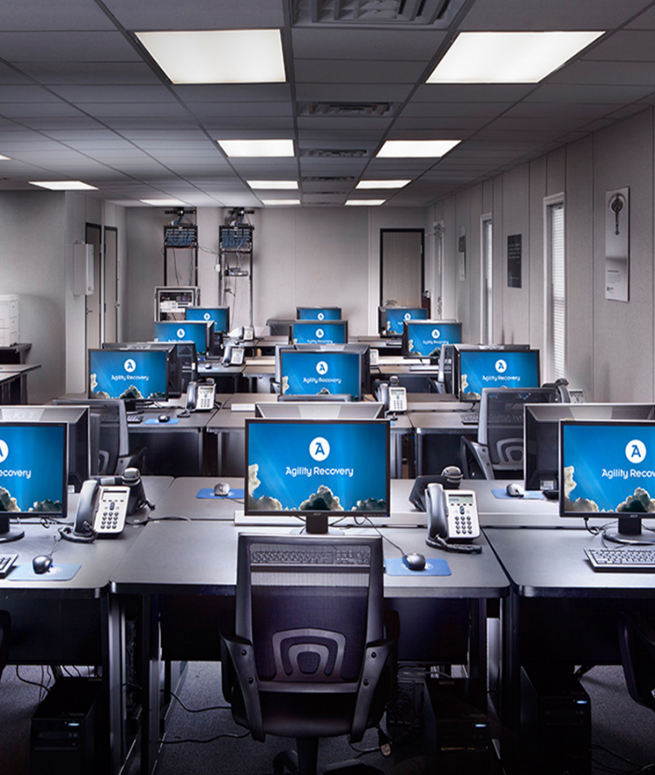
Agility Recovery puts you first in line for …
Hot Topic …
Temporary
  Office Space
  Power Communications
  Computer System

Slide 14




Hot Topic …
Systemwide Learning Management System
Transition from TargetSolutions to
SkillSoft and LawRoom
Questions:
David Krevella
Senior Director, Systemwide Professional Development
CSU Office of the Chancellor
dkervella@calstate.edu
562-951-4454
Notes:
WORK IN PROGRESS

Slide 15
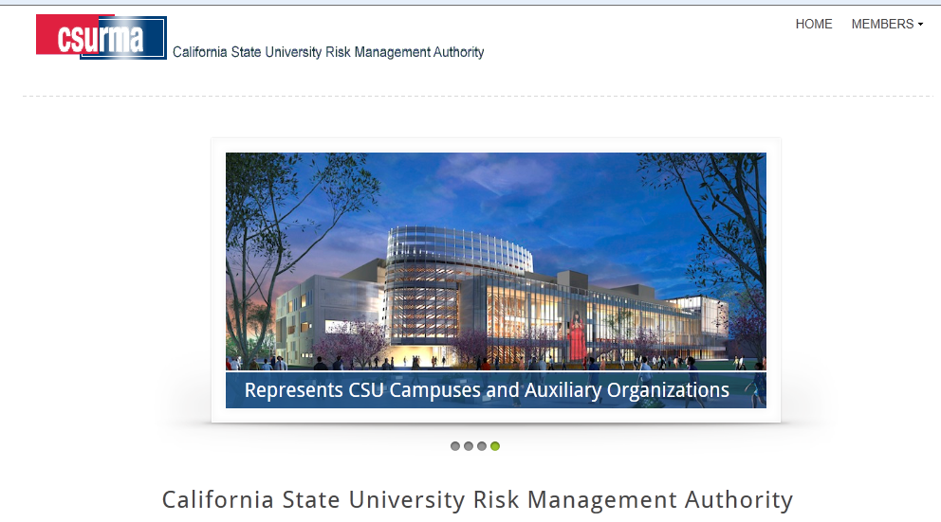
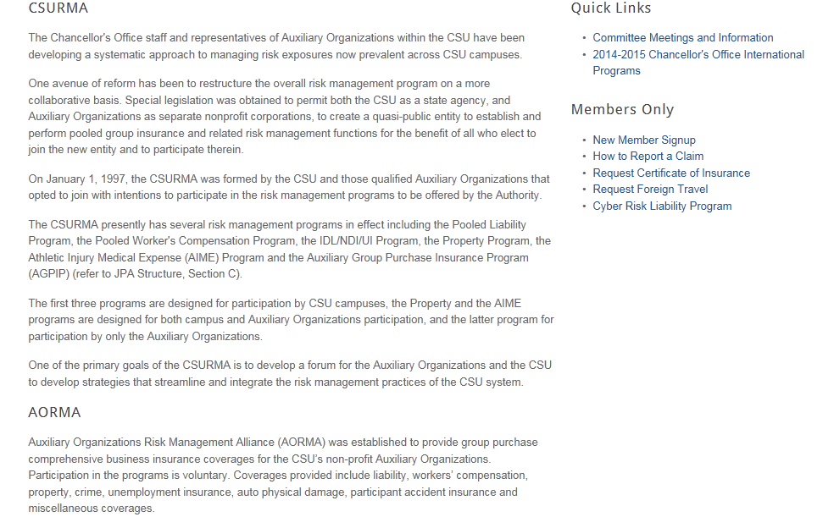
CSURMA Website
Log into the CSURMA website – www.CSURMA.org
Click on MEMBERS
Enter Username and Password
Click sign in
Notes:
ADD PICTURES

Slide 16
Coverage Programs Available to Auxiliary Organizations
Non-Owned Aviation
Property Insurance Program
Pollution Legal Liability
Special Liability Insurance Program (SLIP)
Liability Insurance Program
Crime Insurance Program
Cyber Liability Program
Builder’s Risk Insurance Program
Unmanned Aerial Vehicle
Club Sports / Intramurals Program
Coverage Programs
Special Events Insurance Program
Foreign Travel Insurance Program (FTIP)
Participant Accident Insurance (PAI) Program
Identity Fraud Expense Reimbursement
Fine Arts, Archives and Artifacts Program (FAAAP)
Student Travel Accident
Athletic Injury Medical Expense Program (AIME)
Workers’ Compensation Program
Inland Marine Insurance Program
Rocketry Insurance
Unemployment Insurance Program (UIP)
Public Entity Physical Damage Program
Auto Liability
Vendors / Contractors Liability Program
All members are automatically enrolled in “Blue Programs” / “Red Programs” are optional and must be purchased separately.

Slide 17
Liability
Program Layer Structure
AORMA | CSURMA
Excess Insurance Layer
Various Insurers - $15,000,000 xs of $5,000,000
AORMA Reinsured Layer | Campus Pooled Layer
Genesis Reinsurance Corp. - $4,650,000 xs of $350,000 | $5,000,000 inclusive of individual campus deductible
 | Campus deductibles …
 | $35,000 to 900,000
AORMA Pooled Layer
$350,000 per occurrence
AORMA Member Deductible $0; except for EPL
Member employment practices deductibles … $25,000; $50,000; $75,000; or$100,000
Notes:
Format

Slide 18
Workers’ Compensation
Program Layer Structure
AORMA | CSURMA
Excess Insurance Layer | Excess Insurance Layer
Safety National Workers' Compensation Statutory Employer's Liability | Safety National Workers' Compensation Statutory Employer's Liability
$4,500,000 xs of $500,000 | $2,500,000 xs of $2,500,000
 | Campus Pooled Layer
 | $2,500,000
AORMA Pooled Layer
$500,000
This layer is reinsured by CSAC EIA effective 1/1/15
Notes:
Format

Slide 19
Property
Program Layer Structure
AORMA | CSURMA
Excess Insurance Layer | Excess Insurance Layer PEPIP
APIP (Alliant Property Insurance Program) Various Insurers | APIP (Alliant Property Insurance Program) Various Insurers
$1,000,000,000 xs of $100,000 | $999,000,000 xs of $1,000,000
 | Campus Pooled Layer
 | $1,000,000 per occurrence
 | $2,000,000 aggregate
 | Campus Deductible
 | $100,000 to $1,000,000
AORMA Pooled Layer
$100,000 per occurrence
$250,000 aggregate
Member Deductible
$5,000 to 100,000
Notes:
Format

Slide 20
Fidelity / Crime
Program Layer Structure
AORMA | CSURMA
Excess Insurance Layer | Excess Insurance Layer
Lloyd’s of London | Lloyd’s of London
$2,000,000 any one loss (inclusive of $100,000 AORMA pooled layer) | $20,000,000 any one loss (inclusive of $250,000 deductible)
$40,000,000 aggregate | $40,000,000 aggregate
 | Individual Campus Deductible
 | $250,000
AORMA Pooled Layer
$25,000 per loss
$100,000 aggregate
Member Deductible
$5,000
Notes:
Format

Slide 21
AORMA Liability Program Losses
The losses the green column have been capped at $350,000 per occurrence, which is the AORMA Liability Program Pooled Layer
Notes:
G:\Share\CLIENT\jpa\csu\AORMA\AORMA Claims\Loss Runs\Liability\2015 06 30 - CSURMA Loss Run History – sortable.xlsx

Slide 22
AORMA Liability Program Losses
The red line indicates the AORMA Liability Program Pooled Layer of $350,000 per occurrence. All losses above the red line receive reinsurance reimbursement excess of $350,000.
Notes:
G:\Share\CLIENT\jpa\csu\AORMA\AORMA Claims\Loss Runs\Liability\2015 10 15 - CSURMA Liab Loss Run for Member Presentation.xlsx

Slide 23
Risk Pools Funding Status
The Program Assets have been reduced by the dividend of $464,087 payable in July 2015, accounts payable of $18,637 and Unearned Revenue of $2,066,470. The Program Assets have been increased by $3,586,043 for the reinsurance recoveries.
The Program Assets have been reduced by the dividend of $715,802 payable in July 2015, and accounts payable of $197,914.
Assets
$13,869,838
Assets
$12,960,540
Assets $8,251,512
Assets $7,484,954
Notes:
G:\Share\CLIENT\jpa\csu\Pooled Program Funding Status\FY 2014-15\Risk Pools Funding Status 2014 2015 – Charts.xlsx

Slide 24
CSURMA Program Expenses as of June 30, 2015
Notes:
G:\Share\CLIENT\jpa\csu\AORMA\AORMA Program Expenses\CSURMA Program Expenses.xlsx

Slide 25
AORMA Program Expenses as of June 30, 2015
Notes:
25
G:\Share\CLIENT\jpa\csu\AORMA\AORMA Program Expenses\2015 AORMA Program Expenses.xlsx

Slide 26
Total AORMA Program Dividend
Notes:
G:\Share\CLIENT\jpa\csu\AORMA\AORMA Dividends\AORMA Historical Dividends.xls

Slide 27

How to Keep Up to Date
  “Fitting the Pieces Together” Conference
  AOA Conference
  CSURMA website
  Board meetings
  Committee meetings
  AORMA bulletins
  Quarterly AORMA Chair updates
  Newsletter

Slide 28

Thank You!
Questions? Please contact your Program Administrators:
Mimi Long, AORMA Programs
415-403-1423 mlong@alliant.com
Daniel Howell, Program Director
415-403-1426 dhowell@alliant.com
Or, your friendly Systemwide Risk Management professional:
Zachary Gifford, Director Systemwide Risk Management
562-951-4568 zgifford@calstate.edu

Slide 29

Conclusion and Questions
This presentation and much more can be downloaded at:
www.csurma.org

