Slide 1


Insurance Coverage and
Risks for Research Auxiliaries
Monday, January 11, 2016
3:30 pm – 4:45 pm
Presented by:
Daniel Howell
Sr. Executive Vice President
Alliant Insurance Services, Inc.
Zachary Gifford
Director Systemwide Risk Management
CSU Chancellor’s Office

Slide 2

Insurance Coverage and
Risks for Research Auxiliaries
Presentation disclaimer!
Coverage is determined based on the facts of each situation in accordance with all of the terms, conditions and exclusions within a coverage program
Notes:
ADD PICTURES

Slide 3

Insurance Coverage and
Risks for Research Auxiliaries
Let’s begin!!!
Notes:
ADD PICTURES

Slide 4
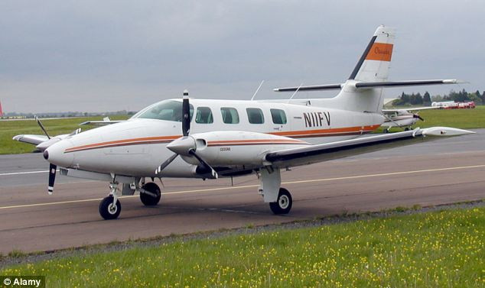
Aircraft / Aviation Activities
Aircraft and aviation activities are excluded from the liability program; however, a non-owned aviation policy is purchased to cover campuses and auxiliary organizations.
Non-Owned Aviation
Non-Owned Aircraft | Covered
Limit | $50,000,000
Max seats 40
Cannot be flown by campus or auxiliary employee

Slide 5
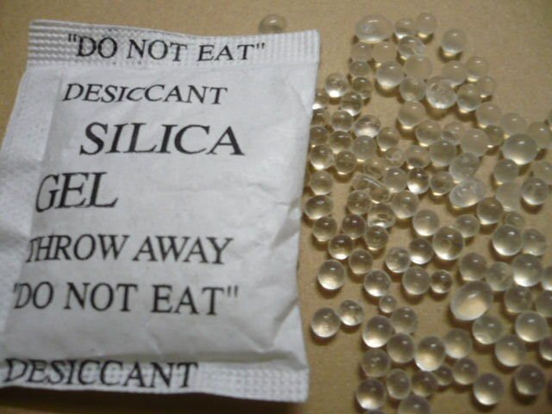

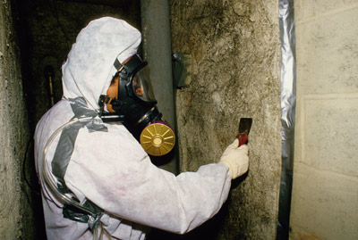

Pollution including Silicia, Asbestos, Lead, Mold and Nuclear
Pollution Coverage (First and Third Party) | $7,000,000
Fungi and Legionella | $4,500,000
Asbestos | No coverage
Lead | No coverage
Nuclear | Excluded; except for $250,000 for labs or research activities

Slide 6



Medical
Prior review is highly recommended
If the project involves an Medical Doctor, additional coverage must be purchased

Slide 7
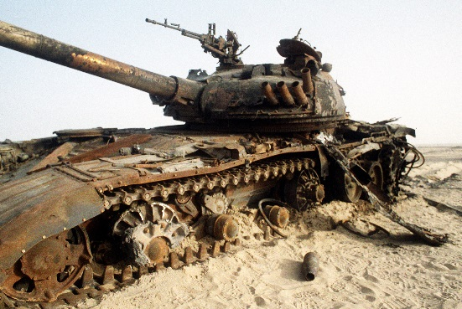
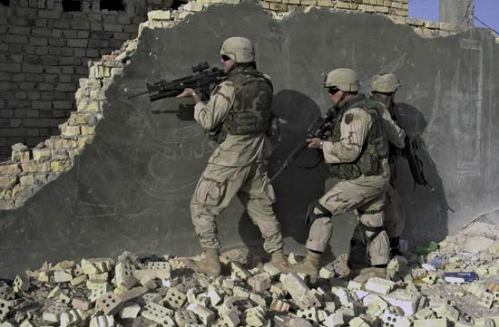
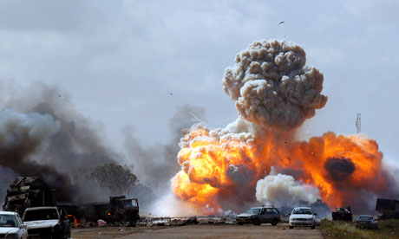
War
Please don’t start or attend!

Slide 8
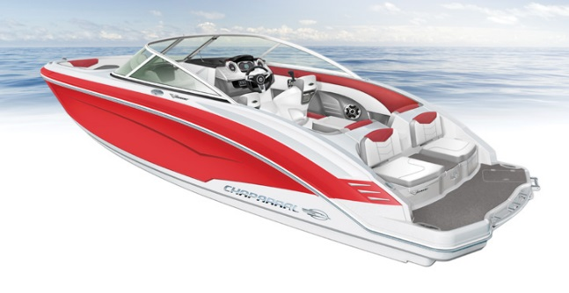
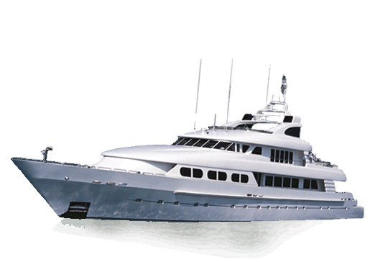

Watercraft
The hull can be insured within the program; however, all watercraft over 27 feet must be scheduled.
Watercraft over 50 feet require a separate marine policy to cover both the Protection & Indemnity (third party liability and crew) and the hull.

Slide 9
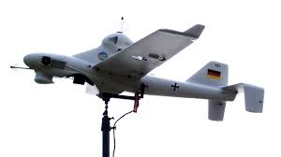
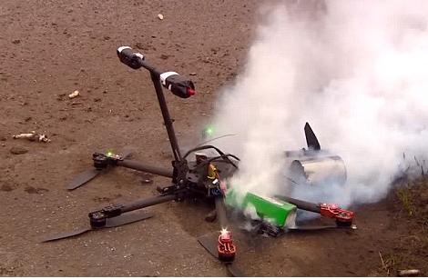
UAV
Third party liability coverage up to $20,000,000 – UAV 100 lbs or less.
Hull coverage available for separate purchase.

Slide 10
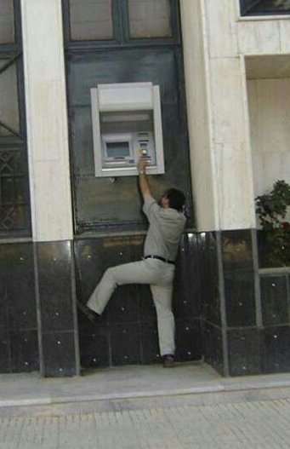
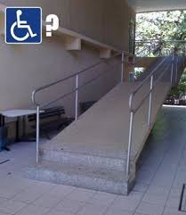
Non-tort causes of action related to breach of contract
Examples …
Failure to deliver a project as specified in the contract.
Failure to perform.

Slide 11

Illegal Acts
Excluded -
Willful violation of a penal statute, code or ordinance.
Obtaining remuneration or financial gain to which the member is not entitled.

Slide 12


Employees hired and working in states other than California
A separate workers’ compensation policy is required for all employees hired and working in states other than California.

Slide 13
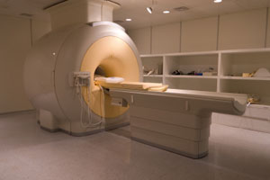


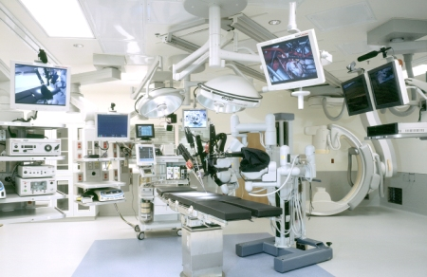


Foreign activities / operations
Must be reported and approved prior to departure.

Slide 14




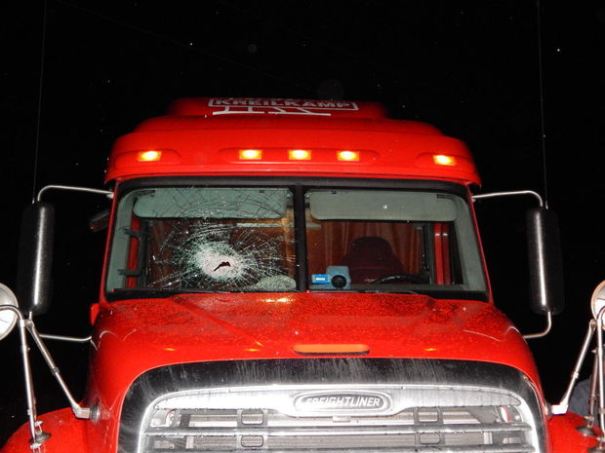
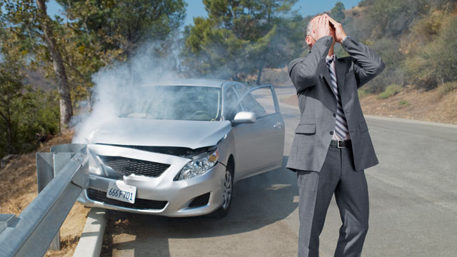
Physical damage to owned vehicles / equipment
Can be covered but must be scheduled.
Certain high valued autos are excluded.
See checklist.

Slide 15


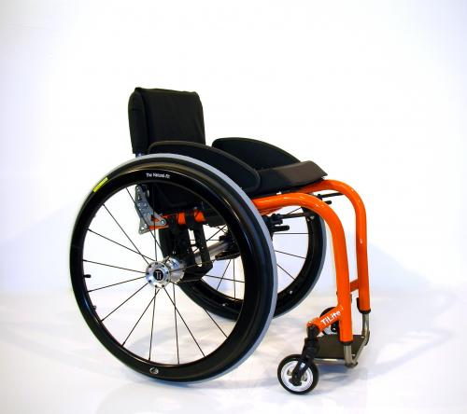
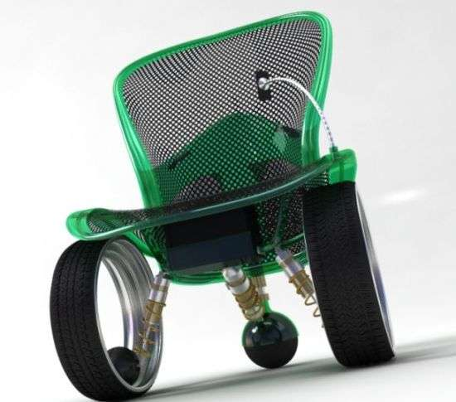
Products Liability
Products manufactured, modified, built and then sold, may necessitate additional products liability insurance. Prior review is highly recommended.

Slide 16



Contract employees
Your contract employees are not considered insureds and therefore require their own liability insurance.

Slide 17

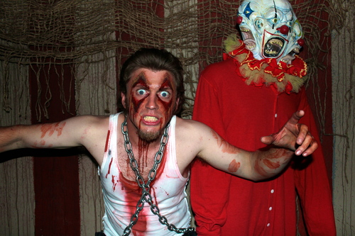

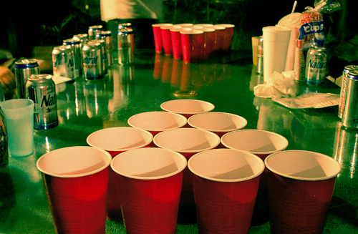
Related Organizations
Alumni organizations
Booster groups
Student groups
Other related entities
Coverage may be available through the liability program if an Auxiliary Organization Member exercises substantial control over all events, activities and operations, as well as exercises financial control over the entity.

Slide 18





Business Incubator / For-Profit Entities
The AORMA Liability Program cannot cover for-profit entities at this time; separate insurance should be purchased.
Depending on the structure of the business incubator, coverage maybe included within the Liability Program.

Slide 19

Any other operation that may not support the mission of the CSU
How would you feel about seeing this loss event on the front page of your local newspaper?
Or
How would you feel about sitting at a table with your peers asking for coverage?

Slide 20

Thank You!
Questions? Please contact your Program Administrators:
Mimi Long, AORMA Programs
415-403-1423 mlong@alliant.com
Daniel Howell, Program Director
415-403-1426 dhowell@alliant.com
Or, your friendly Systemwide Risk Management professional:
Zachary Gifford, Director Systemwide Risk Management
562-951-4568 zgifford@calstate.edu

Slide 21

Conclusion and Questions
This presentation and much more can be downloaded at:
www.csurma.org

