Slide 1
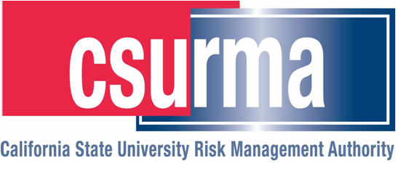

Insurance Requirements in Contracts
2019 Presentation
CSU IRIC Presentation
March 26, 2019
CSU Fresno

Slide 2
Today’s Topics
Indemnification
Insurance Requirements
Verification of Coverage
Document Retention
Claims
Additional Resources
Conclusion & Questions

Slide 3
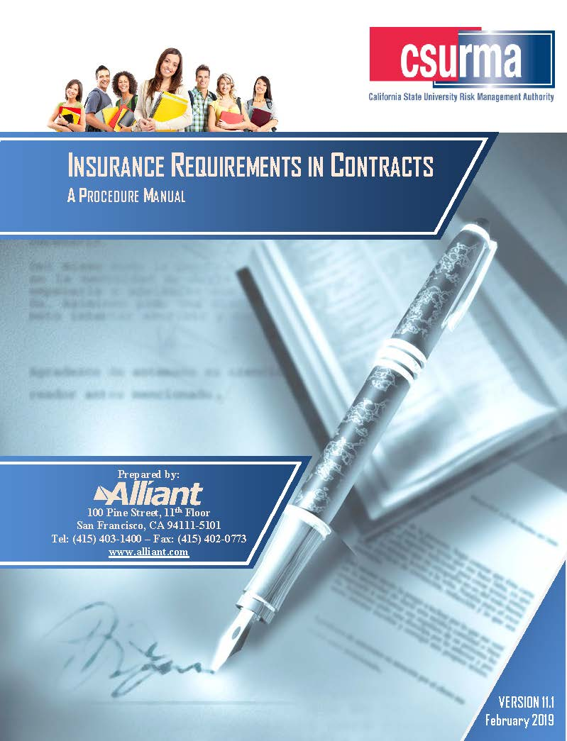
IRIC Manual History
Stems from work by public entity risk managers and consultants since the 1970’s.
Relied upon by hundreds of public entities.
Regular updates responding to new issues.
Customized for CSU campuses and auxiliary organizations since 2008.
VERSION 11.0
February 2018

Slide 4
IRIC 2018 - updates
General Editing, Updates, and Clarifications/Corrections
  Updated all Exhibits for uniformity, as possible.
  Updated A.M. Best, Standard & Poor’s Ratings.
  California Civil Code §2782 update as of 1/1/18 regarding professional service contracts indemnification.
  Additional ISO Professional Liability Policy analysis.
  Design/Build Contracts analysis per CA Civil Code §2782.9 update.
  Cyber Risks analysis as related to and expanded from common cyber/technology liability insurance policies.
  Included Jones Act discussion in chapter on Marine Related Risks.
  Replaced outdated MCS-90: Motor Carrier Public Liability sample form with current version.

Slide 5
IRIC 2018 - updates
Appendix C: Hold Harmless Agreements
  Comprehensive update of amended subsections 2782.8, 2782.9
  Explanation of “Wrap-Up” insurance policy as defined in California Insurance Code 11751.82(b) and referenced in 2782.9
    A policy written to cover all risks associated with a work of improvement.
Sample Hold Harmless language for a public entity
  Sample focused on contracts entered into with Design Professionals concerning the Contractor’s negligence, recklessness or willful misconduct.

Slide 6
IRIC 2019 - updates – (v.2019.0)
Updates in California Law regarding indemnity of design professionals and Owner Controlled Insurance Programs
Drones coverage updates as regulations evolve
Carnival Rides
Food Trucks/Farmers Markets
Political Protests/Rallies/Signage
Traffic Safety Plan

Slide 7
New Additions to IRIC
Railroad Protective Liability – New: Chapter 3
  Summary of coverage protecting railroad companies from liability for work done on/near railroad owned property.
  Highlights include coverages, physical damage, and for whom coverage is necessary.
  Synopsis and inclusion of applicable ISO forms.
CSU Special Events Resource Guide – New: Chapter 7
  New manual Alliant and CSU are working on to guide you through every facet of an event, including post-event analysis to help improve the event for its next occurrence.
  Outlines and explanations for any type of on or off campus event sponsored by CSU: prep, during, after event discussions, reminders and tips.

Slide 8
New Additions to IRIC
Traffic Safety – New: Chapter 7
  Require a Traffic Safety Plan for parades, craft fairs, farmers markets, etc.
  The Traffic Safety Plan should be approved by a qualified engineer, delegated such authority by the CSU
  Provides design immunity if a claim alleges unsafe or ineffective traffic safety precautions.
  California Manual on Uniform Traffic Control Devices:
    http://www.dot.ca.gov/trafficcops/tcd/workzones.html

Slide 9
New Additions to IRIC
Political Protests/Rallies/Signage – New: Chapter 7
  Subject to permitting and insurance requirements
  Difference between Public Forum, Designated Public Forum, and Nonpublic Forum & standard of scrutiny the speech-restriction is subjected to
  Government cannot prohibit rallies on public sidewalks/parks/plazas
  May not be able to restrict small demonstrations that do not present serious safety or competing use concerns
  Be sure to check with legal counsel and local ordinances as to the speech restrictions of your chosen area
  ACLU: http://www.aclunc.org/our-work/know-your-rights/free-speech-protests-demonstrations

Slide 10
New Additions to IRIC
Carnival Rides – New: Chapter 7
  Guidelines set by OSHA
  Mandatory Inspections:
    Prior to ride being operational
    At least once per year
    Whenever a ride is assembled/dissembled
    Reporting required for any accident resulting in greater treatment than ordinary First Aid
  Comprehensive coverage for carnival itself

Slide 11
New Additions to IRIC
Food Trucks/Farmers Markets – New: Chapter 7
  General Liability & Workers’ Comp
  Auto Liability & APD – Food TRUCKS are driven!
  Vendor & Host Coverage
  Common Injuries:
    High frequency, low severity
    Slip & Falls, illness from food, equipment theft/damage

Slide 12
Poll
When reviewing an agreement, it’s important to:
A. Verify and negotiate types and limits of insurance.
B. Address indemnity verbiage first.
C. Analyze termination clause.
D. Address the font.

Slide 13
Hidden (and Uninsured) Costs of Accidents
Time Lost from work by injured.
Lost Time by fellow workers.
Loss of Efficiency due to breakup of crew.
Lost Time of supervision.
Decreased Output of injured worker on return.
Cost to Hire replacement employee.
Cost of Training and/or break-in of new employee.

Slide 14
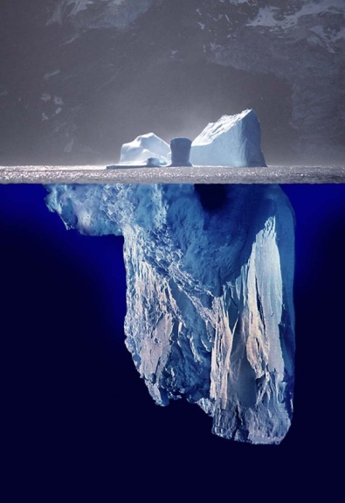
Hidden (and Uninsured) Costs of Accidents
Overtime paid to remaining employees.
Clerical time.
Building or Facility damage.
Tools/equipment damage.
Production and/or Schedule Delays, liquidated damages potential.
From International Risk Management Institute, Inc.

Slide 15
Indemnification –
How Does it Work?
Insurance language flows from agreements made in indemnification.
Insurance is the "collateral" for the indemnification. Ensures that there are funds available to back up most of the indemnity provisions.
Start with negotiating CSU’s preferred indemnity language, then move on to the insurance to support the indemnity.

Slide 16
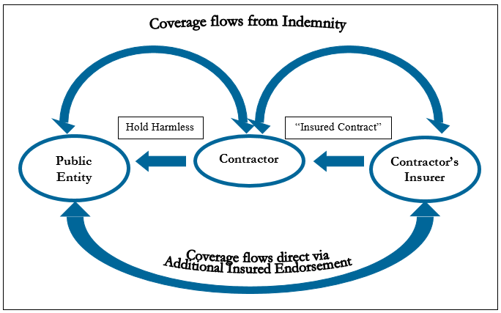
Hold Harmless vs. Additional Insured

Slide 17

Hold Harmless vs. Additional Insured

Slide 18
Three Main Types of Indemnification
Strict “Type I” Indemnification
  Contractor indemnifies entity for all claims costs arising from project except entity’s Sole Negligence or willful misconduct.
Intermediate “Type II” Form (Construction)
  Contractor indemnifies except for entity’s active negligence or willful misconduct.
Limited “Type III” Form
  Contractor indemnifies for contractor’s negligence.
  Can be used for cross indemnity, comparative negligence.
See OGC requirements.

Slide 19
Important Note:
Hold Harmless Agreements
Attorney’s Fees, Litigation Expenses
It is important to make certain that attorney fees and litigation expenses are assumed by the contractor in the indemnity and hold harmless section of the contract.
Failure to do so will result in these expenses not being covered.
Additionally, the new Commercial General Liability form restricts defense costs to only those lawsuits involving issues that are covered perils under the contractor's insurance

Slide 20
Just Say No?
Where to Draw the Line
At what point will the Entity be so exposed that the proposed indemnity clause is too risky?
Recommendation: Focus on indemnification before insurance.
Recommendation: Involve your Risk Manager in negotiations that deviate from approved indemnity language.

Slide 21
Impact of SB 474
Effective January 1, 2013.
Limits the Public Entity owners to a Type II indemnity by construction contractors – no indemnity for PE’s active negligence or willful misconduct.
Limits general contractors to a Type II indemnity by sub-contractors.
SB 474 prohibits shifting the risk via Type I indemnity agreements.

Slide 22
Additional Insured Endorsement
Preferred insurer endorsement: Insurance Services Office (ISO) Form No. CG 20 10 11 85, covering damages arising from “your work”.
  11 85 = edition date (November 1985).
  Covers both “Products and Completed Operations” - “your work” as well as your “ongoing operations” with potential to cover your sole negligence as well.
Newer forms may have to be accepted:
  CG 20 10 10 01
  CG 20 10 07 04
  CG 20 10 04 13

Slide 23
Additional Insured Endorsement
Newer endorsements forms that are acceptable, if
CG 20 10 11 85 not available:
CG 2010 10 01 = “ongoing operations”
CG 2037 10 01 = “your work” = “products–completed operations hazard”
Need both to get the same coverage as CG 2010 11 85 form.
07 04 and 04 13 editions of the above forms eliminate coverage for your sole negligence.

Slide 24
ISO 04 13 Changes -
Impact to Additional Insured Endorsement
Provides Additional Insured coverage only for contractor’s negligence.
Sets up potential for conflict of interest between Named Insured and Additional Insureds:
  Insurer will want to show the Named Insured is 0% at fault, to eliminate coverage for the Additional Insureds.
  Additional Insured will want to show the Named Insured is at least 1% at fault to trigger coverage.
  Conflict could to erode the available limits by paying for Additional Insured defense due to changes in “Insured Contract” definition.

Slide 25
ISO 04 13 changes
Impact to AI Endorsement (cont.)
Limits contractual liability coverage to vicarious liability of the indemnitee.
Only provides coverage to the amount of insurance requested.
  We have added suggested language to the manual that should be reviewed with Campus Counsel.
CG 20 38 04 13 is a benefit for handling Additional Insured with subcontractors where there is a written requirement for subs to indemnify the owner.

Slide 26
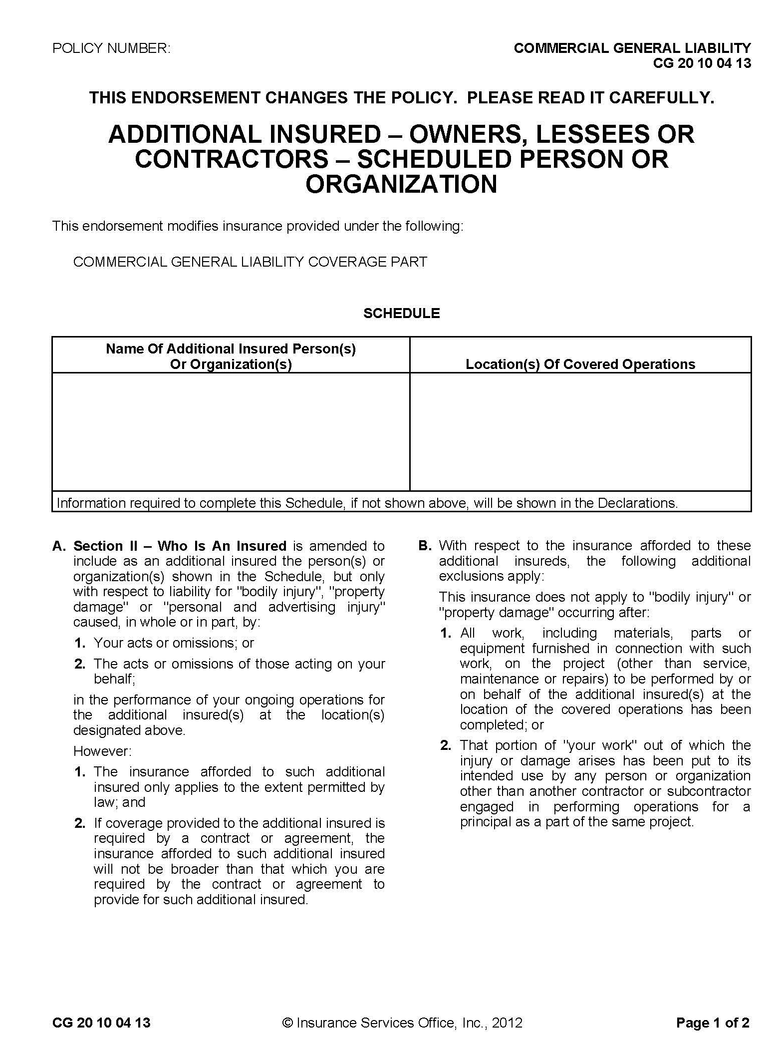
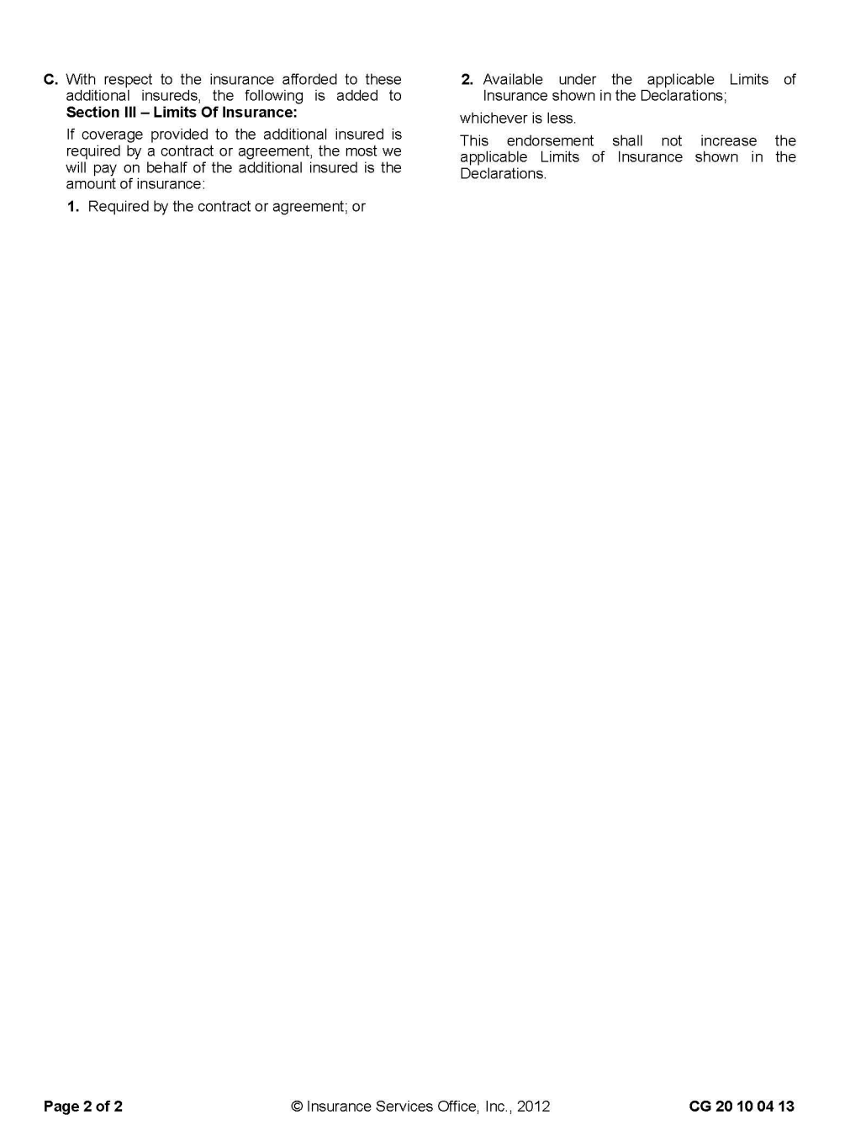

Slide 27
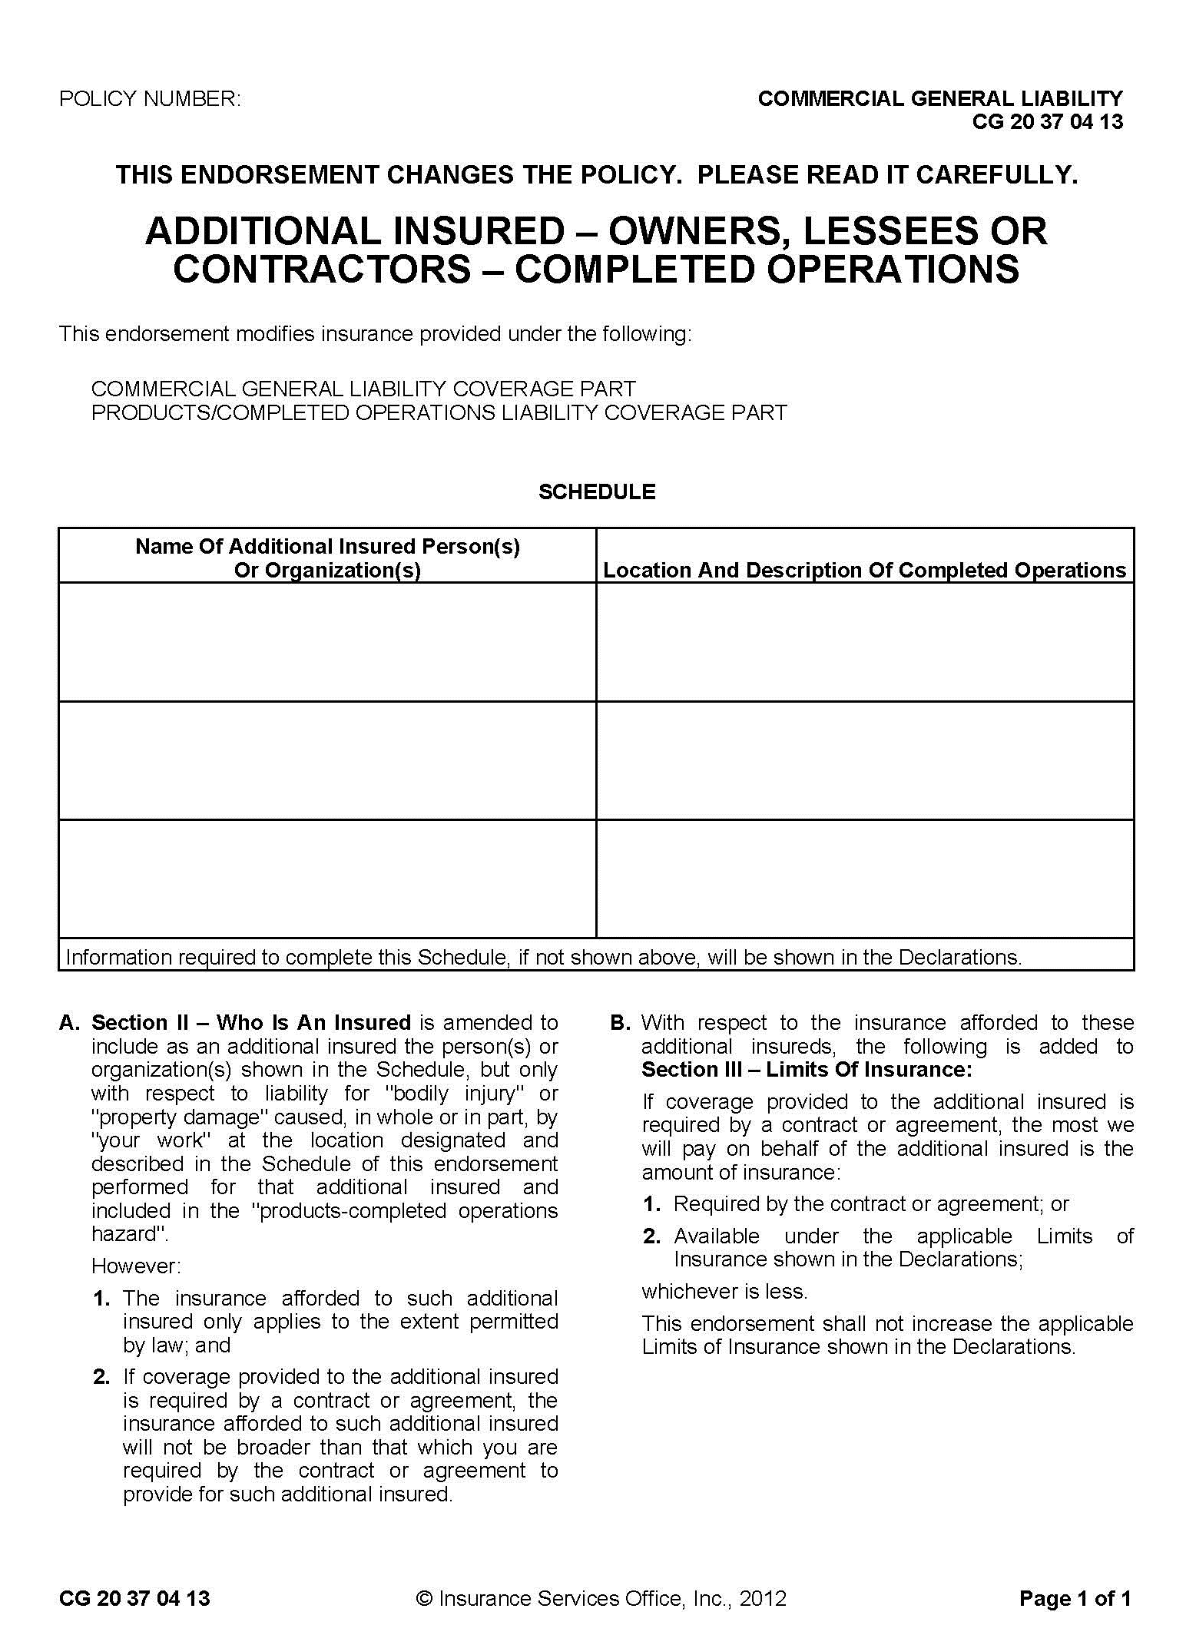

Slide 28
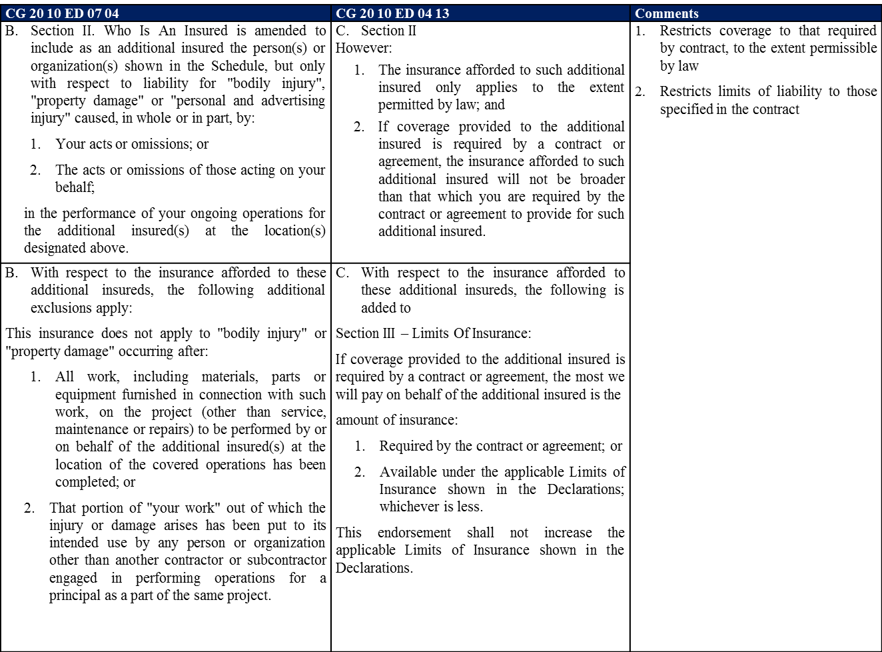
Additional Insured Endorsement Comparison

Slide 29
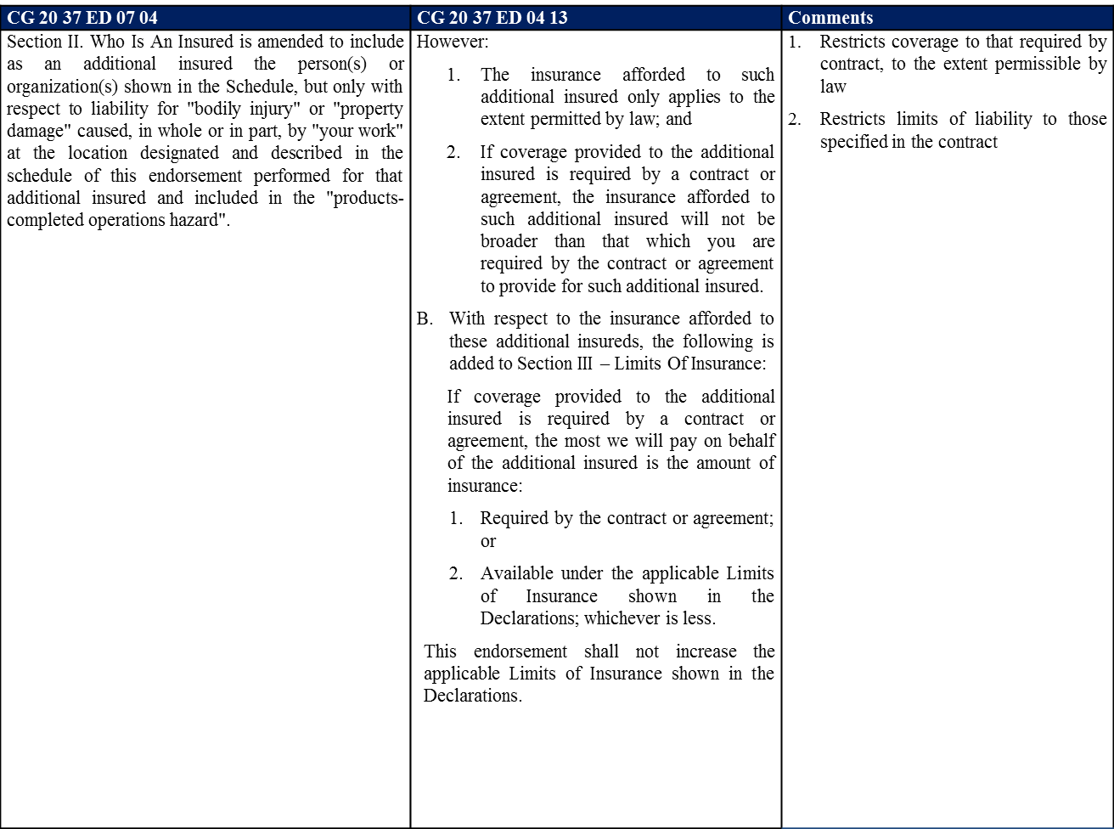
Additional Insured Endorsement Comparison (cont.)

Slide 30
Proprietary Additional Insured Endorsements
Be wary of Non-ISO or Carrier-specific endorsements.
Can contain limitations, such as
  Amended “duties in the event of occurrence, claim or suit” condition.

Slide 31
Quiz
If I can't get an ISO 2010 11 85, what should I get?
  A. 2010 04 13.
  B. 2037 04 13.
  C. All of the above.
  D. None of the above.

Slide 32
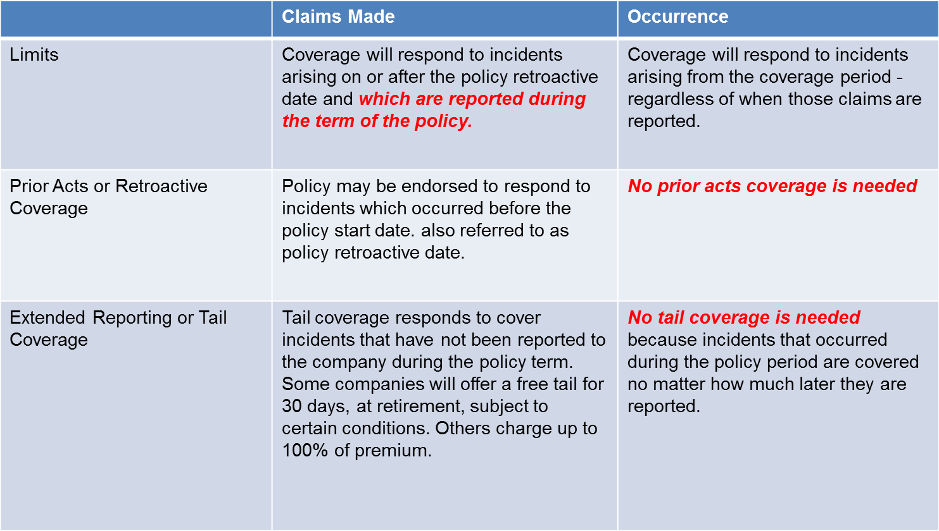
What is “Claims-Made”?

Slide 33
What are the Solutions?
Review and redraft standard insurance conditions for all agreements.
Separate indemnity language for construction agreements.
Consider Owner’s Protective Professional Indemnity (OPPI) coverage.
  - Sits excess of other coverage just for owner.
Consider OCIP or ROCIP
  - New programs can handle smaller projects.

Slide 34
Insurance Requirements
Drafting to Fit the Need
Evaluate the Risk:
  Who could be harmed? Visitors attracted?
  What are the activities and maximum likely loss? Dangerous? Crowds? Pollution? Alcohol?
  Where - On vs. off-campus? Site control?
  When - Night? During sporting events?
  How likely would the Entity be a defendant if there is a loss?
Notes:
ZG

Slide 35
The Risk Management Process
Identify the exposures.
Analyze the exposures.
Consider feasibility of alternative techniques to treat the exposures:
  Prevention/Reduction
  Retention
  Risk Financing
  Avoidance
  Transfer
Select the best technique.
Implement the selected technique.
Monitor results and change as needed.

Slide 36
The Basics
Avoid terms that do not have meaning in the insurance industry.
Request coverage on an “Occurrence” basis, except professional liability or pollution liability can be “claims-made.”
Describe maximum deductibles or self insured retentions.
Require the addition of CSU and/or Auxiliary Organization as an Additional Insured by endorsement to all policies except workers' compensation and professional liability.

Slide 37
The Basics (cont’d)
Require the other party's insurance be Primary.
Require Notice of Cancellation.
Require an Aggregate limit higher than the per Occurrence limit (note TULIP program has 1x agg.)
Specify that insurance be placed with insurers that meet a A.M. Best rating of A-,VII (minimum).
  Is the carrier strong enough to back the insurance contract that is backing the indemnification language?
    Management Rating = the Letters
    Financial Size Category = the Roman Numerals
  A “cut-through” endorsement to a higher-rated reinsurer may be used to solve a low-rated carrier problem. Refer to the Office of Systemwide Risk Management for review.

Slide 38
The Basics (cont’d)
Require that the Contractor’s insurer waive subrogation against CSU and/or Auxiliary Organization.
  Subrogation is the requirement that the insured transfer rights of recovery to the insurer; i.e., insurer pays claim for property damage, seeks recovery from third party – You don’t not want to be that third party!
  If necessary, only waive Entity’s right to subrogation on property, and even that creates significant exposure.
    Example claim: The vending machine
Notes:
Daniel

Slide 39
Insurer Ratings –
Will they be there to pay the claim?
Two Main Insurer Rating Agencies:
  Standard & Poor’s
  A.M. Best
Best’s Ratings
Standard and Poor’s
A++, A+
Superior
AAA
Superior
A, A-
Excellent
AA +/-
Excellent
B++, B+
Good
A +/-
Good
B, B-
Fair
BBB +/-
Fair
C++, C+
Marginal
BB +/-
Needs Improvement
C, C-
Weak
B +/-
Barely Acceptable
D
Poor
CCC +/-
Poor
CC +/-
Exceptionally Poor
R
Failing
+/- These signs following the letter rating indicate the relative position within the class. Italics represent minimum recommended.

Slide 40
Best’s Financial Size Category (FSC)
Reported Capital, Surplus and Conditional Reserve Funds (in Millions)
FSC XV Greater than $2,000
FSC XIV $1,500 to $2,000
FSC XIII $1,250 to $1,500
FSC XII $1,000 to $1,250
FSC XI $750 to $1,000
FSC X $500 to $750
FSC IX $250 to $500
FSC VIII $100 to $250
FSC VII $50 to $100 Minimum Recommended

Slide 41
Cumulative Average Impairment Rates by Best Financial Strength Rating*
Insurers with strong ratings are far less likely to become impaired over long periods of time. This is especially important for long-tailed lines of coverage.
*US P/C and L/H companies, 1977-2014
Sources: A.M. Best: Best’s Impairment Rate and Rating Transition Study—1977-2014, August 21, 2015

Slide 42
How Much Coverage is Enough?
Guidelines Matrix
  High, Moderate, Low
Tort Costs: +8.7% average annual increase since 1951! (Towers Watson’s US Tort Costs: 2011 Update)
  $1 Million (1986) is over $4 Million today, based on COLA.
  $1 Million (1986) is over $9 Million today, based on tort inflation.
Jury Verdicts continue to rise
  (www.iii.org)
Analyze the Exposure
Maximum Possible Loss vs.
Maximum Probable Loss

Slide 43
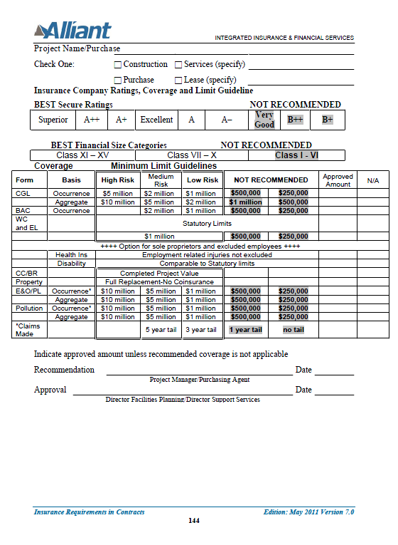

Slide 44
Rating Alternative Risk Transfer Vehicles
Many organizations are moving to Alternative Risk Transfer financing vehicles (ART).
Self Insurance:
  Workers’ Compensation – regulated stand alone, and Self Insured Groups
  Liability – not regulated
    High self-insured retention (SIR)
    Risk Retention Groups
    Captive insurance company
How does one evaluate ART vehicles?

Slide 45
Bid Situations
Would you decline a bid not meeting the minimum requirements?
Draft RFBs with wiggle room to allow you to accept the best bid in light of all the facts and circumstances.

Slide 46
When CSU is the Contractor
Role Reversal
Can the CSU or Auxiliary Organizations comply with the Insurance Requirements?
  CSURMA’s programs may have significant elements of self-insurance and pooling that is not traditional insurance.
  Pools issue “certificates of coverage” not “certificates of insurance”
  The CSU and Auxiliary Organizations should include language that allow for self-insurance and/or pool participation.

Slide 47
Verification of Coverage
Having a Process.
  What is your threshold for obtaining certificates vs. policies vs. endorsements?
  How do you determine the appropriate coverages and limits?
  How do you determine and respond to non-compliance?
  Will the job be delayed or halted?
  Leverage after commencement?
Using the Process.
  HDIKT – “How Do I Know That?” Have an audit trail documenting compliance.
Get Involved Early.
  Sample Certificate
  Sample Checklist

Slide 48
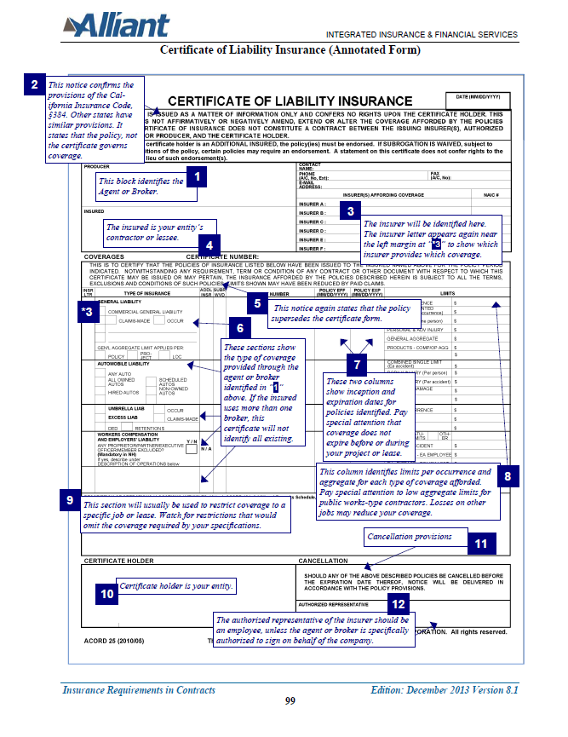
Sample Certificate
Notes:
Daniel

Slide 49
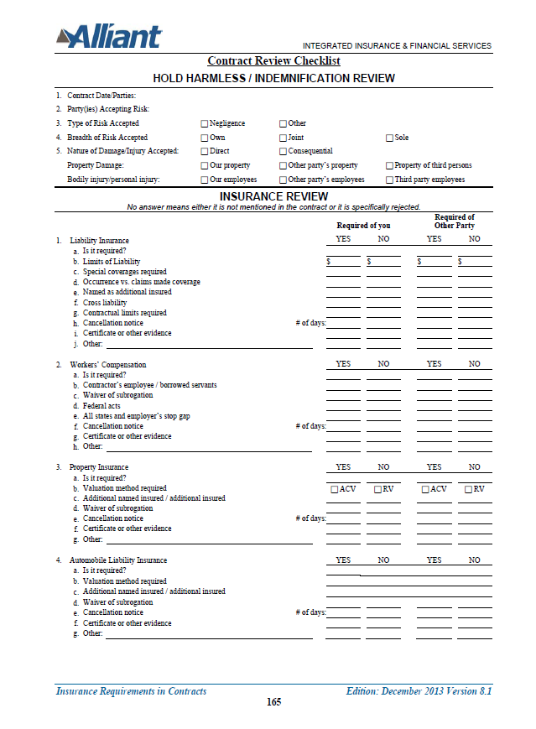
Sample Checklist

Slide 50
Document Retention
Policy & Procedure
Your Certificates & Endorsements are your insurance policy.
How long does your Campus or Auxiliary keep its own insurance policies?
Alternative storage methods.

Slide 51
Claims
Responding to Loss Events.
Reporting to Contractor’s insurers.
The Subcontractor’s Subcontractor.
  Chasing Certificates and Endorsements
  Special Situations (such as Underwater Construction, Asbestos Removal, Blasting)
  The benefit of new ISO 20 38 form
Negotiating Your Coverage.

Slide 52
Resources
Peer Groups
Campus Risk Management
  Access to their resource pool.
Office of Systemwide Risk Management
  (562) 951-4580
CSURMA Program Administrators
  Alliant (415) 403-1400
Risk Management Community
  Manuals
  Feedback through Campus Risk Management.
  Developing a library based on experience.
  Odds are, this is not the first time the issue arose –
    No need to reinvent the wheel!

Slide 53
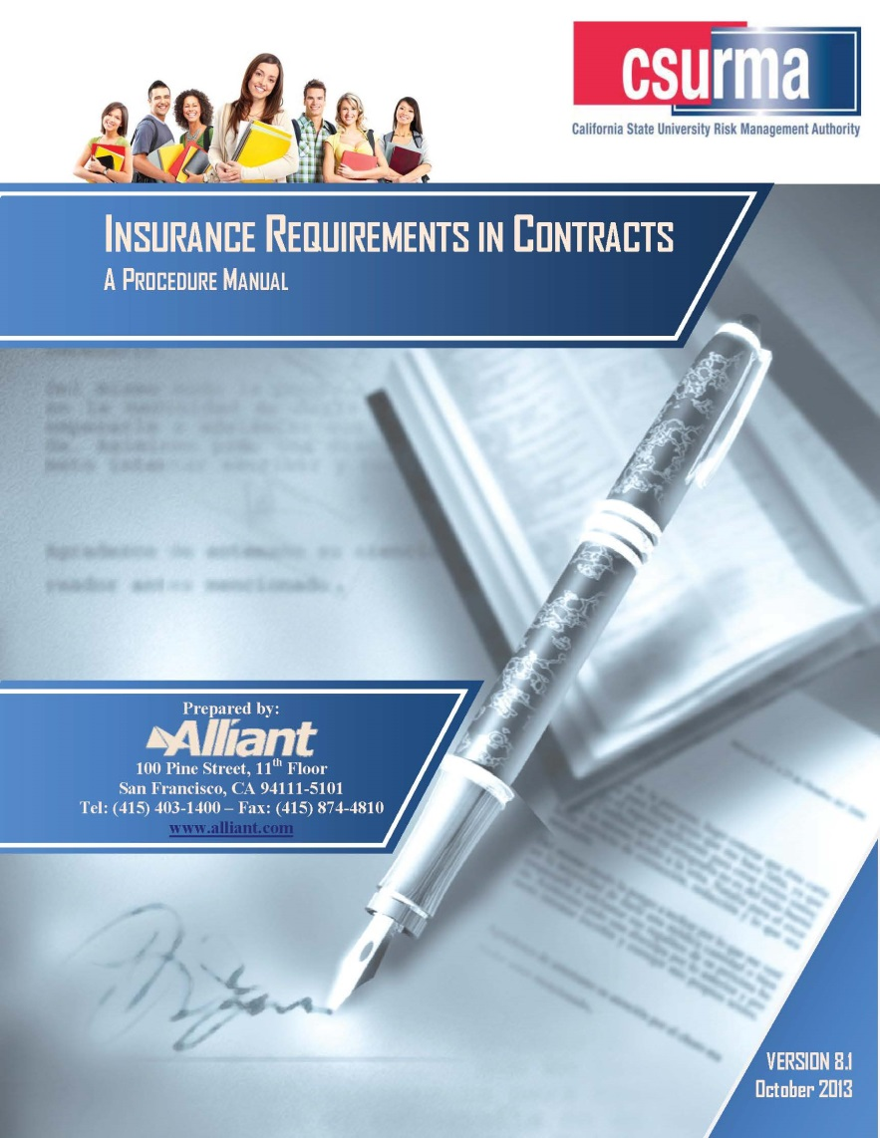
Sources of Knowledge
See CSURMA.org for the latest version

Slide 54
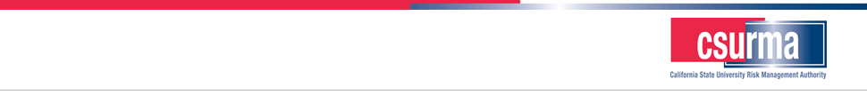
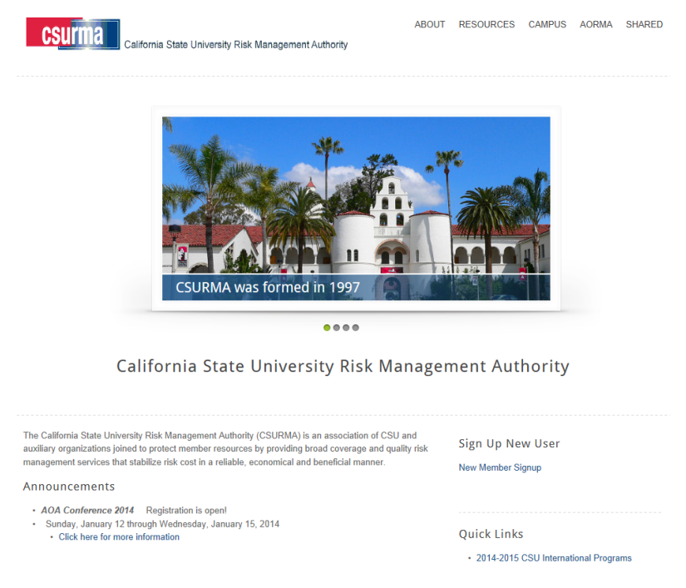
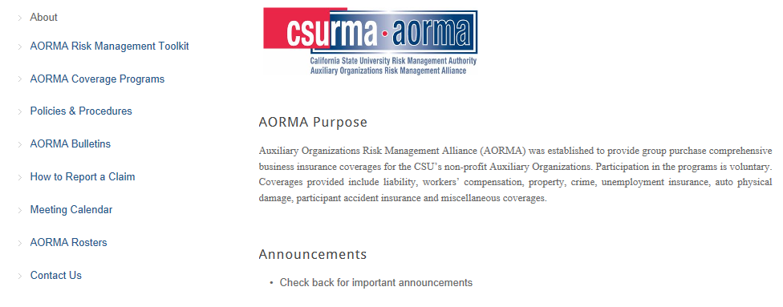
CSURMA Website
Log into the CSURMA website – www.CSURMA.org
Enter Username, Password
Click sign in

Slide 55

Questions?
Please contact your Program Administrators:
Rob Leong - Campus Programs
415-403-1441 rleong@alliant.com
Andrew Gaspari – Program Administrator
415-403-1412 agaspari@alliant.com
Mimi Long - AORMA Programs
415-403-1423 mlong@alliant.com
Daniel Howell - Program Director
415-403-1426 dhowell@alliant.com
Or, your friendly Systemwide Risk Management professional:
Zachary Gifford - Director, CSU Systemwide Risk Management
562-951-4568 zgifford@calstate.edu

Slide 56

Thank You!
This presentation and other resources can be downloaded at:
www.csurma.org

