Slide 1
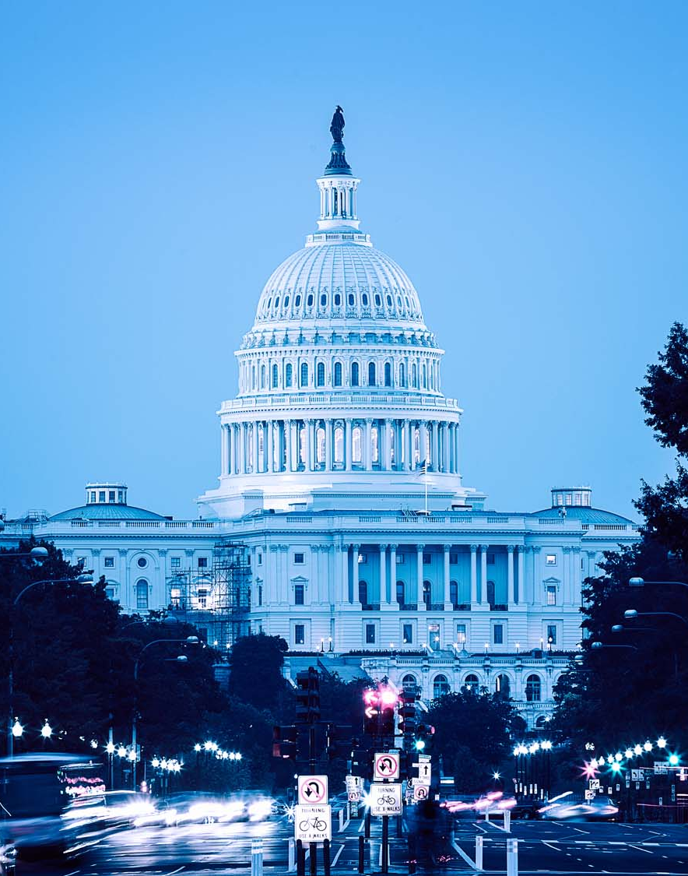
Insurance Requirements in Contracts
Parks and Recreation
Conor Boughey, ARM
SVP, Alliant
415-744-4889 cboughey@alliant.com
September 2024

Slide 2

Agenda
Risk and Insurance Orientation
Common Scenarios
Insurance Requirements
Contract Language
Insurance Verification

Slide 3
Disclaimer
Always Consult with your agencies Legal Counsel
before changing any Contract Requirements
The following presentation uses information from the
Insurance Requirements in Contracts (IRIC) Manual
found on www.alliant.com

Slide 4

Park and Recreation Activities
Cities provide programming to potential participants
Some programming is conducted by city employees, and some is provided by third party independent contractors or entities
This presentation focuses on programming provided by non-employees
When a city provides programming that includes third party representatives, the city should take steps to protect itself from claims arising out of third-party operations

Slide 5

Municipal Risk and Insurance Orientation
California Cities largely self insure their exposures
  The legal environment is very challenging
  Public entities are targets for litigation
  Claims against the city are paid from self funded accounts
The City’s coverage program is designed to cover City operations
Third parties who contract with the city should have their own insurance to cover their operations and activities
Copyright © 2024

Slide 6

Risk and Insurance Orientation – Example Scenario
City of Fiction has a summer program they provide as a community benefit
The City is hiring service providers to host camps, classes and activities
City of Fiction hires John Kreese to host a karate class in a city community center
John Kreese losses his temper with a parent and karate chops them
The parent falls back, hits their head and is in a comma
Should the City be liable for this?
What could it cost?
Image: The Karate Kid Movie, 1984
Copyright © 2024

Slide 7

Risk and Insurance Orientation
Risk Challenges:
No Tort Caps in California:
  Some states limit municipal liability to $100,000
  In California, settlements and verdicts have no limit
Joint and Several Liability:
  1% at fault? Pay 100%!
Injuries Resulting in Lifetime Care Plans:
  Medical Costs, a lifetime care plan can sometimes be more than $20,000,000 for one individual (2022 we witnessed $50M for a single injured party)
Copyright © 2024

Slide 8
Risk and Insurance Orientation: Today’s Focus
Reason for Risk Transfer:
  Protects the City from liability arising out of the contractor’s negligent delivery of products, services, or activities
  Address the City’s exposure through joint and several liability
  Control costs related to third party activities
How to Transfer Risk:
  Start with a clause to Defend, Indemnify and Hold Harmless
  Support the Indemnification clause with insurance
Why Require Insurance:
  Protects contractor’s balance sheet
  Ensures contractor will have money to deliver on their hold harmless promise
  Proper insurance requirements are required by City insurers
Copyright © 2024

Slide 9
Risk and Insurance Orientation : Today’s Focus
Whenever the City is working with third parties, there should be a contract:
  Service Providers (E.g., YMCA, KinderCare, Finger Paint Instructor)
  Facility Use Agreement (E.g., Wedding, Birthdays, Classes, Sports)
  Special Events (E.g., Farmers Market, Concert Series, Movies in the Park)
The Contract should outline the responsible parties should a loss occur
Appropriate insurance should always be required for applicable lines of coverage
  Waivers of insurance should be documented
City should have all documents necessary to evidence coverage prior to work beginning
City should maintain records of all contracts and insurance
Copyright © 2024

Slide 10
Common Scenarios

Slide 11
Parks and Recreation Exposures
Long Term Lease Agreements: A City pool with an operator agreement
Short Term Facility Use Agreements: A community room used for birthday parties, pottery classes, etc.
Recreational Programing: Third party service providers who oversee children, or other at-risk populations
Instructors: Music classes, sports coaching, pottery, photography, etc.
- Vetting process?
Events: Public property (e.g., park, road, parking lot), over 100 participants, etc.
Copyright © 2024

Slide 12
Parks and Recreation Exposures
For all these situations a contract between the parties should exist
  New Contracts
  Renewing Contracts
Critical components of the contract are:
  Scope of Work (who is responsible for safety of participants)
  Indemnification Agreement
  Required Insurance Coverages
Insurance responds when contractually obligated
Copyright © 2024

Slide 13
Parks and Recreation Exposures
Service Providers Insurance Options:
Large Vendors: Larger vendors will have comprehensive insurance programs, internal policies and procedures, background checks, and should be able to comply with insurance requirements without significant issue.
Medium Vendors: Like large vendors, these firms should have a business license, insurance coverage and may need to purchase or amend some placements to comply with the City’s requests.
Small Vendors: Most insurance issues arise when working with small vendors and individuals. These parties may not have coverage in place that complies with city requirements. Likely minimal safety controls in place. Homeowners insurance does not cover business exposures. For these situations there are options that include:
1. Special Event Insurance
2. Vendor/Contractor Insurance Program
3. Process for waiving requirements: If the city chooses to waive insurance requirements, there should be a process of review and sign off.
Copyright © 2024

Slide 14

Evaluating Risk
The IRIC Manual contains a Risk Assessment in the Appendix
Many special events programs are rating on activity type
Things to consider:
Number of participants
Supervision (e.g., parent attendance, number of supervisors, experience)
Age/Type of participants
Location of activities
Location details (e.g., locker rooms, private areas)
Type of activities
Food, wine, music, etc.
Copyright © 2024

Slide 15
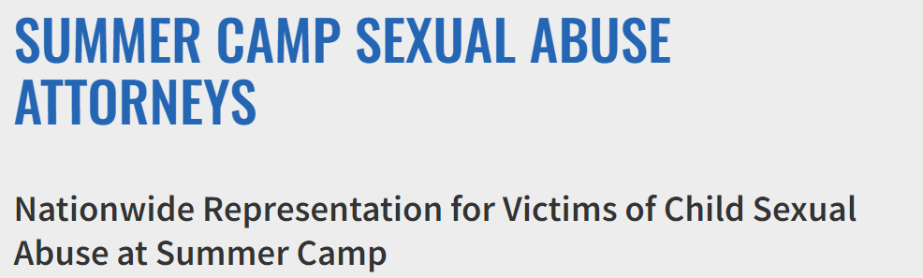
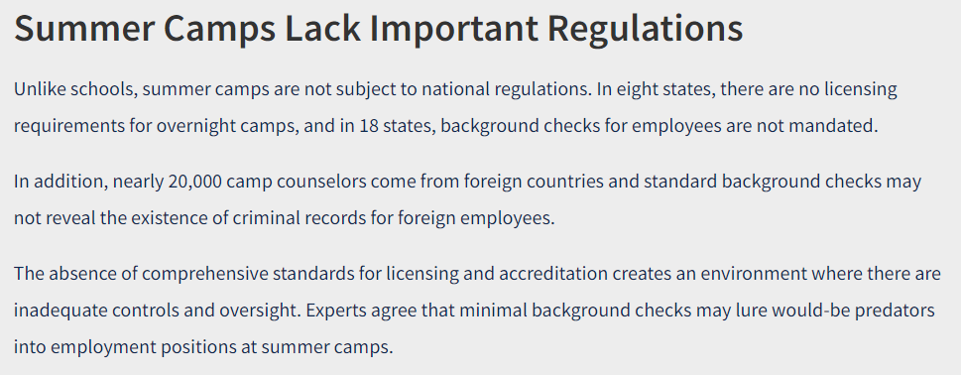
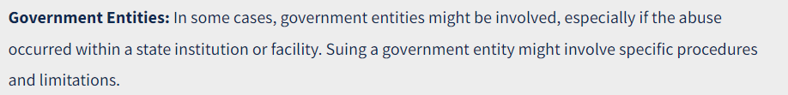
A note about SAM: Sexual Abuse and Molestation
A few Examples:
Camp Woodward: $8M
US Twirling Association: $4.2M
Archdiocese of Baltimore: $1B
River Way Ranch Camp: $1M
Bay Area Martial Arts Teacher: $1M
Police Athletic League: $200M
Youth Bowling: $6M
Volleyball Coach: $1.8M
Copyright © 2024

Slide 16
Insurance
Lines of Coverage

Slide 17
What Insurance is Necessary?
Commercial General Liability
Commercial Auto Liability
Workers’ Compensation & Employer’s Liability
Professional Liability (if applicable, design, engineering, etc.)
Aviation Liability (if applicable, drone use)
Excess or Umbrella Liability (if needed)
Copyright © 2024

Slide 18


All Contracts:
Commercial General Liability (CGL)
Includes the following types of coverage:
  Bodily injury
  Property damage
  Personal injury (libel, slander, defamation)
  Advertising injury (trademark)
  Products & Completed Operations – must have for any product liability or construction exposures.
Copyright © 2024

Slide 19

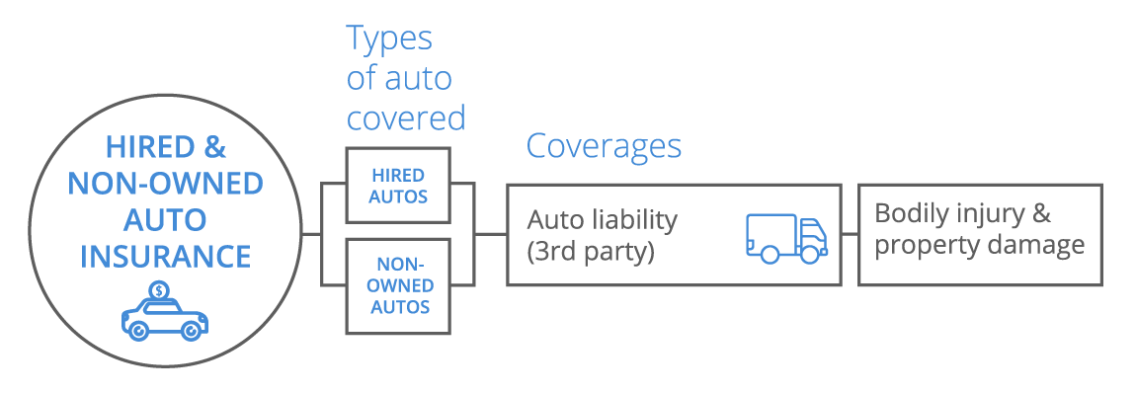
Most All Contracts:
Commercial Auto
Includes the following types of coverage:
  Auto Liability for owned autos
  Important to require:
  Non Owned and Hired Auto
Copyright © 2024

Slide 20


All Contracts with Employees:
Workers’ Compensation
Coverage A: Workers’ Compensation
  Statutory benefits – no limit
  Critical that all subcontractors carry
  N/A to sole proprietor &/or if have no employees
Coverage B: Employer’s Liability (EL)
  $1,000,000 limit common
  Covers “dual capacity” and other exceptions to exclusive remedy of workers’ compensation
  This is NOT Employment Practices Liability
Copyright © 2024

Slide 21


For Large Exposures (pool, youth, transportation):
Excess or Umbrella Liability
To comply with limit requirements, companies usually provide Umbrella or Excess coverage
Smaller companies will typically provide Umbrella, while larger companies carry excess (cities carry excess).
Either form of insurance is acceptable, but verification is required to be sure the excess/umbrella is following the terms of the contract and underlying coverage
Copyright © 2024

Slide 22
Contract Language

Slide 23
Insurance Language in Contracts
Insurance carriers respond to claims against their insured.
  In addition, they follow the contractual agreements of the insured.
If the City and a service provider have no contract, and a claim is filed against the City for the contractor’s act, their insurer isn’t triggered to protect the City.
A contract must exist between the City and the service provider.
The contract should include:
  Scope of Work: Identifying the contractor’s responsibilities
  Indemnification Agreement: Service Provider agrees to indemnify the City for their acts, use, etc.
Insurance Requirement Benefits:
  Insurance will provide financial protection to the service provider and city.
  Insurance requirements set a minimum standard for vendors and requires their insurance to respond.
Copyright © 2024

Slide 24
In Contract: Hold Harmless / Indemnification
Hold harmless: to the fullest extent permitted by law, Contractor shall hold harmless, defend at its own expense, and indemnify Entity its officers, employees, agents, and volunteers, against any and all liability, claims, losses, damages, or expenses, including reasonable attorney’s fees, arising from all acts or omissions of contractor or its officers, agents, or employees in rendering services under this contract; excluding, however, such liability, claims, losses, damages, or expenses arising from Entity’s sole negligence or willful acts.
“To the degree possible, the contractor will take financial responsibility for their actions and will defend the city if the city is also sued. Including paying costs to defend the matter.”
* Only use language approved by your entity’s general counsel.
Copyright © 2024

Slide 25
In Contract: Insurance Requirements
INSURANCE REQUIREMENTS. Contractor agrees to have and maintain the policies set forth in Exhibit A entitled “INSURANCE REQUIREMENTS,” which is attached hereto and incorporated herein. All policies, endorsements, certificates, and/or binders shall be subject to approval by the Entity as to form and content. These requirements are subject to amendment or waiver only if so approved in writing by the Entity. A lapse in any required insurance coverage during this Agreement shall be a breach of this Agreement.
Be sure these requirements are expressed as minimum limits and that City is able to access all valid and collectible insurance available to contractor.
Copyright © 2024

Slide 26
Contract Exhibit:
Applicable Insurance Requirements (Part 1)
Exhibit 13:
Insurance Requirements for Instructors
Contractor shall procure and maintain for the duration of the contract insurance against claims for injuries to persons or damages to property which may arise from or in connection with the performance of the work hereunder and the results of that work by the Instructor, his agents, representatives, employees or subcontractors.
Minimum Scope and limit of Insurance
Coverage shall be at least as broad as:
Commercial General Liability (CGL): Insurance Services Office Form CG 00 01 covering CGL on an “occurrence” basis, including property damage, bodily injury and personal & advertising injury with limits no less than $1,000,000 per occurrence. If a general aggregate limit applies, either the general aggregate limit shall apply separately to this project/location (ISO CG 25 03 or 25 04) or the general aggregate limit shall be twice the required occurrence limit.
Automobile Liability: Insurance Services Office Form Number CA 0001 covering Code 1 (any auto), or if Instructor has no owned autos, Code 8 (hired) and 9 (non-owned), with limits no less than $1,000,000 per accident for bodily injury and property damage. (Note – required only if auto is used in performance of work).
Workers’ Compensation insurance as required by the State of California, with Statutory Limits, and Employer’s Liability Insurance with limit of no less than $1,000,000 per accident for bodily injury or disease. (Note – required only if Instructor has employees).
Sexual Abuse or Molestation (SAM) Liability: If the work will include contact with minors, and the CGL policy referenced above is not endorsed to include affirmative coverage for sexual abuse or molestation, Contractor shall obtain and maintain a policy covering Sexual Abuse and Molestation with a limit no less than $1,000,000 per occurrence or claim.
Copyright © 2024

Slide 27
Contract Exhibit:
Applicable Insurance Requirements (Part 2)
If the Contractor maintains broader coverage and/or higher limits than the minimums shown above, the Entity requires and shall be entitled to the broader coverage and/or the higher limits maintained by the Contractor. Any available insurance proceeds in excess of the specified minimum limits of insurance and coverage shall be available to the Entity.
Self-Insured Retentions
Self-insured retentions must be declared to and approved by the Entity. The Entity may require the Instructor to provide proof of ability to pay losses and related investigations, claim administration, and defense expenses within the retention. The policy language shall provide, or be endorsed to provide, that the self-insured retention may be satisfied by either the named insured or Entity.
Other Insurance Provisions
The general liability policy is to contain, or be endorsed to contain, the following provisions:
The Entity, its officers, officials, employees, agents, and volunteers are to be covered as additional insureds with respect to liability arising out of work or operations performed by or on behalf of the Instructor including materials, parts or equipment furnished in connection with such work or operations.
For any claims related to this contract, the Instructor’s insurance coverage shall be primary and non-contributory insurance coverage at least as broad as ISO CG 20 01 04 13 as respects the Entity, its officers, officials, employees, agents, and volunteers. This requirement shall also apply to any Excess or Umbrella liability policies.
The Insurance Company agrees to waive all rights of subrogation against the Entity, its elected or appointed officers, officials, agents, and employees for losses paid under the terms of any policy which arise from work performed by the Instructor for the Entity. This provision also applies to the Instructor’s Workers’ Compensation policy.
Each insurance policy required above shall provide that coverage shall not be canceled, except with notice to the Entity.
Copyright © 2024

Slide 28
Contract Exhibit:
Applicable Insurance Requirements (Part 3)
Umbrella or Excess Policy
The Instructor may use Umbrella or Excess Policies to provide the liability limits as required in this agreement. This form of insurance will be acceptable provided that all of the Primary and Umbrella or Excess Policies shall provide all of the insurance coverages herein required, including, but not limited to, primary and non-contributory, additional insured, Self-Insured Retentions (SIRs), indemnity, and defense requirements. The Umbrella or Excess policies shall be provided on a true “following form” or broader coverage basis, with coverage at least as broad as provided on the underlying Commercial General Liability insurance. No insurance policies maintained by the Additional Insureds, whether primary or excess, and which also apply to a loss covered hereunder, shall be called upon to contribute to a loss until the Instructor’s primary and excess liability policies are exhausted.
NOTE to Agencies: Please see the section on The Myth of “Following Form” Excess Limits Insurance Policies in chapter 2 for additional explanatory information on this very common Excess policy problem that needs to be verified and corrected.
Acceptability of Insurers
Insurance is to be placed with insurers authorized to conduct business in the state with a current A.M. Best’s rating of no less than A: VII, unless otherwise acceptable to the Entity.
Verification of Coverage
Instructor shall furnish the Entity with original Certificates of Insurance including all required amendatory endorsements (or copies of the applicable policy language effecting coverage required by this clause) and a copy of the Declarations and Endorsement Page of the CGL policy listing all policy endorsements to Entity before work begins. The Entity reserves the right to require complete, certified copies of all required insurance policies, including endorsements affecting the coverage required by these specifications, at any time.
Copyright © 2024

Slide 29
Contract Exhibit:
Applicable Insurance Requirements (Part 4)
Homeowner’s Insurance
In some cases, the Instructor’s homeowner’s liability insurance may provide coverage sufficient to meet these requirements. Instructor should provide these requirements to his or her agent to confirm and provide verification to the Entity.
Special Events Coverage for Instructors
Special events coverage is available for an additional fee to provide the liability insurance required by this agreement. Instructor can obtain additional information and cost from the Entity.
Special or Low Risk Activities
Entity reserves the right to modify these requirements, including limits, based on the nature of the risk, prior experience, insurer, coverage, or other special circumstances. The Entity reserves the right to modify or waive insurance requirements for certain low risk recreational activities.
Copyright © 2024

Slide 30
Insurance Requirements: Match to Risk
IRIC contains sample insurance contract templates for:
Long Term Lease
Short Term Lease
Instructors
Special Risks & Large Events
Each template has unique insurance requirements, limits, or details:
  Long Term lease incudes Property requirements for betterments and improvements. May require higher limits
  Short Term do not require property coverage
  Instructor’s coverage includes auto liability
  Special Events may have higher limits and liquor liability
Copyright © 2024

Slide 31
Insurance Verification

Slide 32
Evidencing Coverage:
Certificate of Insurance
The certificate holder should always be the Agency or entity contracting for services:
  Do not limit to a department or subsidiary
  Do specify who should receive it, example:
  Attention: Contract Manager
The certificate should be signed!
Copyright © 2024

Slide 33
Evidencing Coverage:
Keep Good Records - Indefinitely
Original bid specs, contract, addenda, support documentation
Certificate(s) of insurance
Additional insured endorsement
Any other endorsements
All correspondence concerning insurance or claims pertaining to the contract
Copy of contractor’s policy, if provided
Participant Lists
Copyright © 2024

Slide 34

Evidencing Coverage:
Check For Compliance
Confirm name of insured
Date(s) of coverage
Limits, including aggregate
Auto liability covers “any auto”
Description of operations, locations correct
Check out insurers – www.ambest.com
Copyright © 2024

Slide 35
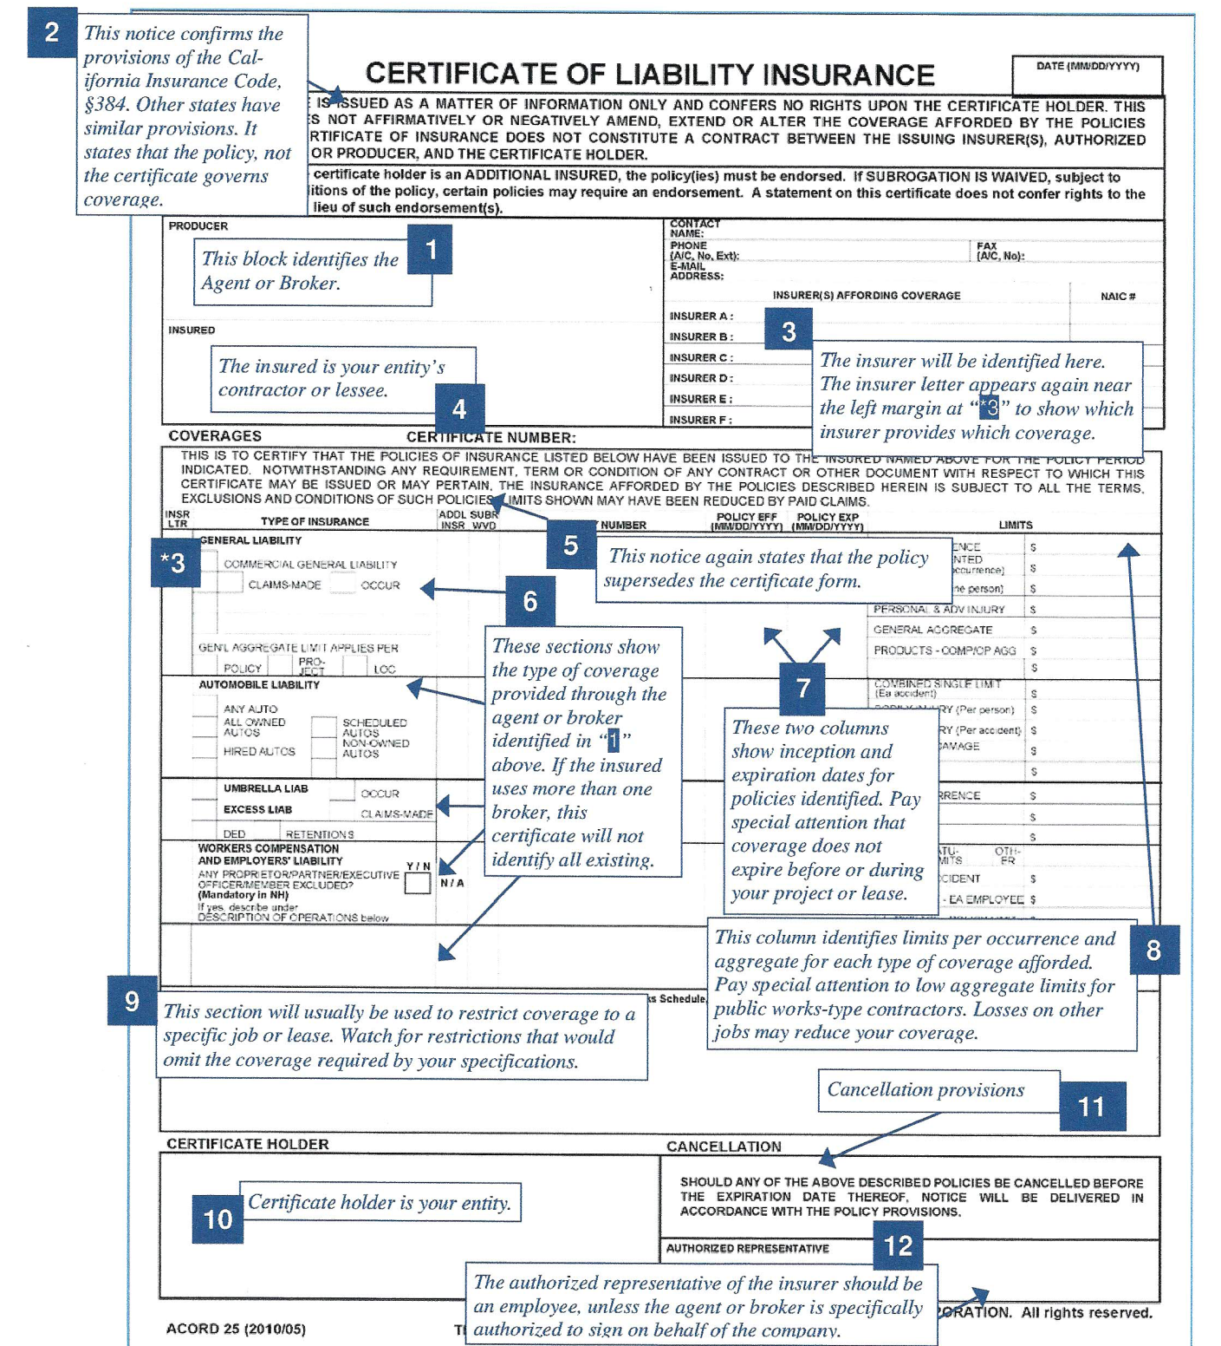
Check Certificate
For Compliance
Copyright © 2024

Slide 36
Evidencing Coverage:
Check for Endorsements
Two pieces of paper:
Certificate of Coverage: provides evidence of coverage, and information about how coverage is structured – it provides no additional status to the city, no matter what is stated in the ‘description of operations’
Additional Insured Endorsement: When the City requires “additional insured” that must be provided with an Endorsement from their insurance policy
Copyright © 2024

Slide 37
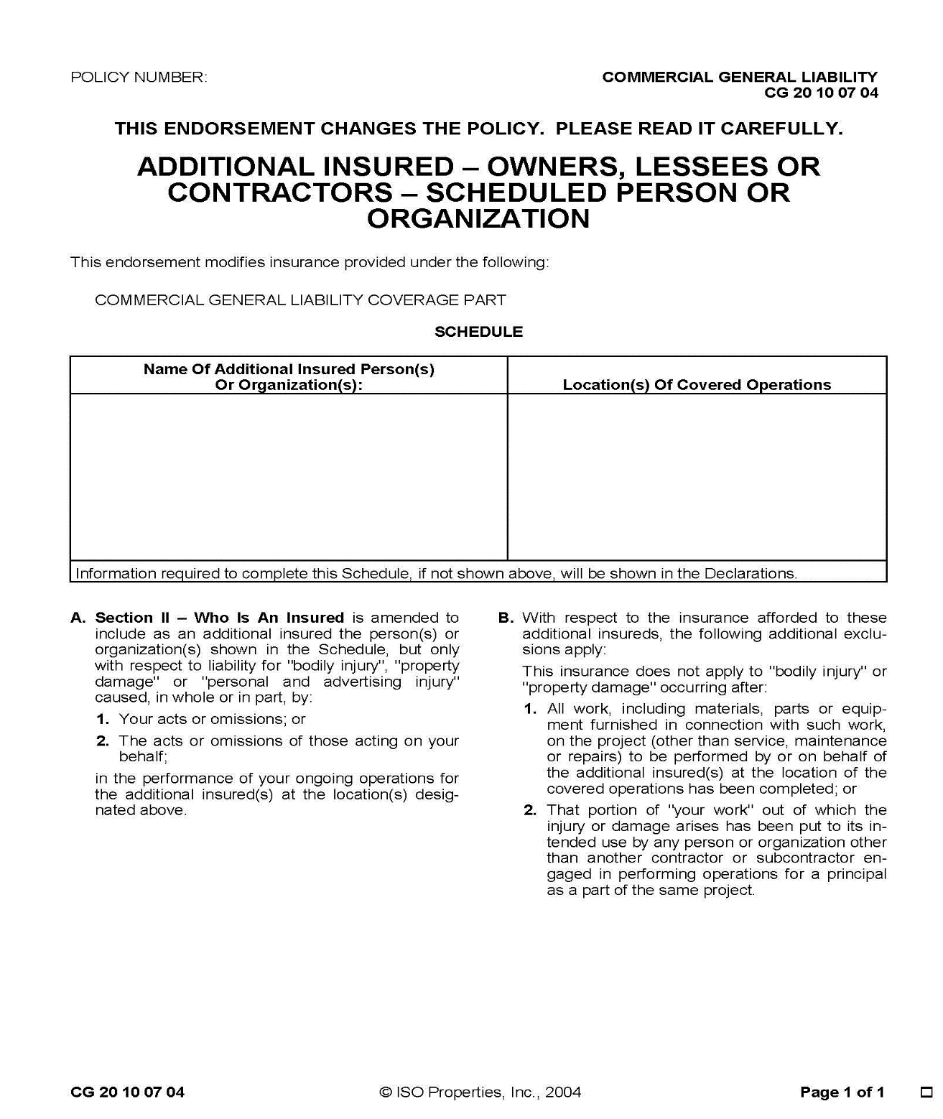
Check Endorsement for Compliance
Copyright © 2024

Slide 38
Insurance Documentation
Notify the other party of requirements early
Obtain coverage verification before contract signed!
Maintain records
Need at least two pieces of paper:
  Certificate of Insurance
  Additional Insured Endorsement
  Or proof of policy language (Blanket Additional Insured)
Copyright © 2024

Slide 39
Scenario - Example 1
Wrestling Instructor at Community Center
A member of the public would like to lease a city location and provide programming for wrestling instruction.
What should the city do?
Process Should Include:
Documented process to evaluate instructor (i.e. resume, background)
Inspection of city facility
Suitability for city programming / facility
Reach agreement in contract
Verify all aspects of contract are complied with (e.g. insurance)
Review annually, maintain records

Slide 40
Scenario - Example 2
Birthday Party at a City Park with Bounce House
A member of the public would like to reserve a section of a public park and host a birthday party. The party will include a bounce house.
What steps should the city take to protect itself?
Process Should Include:
Private rentals require a signed contract (i.e. permit)
Rental agreement should include limitations and directions regarding safety of event
City agreement should require insurance and may require certain approved vendors
Insurance should be provided by the party host and bounce house vendor

Slide 41

Insurance Requirements in Contracts
Park and Recreation Focused
Questions?
Conor Boughey, ARM
SVP, Alliant
415-744-4889 cboughey@alliant.com

