Slide 1



ABC’s of It:
Auxiliaries and Basic Contracts
January 11, 2017
9:00 AM to 10:15 AM
Auxiliaries and Basic Contracts
January 11, 2017
9:00 AM to 10:15 AM
PPRESENTED BY:
Carrie Rasmussen, Lozano Smith
Daniel Howell, Alliant Insurance Services
NTED BY:
Carrie Rasmussen
Daniel Howell, Alliant Insurance Services

Slide 2
The ABC’s of It: Auxiliaries and Basic Contracts
The lawyer’s perspective
Presented by:
Carrie Rasmussen
Notes:
Cover Page

Slide 3

Start with a Good Contract
1. Basic Building Blocks
2. Basic Provisions
3. Basic Considerations
Notes:
Large Photo with Blue boxes as opposed to bullets

Slide 4
1. Basic Building Blocks
Notes:
Divider Slide

Slide 5

Building Blocks of an Enforceable Contract
Offer/Counter offer
Acceptance/rejection
Consideration
Notes:
Space for bulleted text

Slide 6
2. Basic Contract Provisions
Notes:
Divider Slide

Slide 7
Basic Contract Anatomy
Header
Recitals
Main Body/ Terms
Signatures

Slide 8

* DETAILS MATTER *

Slide 9
Recitals
Provides context
Auxiliary, a California nonprofit corporation
Format
  Whereas, or a list
  NOW, THEREFORE, in consideration of the covenants and conditions of this Agreement, including the recitals hereof, which are incorporated herein by this reference, the Parties agree:
Notes:
Space for 2 column bulleted text with headers

Slide 10
Main Body/Key Terms
Parties
Term/Timeframe of Agreement
Definitions
Key Terms for Particular Deal
Notes:
Space for 2 column bulleted text with headers

Slide 11

Other Important Terms
Notices
Counterparts
Successors and Assigns
Amendments
Forum Selection
Entire Agreement
Severability
Entire Agreement
Early Termination
Indemnification
Notes:
Space for 2 column bulleted text with headers

Slide 12

Signatures
Who has authority to contract with third parties?
Notes:
Space for photo and bulleted descriptive text below.

Slide 13
3. Basic Considerations
Notes:
Divider Slide

Slide 14

Other Considerations
Read the entire agreement
Seek clarity,
avoid ambiguity
Negotiate
Use plain English
Keep good records
Be wary of
confidentiality clauses
Notes:
Space for 2 column bulleted text with headers

Slide 15
TAKE-AWAYS
Notes:
Divider Slide

Slide 16

Details Matter
Ensure the contract is enforceable
Read the contract with a critical eye
The contract needs to stand alone: People change
Notes:
Space for photo and bulleted descriptive text below.

Slide 17
Contact Information
Carrie Rasmussen, Attorney
Lozano Smith
1 Capitol Mall, Suite 640
Sacramento, CA 95814
(916) 329-7433
crasmussen@lozanosmith.com
www.lozanosmith.com

Slide 18

Disclaimer: These materials and all discussions of these materials are for instructional purposes only and do not constitute legal advice. If you need legal advice, you should contact your local counsel or an attorney at Lozano Smith. If you are interested in having other in-service programs presented, please contact clientservices@lozanosmith.com or call (559) 431-5600.
Copyright © 2017 Lozano Smith
All rights reserved. No portion of this work may be copied, or sold or used for any commercial advantage or private gain, nor any derivative work prepared there from, without the express prior written permission of Lozano Smith through its Managing Partner. The Managing Partner of Lozano Smith hereby grants permission to any client of Lozano Smith to whom Lozano Smith provides a copy to use such copy intact and solely for the internal purposes of such client.
Notes:
Back Slide

Slide 19
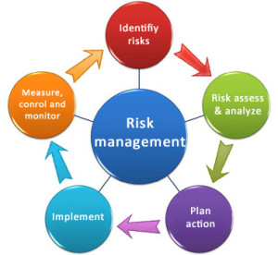
Development of Basic Contracts
The Risk Management Process:
Identify exposures
Analyze exposures
Consider feasibility of alternative techniques to treat exposure
Select the best technique
Implement technique
Monitor results and change as needed

Slide 20
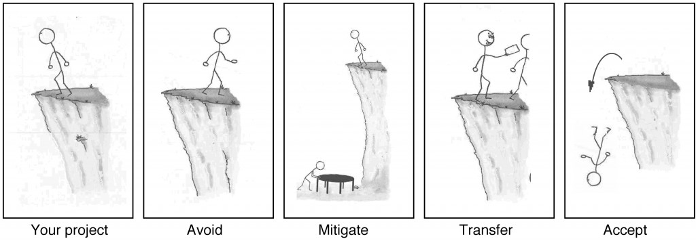
Development of Basic Contracts
Consider feasibility of alternative techniques to treat exposure!
Avoid
Mitigate / Reduce
Transfer
Accept

Slide 21
Development of Basic Contracts
We are going to talk about Risk Transfer today!
How is Risk Transfer accomplished?
Through …
Insurance Policies
Indemnification Agreements (Contractual Risk Transfer)
Releases and Waivers

Slide 22
Development of Basic Contracts
What is Contractual Risk Transfer?
Language that transfers the risk from one organization to another.
Another party who will;
Take responsibility for Project
Manage the Project
Bear responsibility for the Project
Ensure the Project is managed by the best party able to deal with it effectively

Slide 23
Contractual Risk Transfer – This Basics
What are the basic steps in designing the agreement?
Analyze the Risks and Relationships
Use a Hold Harmless (Indemnity) Agreement
Select the Appropriate Insurance Specifications
Verify Insurance Coverage
Report Claims Promptly

Slide 24
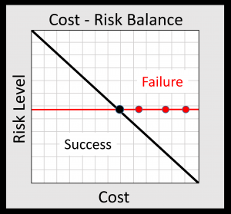
Step 1 – Analyze the Risks and Relationships
Who could be harmed? Visitors attracted?
What are the activities and maximum likely loss? Dangerous? Crowds? Pollution? Alcohol?
Where? On vs. off premises? Site control?
When? Night? During sporting events?
How likely would the Auxiliary or Campus be a defendant if there is a loss?

Slide 25
Step 2 – Use a Hold Harmless Agreement
Why should I bother with a hold harmless agreement?
You can be held liable for damages caused by your contractors
You should be able to rely on the contractor’s expertise to do the job safely, and if it doesn’t, it should pay for the consequences
Responsibility encourages safety
Risk is placed upon those best able to control the work
You have a source for payment of claims against your entity
Maintaining your own budget
Maintaining your own good loss history and lower insurance costs

Slide 26
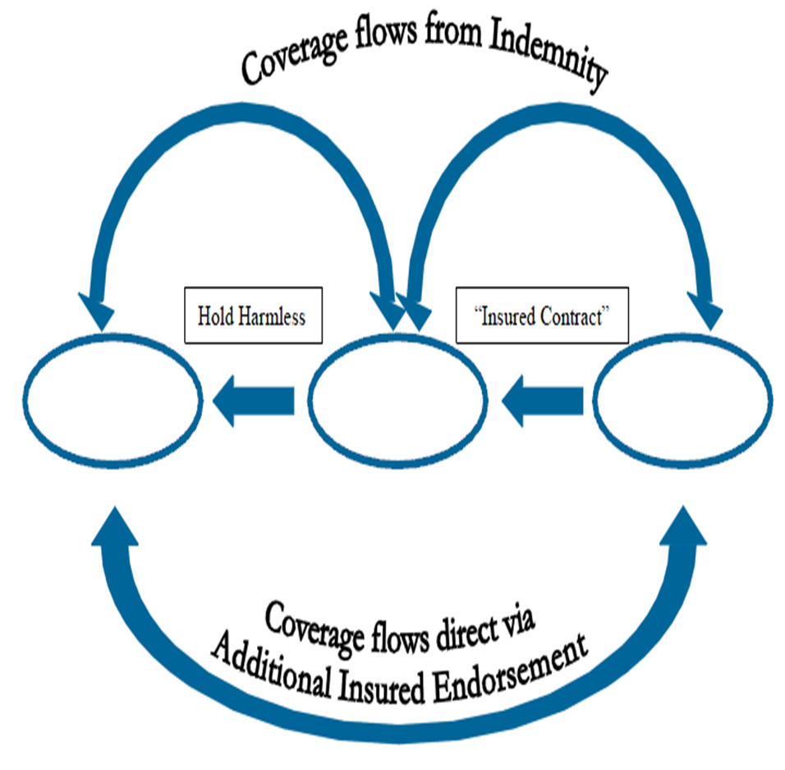
Step 2 – Use a Hold Harmless Agreement
Insurance language flows from covenants made in hold harmless agreement
Insurance is the "collateral" for the hold harmless
Negotiate the hold harmless first
Negotiate the insurance requirements to support the hold harmless

Slide 27
Step 2 – Use a Hold Harmless Agreement
There are three main types of indemnification (hold harmless):
Strict (or “Type I”) Indemnification
  Contractor indemnifies AO for all claims costs arising from project except AO’s sole negligence or willful misconduct.
Intermediate Form (Construction Projects)
  Contractor Indemnifies except for AO’s active negligence or willful misconduct
Limited Form
  Contractor indemnifies for contractor’s negligence
  Can be used for cross indemnity comparative negligence

Slide 28
Step 3 – Select Appropriate Insurance Specifications
Requiring insurance helps ensure contractor will have money to delivery on the hold harmless promise.
Insurance Requirements in Contracts – Basic Coverages
Commercial General Liability
Commercial Auto Liability
Workers’ Compensation
Cyber Liability
Professional Liability
Property Insurance
Generally Included
Optional

Slide 29
Step 3 – Select Appropriate Insurance Specifications
In addition to the Basic Coverages, also request …
Other Insurance Requirements
Additional Insured
Primary Coverage
Notice of Cancellation
Confirmation of Deductible / SIR
Verification of Insurance
Waiver of Subrogation
Acceptability of Insurers
Claims-Made Policy

Slide 30

Step 4 – Verify Coverage
Review the insurance forms:
Certificate of Insurance (COI)
Additional Insured (usually an endorsement)
Primary Coverage
Waiver of Subrogation (usually an endorsement)
Notice of Cancellation
Confirmation of Deductible / SIR (will be included on the COI)
Verification of Insurance (it’s okay to ask for the policy’s declarations page
Acceptability of Insurers
Claims-Made Policy
The use of a checklist is beneficial

Slide 31
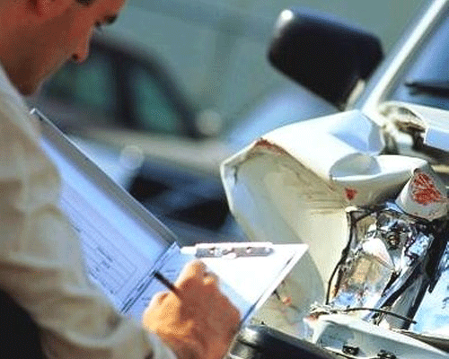
Step 5 – Report Claims Promptly
Inform contractor’s insurer …
In writing
Immediately
Incidents or claims arising out of work

Slide 32

Development of Basic Contracts
Just say no? Where should I draw the line?
At what point will the AO / Campus be so exposed that the proposed hold harmless agreement is too risky?
Recommendation: Focus on hold harmless before insurance.
Recommendation: Involve legal counsel in negotiations that deviate from approved hold harmless agreement within IRIC.

Slide 33
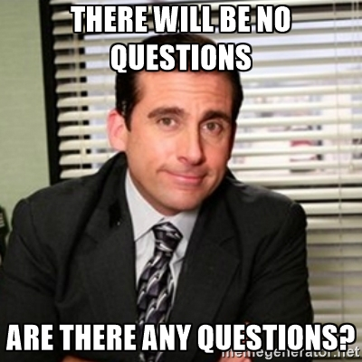
Are there any questions?

Slide 34
Thank You!
Questions? Please contact:
Carrie Rasmussen, Attorney
Lozano Smith
1 Capitol Mall, Suite 640, Sacramento, CA 95814
(916) 329-7433
crasmussen@lozanosmith.com
www.lozanosmith.com
Daniel Howell
CSURMA Program Director
Alliant Insurance Services, Inc.
100 Pine Street, San Francisco, CA 94111
415-403-1426
dhowell@alliant.com

