Slide 1


AORMA: It’s a Fascinating Topic!
AOA Conference
Tuesday, February 10, 2015
3:30 PM to 4:45 PM
Presented by:
Mimi Long
Alliant
mlong@alliant.com
415-403-1423 Office
415-609-5166 Mobile
Melissa Diaz
Alliant
mdiaz@alliant.com
415-403-1444 Office
858-245-5835 Mobile

Slide 2
Why is AORMA so Fascinating?
Formation – evolution, history, design
Governance – guidance, choice, resolution
People – committees, partnership
Coverage - analysis, indemnity
Insurance Program ratings – assessment, judgment
Loss Control to help prevent claims – security, assurance, oversight
Notes:
Because we are self insured we can create programs and they are always changing

Slide 3
Formation
What is a Joint Powers Authority (JPA)?
  1970’s & 1980’s – Private insurance companies unwilling or reluctant to insure public agencies
  Mid 1970’s California Legislature amended Government Code to allow two or more agencies to join together
  JPA’s able to combine their commercial efforts & achieve economies of scale
  Lower Premiums to Members, reducing taxpayer dollars
  Board of Directors
  Can employ Staff - Alliant
  150 JPA’s in the State of California
Notes:
Most JPA’s in California have a $1 million retention, CSURMA has a $350,000 retention.

Slide 4
Formation
Collaboration - Chancellor’s Office & CSU Auxiliary Organizations wanted to restructure the overall risk management program to handle risks prevalent across CSU campuses
Reform - Special legislation was obtained to permit both the CSU and Auxiliary Organizations to create a quasi-public entity
Reform – In 1996, had JPA Law amended so nonprofits could create a JPA
Formation - On January 1, 1997, the CSURMA was formed by the CSU and two Auxiliary Organizations (ASI in San Diego & Humboldt)
Purpose - To develop strategies that streamline and integrate the risk management practices of the CSU system and Auxiliary Organizations, reduce or eliminate losses and loss exposures, decrease the expenses of claims and claims administration and improve procedures to manage risks
Notes:
ADD PICTURES

Slide 5


A Pool within a Pool
California State University Risk Management Authority (CSURMA) – joint powers authority created to provide insurance and risk management services for CSU Campuses and Auxiliary Organizations, including insurance and self-insurance.
  Auxiliary Organizations Risk Management Alliance (AORMA) - operates within CSURMA to offer tailored coverage for CSU Auxiliary Organizations, including lower deductibles and other special coverage requirements.
Notes:
CSU is a $6 Billion dollar organization. The CSURMA is a separate authority – like “captive insurance” – we provide coverage for all lines of insurance except benefits. 100% of our members are a part of the property and liability program and almost 100% for WC. AORMA is run completely separate from CSURMA – you can think of their association as a “Pool within a Pool.”

Slide 6
Mission Statement
The California State University Risk Management Authority (CSURMA) is a joint power authority composed of CSU and its Auxiliary Organizations joined to protect member resources by providing broad coverage and quality risk management services that stabilize risk cost in a reliable, economical and beneficial manner.
Notes:
ADD PICTURES

Slide 7
History
AORMA was called AGPIP before 2007
Auxiliary Organization Group Purchase Insurance Program
Initially, the Auxiliary Organizations were reluctant to share risk believing that their loss exposures varied too greatly from each other to equitably share in each other’s losses
On July 1, 1997, AGPIP was formed with eight Auxiliary Organization members
Initially formed as a liability group purchase program
After building its loss history, it was discovered that there were more similarities than differences in the group
By 2006, all of the Auxiliary Organizations had voluntarily joined AGPIP
In May 2007 AGPIP changed its name to AORMA – new logo rolled out at the 2007 AoA Conference
Notes:
ADD PICTURES

Slide 8
History
Auxiliary Workers’ Compensation was once AO-Comp
In 2003/2004, workers’ compensation insurance market collapsed
Auxiliary Organizations saw their workers’ compensation premiums increase 400% over three-year period
May 1, 2004 - AO-Comp, Inc. was formed as a private self-insurance group, after seeing AGPIP success
Initially, the Auxiliary Organizations wanted to maintain separate control
Eventually, the AO-Comp members did see the monetary value of inclusion within CSURMA
In 2008, AO-Comp transferred its remaining liabilities to CSURMA AORMA and filed for dissolution with the State
Notes:
ADD PICTURES

Slide 9
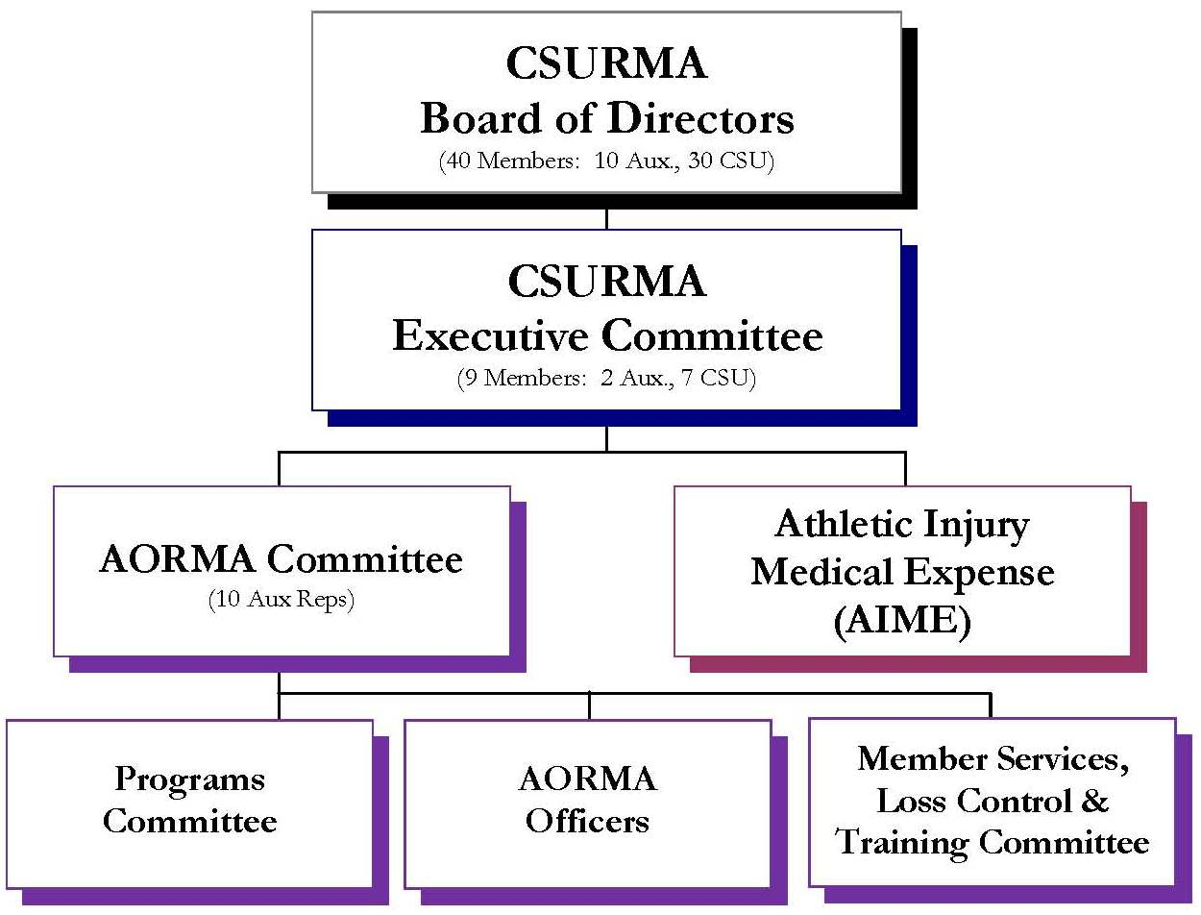
Governance & Committees
Notes:
Because we are self insured we can create programs and they are always changing

Slide 10
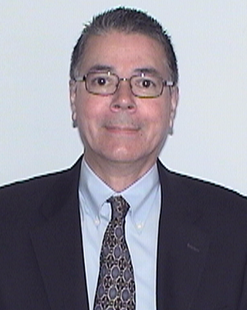
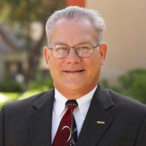
AORMA Committee Chair &
Vice Chair
Robert de Wit, Chair
CSU Long Beach
Frank Mumford, Vice Chair
CSU Fullerton

Slide 11
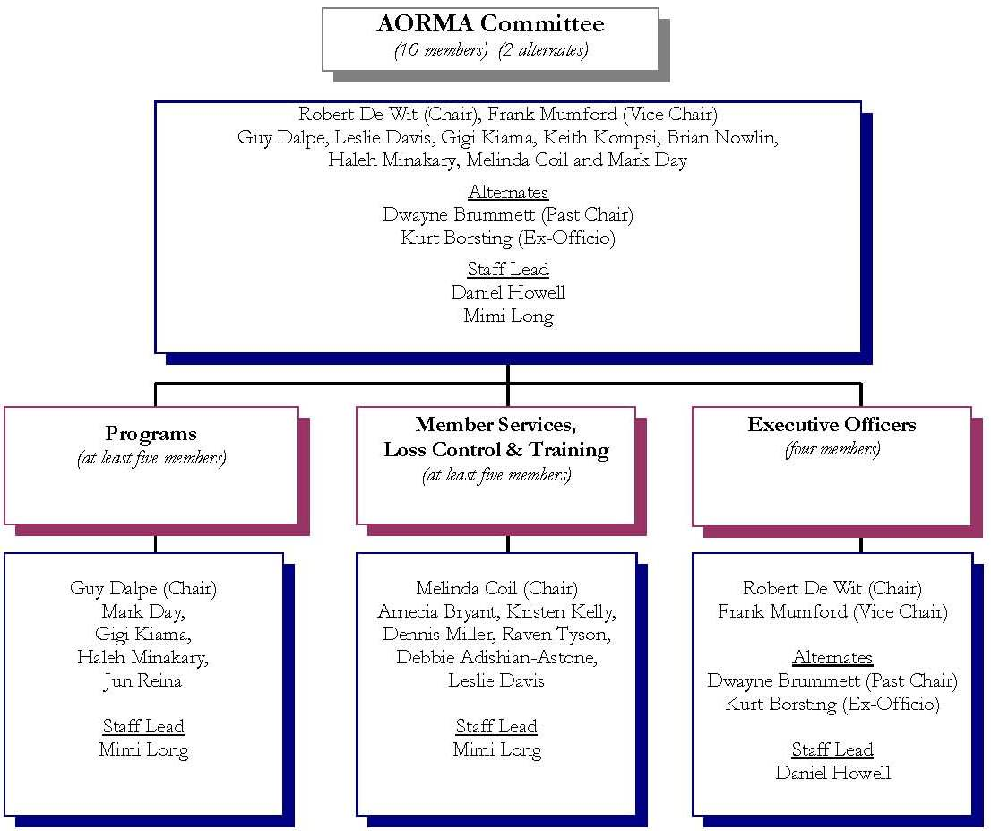
AORMA Committee Members
Past or Present - Please Stand!
Notes:
AORMA Members (past or present) please stand – can we give them a round of applause for their time and commitment to all of you?
The hard work done by Committees within CSURMA and AORMA are really what help keep members from going through financial peaks and valleys. The Executive Officers get together once in a while to discuss claims. CSURMA renews on July 1. Because of the work that our Programs committee does, we are able to have rates set by Sept or October for the following year. Usually in January or around the time of AOA, we will know your rate for a July 1 renewal – this doesn’t happen in the regular insurance world. What also doesn’t happen in the regular insurance world are “dividends.” – and we will talk about that more at the end of this presentation.

Slide 12
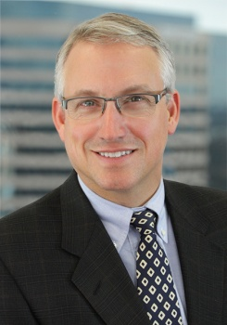
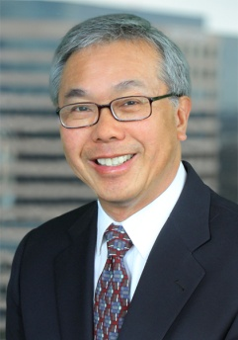
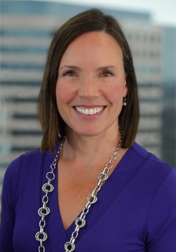
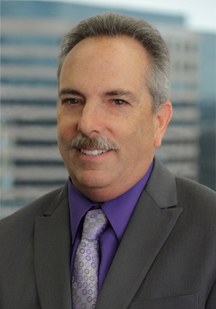
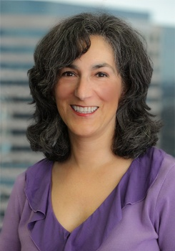
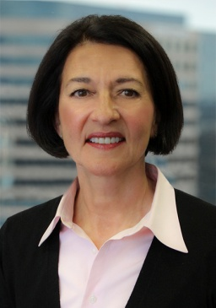
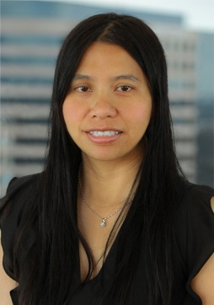
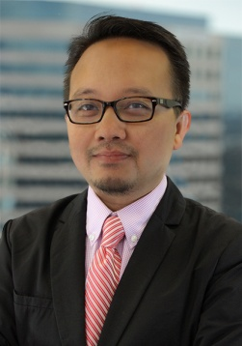
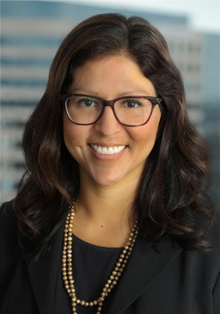
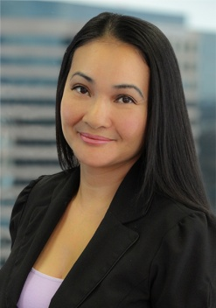
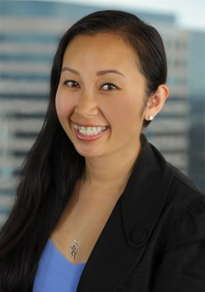
Program Administrators
Daniel Howell
Program Director
D: (415) 403-1426
M: (415) 309-1243
dhowell@alliant.com
Robert Leong
Campus Programs
D: (415) 403-1441
M: (619) 405-9549
rleong@alliant.com
Mimi Long
AORMA Programs
D: (415) 403-1423
M: (415) 609-5166
mlong@alliant.com
Robert Frey
Claims Manager
D: (415) 403-1445
M: (415) 518-8490
rfrey@alliant.com
Jacki Graf
WC Claims Consultant
D: (415) 403-1438
jgraf@alliant.com
Stacey Weeks
AIME, Foreign Travel
(415) 403-1448
sweeks@alliant.com
Van Rin
Program Administrator
(415) 403-1408
vrin@alliant.com
Hsan Htein
Program Administrator
(415) 403-1452
hhtein@alliant.com
Melissa Diaz
JPA Administrator
(415) 403-1444
mdiaz@alliant.com
Tevea Him
JPA Administrator
(415) 403-1416
thim@alliant.com
Yung Lam
JPA Administrator
(415) 403-1461
ylam@alliant.com
Notes:
Rob – Drone Boy, intramurals, aircraft, club sports. Robert Frey mainly does property excess claims. Jacki Graff works with Sedgwick – your Work Comp TPA and has monthly calls with Zachary’s office and the campus about open claims. Stacey works on the athletic injury program for NCAA sports and is your foreign travel expert. Van does our accounting and financials. Hsan handles the technical insurance transactions and takes care of the tricky one-offs. Tevea provides Admin support and has worked with us since 1993. Yung does graphics and reorgs for us.

Slide 13

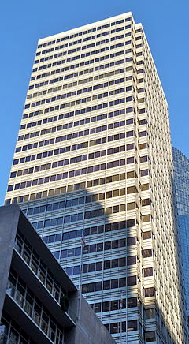

Alliant San Francisco
Service Office

Slide 14
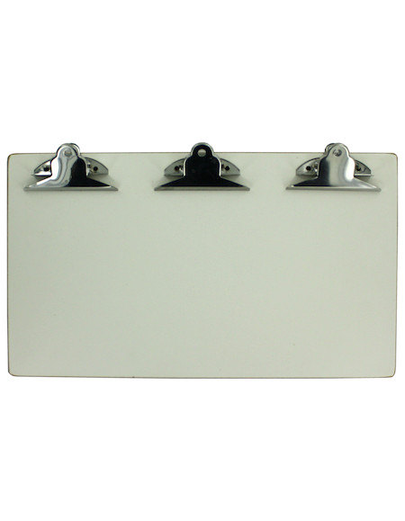
Coverage Programs
  Liability
  Workers’ Compensation
  Property / Boiler & Machinery
  Fidelity / Crime
  Unemployment Insurance Program

Slide 15
Liability Insurance Program
AORMA Liability Insurance Program
Fiduciary Liability
General Liability
Abuse or Molestation
Directors and Officers Liability
Publishers’ Liability
Broadcasters’ Liability
Liquor Liability
Employment Practices Liability
Outside Directors’ Liability
Watercraft Liability
(up to 50 Ft)
Unmanned Aerial Vehicle Liability
Employee Benefits Liability
Miscellaneous Professional Liability
Emotional Distress / Mental Anguish
Auto Liability
Notes:
This covers AORMA’s negligence – not an outside party
Liquor – host and if serving – if you have a party, bring in people, it covers you as the host
Watercraft – rented – you are covered
Fiduciary Liability is new in the last few years
Auto liability is excess
Rockets – separate policy

Slide 16


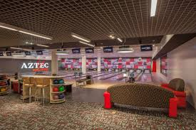
Liability – Entities Covered
Auxiliary Organizations
Governing Board
Officers
Employees
Volunteers

Slide 17
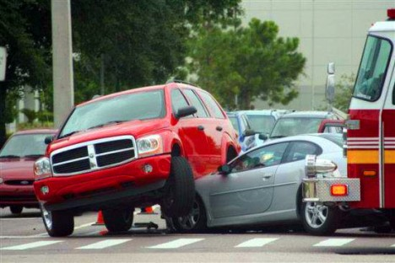
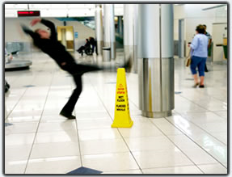

AORMA Liability Program
Rating Plan
Total Payroll
Square Footage
Number of Owned Autos
Total Expenditures
Loss Experience
Size Credit

Slide 18
Liability Insurance Program
$20,000,000 |  | Excess Insurance Layer Various Insurers $15,000,000 xs of $5,000,000
$5,000,000 |  | AORMA Reinsured Layer Genesis Reinsurance Corp $4,650,000 xs of $350,000
$350,000 |  | AORMA Pooled Layer $350,000 per occurrence
$25,000 to $100,000 |  | AORMA Member Deductible $0; except for EPL
Notes:
Format

Slide 19
Employment Practices Deductibles
$25,000 for all Members except:
$50,000
  CSU East Bay Foundation
  CSU Fresno Foundation
  Cal State L.A. UAS
  UEI CSU Sacramento
  SJSURF
  Cal Poly Corp (SLO)
$75,000
  CSULB RF
  Cal Poly Pomona
  SDSURF

Slide 20
Workers’ Compensation Insurance Program
AORMA Workers’ Compensation Insurance Program
Workers’ Compensation
Volunteers Covered as Employees
Incidental USL&H
Maritime Exposures
Employers’ Liability
Notes:
Other issues that don’t fall under traditional workers’ compensation
Volunteers covered as employees (per auxiliary organization resolution – registered volunteers)
Research Foundation in Hawaii – have to deal with them separately

Slide 21


AORMA Workers’ Compensation Rating Plan
Payroll Separate by AORMA class codes
Experience modification factor (Loss Experience)

Slide 22
Workers’ Compensation Insurance Program
Statutory – WC $5,000,000 - EL |  | Excess Insurance Layer Safety National Workers’ Compensation Statutory Employer’s Liability $4,500,000 xs of $500,000
$500,000 |  | AORMA Pooled Layer $500,000
Low SIR for California
$0 Deductible
Notes:
$500,000 SIR is extremely low in California
Only once in the last 5 years have we breached the SIR

Slide 23
Property Insurance Program
“All Risk”
AORMA Property Insurance Program
Boiler & Machinery
Cyber
Real Property
Business
Personal Property
Extra
Expense
Business Interruption/
Loss of Rents
Flood & Limited Pollution
Notes:
All Risk – covered loss arising from any fortuitous cause expect those that are specifically excluded
Pollution is $1M per pollution condition
This is a program that runs parallel to the university.

Slide 24
Property Insurance Program
$1,000,000,000 Subject to sub-limits |  | Excess Insurance Layer PEPIP Various Insurers $1,000,000,000 xs of $100,000
$100,000 |  | AORMA Pooled Layer $100,000 per occurrence $200,000 aggregate
$5,000 to $50,000 |  | AORMA Member Deductible Between $5,000 - $50,000
Notes:
Format

Slide 25
Property Insurance Deductibles
$5,000 for personal property and business interruption / loss of rents
1% of real property value subject to a minimum of $5,000 and a maximum of $50,000 (sliding deduct.)
Flood Deductibles- $250,000 in zones A & V
$100,000 for all other zones
$50,000 for fine arts
$10,000 per vehicle or mobile equipment, $50,000 maximum

Slide 26
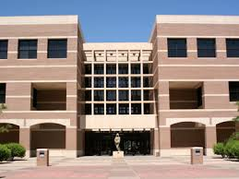
“Campus 99”
Bond Funded Buildings
Leased by Auxiliaries from Campus
Campus Property Deductible starts at $100,000
Auxiliaries “buy down” the deductible from the Campus

Slide 27
Crime Insurance Program
AORMA Crime Insurance Program
Theft
Employee Benefit
Assets
Computer Crime
Counterfeiting
Employee Dishonesty incl. Faithful Performance
Forgery
Notes:
All Risk – covered loss arising from any fortuitous cause expect those that are specifically excluded
This is a program that runs parallel to the university.

Slide 28
Fidelity / Crime
Insurance Program
$2,000,000 |  | Excess Insurance Layer Lloyd’s of London $2,000,000 any one loss (inclusive of $100,000 AORMA pooled layer) $40,000,000 aggregate
$25,000
 |  | AORMA Pooled Layer $25,000 per loss $100,000 aggregate
$5,000 |  | Member Deductible $5,000
Additional Limits Available
Notes:
This is when you find out that people were giving themselves a raise over the years!!
Example: During the recession in 2008, the Port of Seattle parking was only taking credit cards – the woman working at the kiosk
was collecting parking $$ - $30 pp and over the course of time, it was a $700,000 loss

Slide 29

AORMA Crime Program
Rating Plan
Total Payroll
Total Expenditures
Loss Experience
Size Credit

Slide 30

AORMA Unemployment
Rating Plan
Average Claims for Five Years
Five Year Period to Pay Back Deficit
Administration Costs
No Loss Sharing

Slide 31
Other AORMA Programs
  Data and Privacy Security (Cyber) – 1st and 3rd party coverage
  Foreign Travel Insurance Program (FTIP) – Trips must be reported and approved prior to departure
  Identity Fraud – This coverage is only available to Auxiliary Organization employees
  Student Travel Accident – “No Fault”
Notes:
Do you ever send anyone somewhere abroad? This provides medical coverage, gets parents to location if needed, evacuation,
$5/trip – wildfires in Russia – had to relocate people
Student Travel - $25,000 per accident – covers medical expenses on the way to an event. “No Fault” – you don’t have to be negligent – traveling to the final location
$2500 coverage –for trip cancellation – created this for cancellations that usually aren’t covered

Slide 32
Other AORMA Programs
  Auto Physical Damage (APD)
  Club Sports / Intramurals Program
  Participant Accident Insurance (PAI)
  Special Events
  Special Liability Insurance Program (SLIP)
  Vendors / Contractors Liability Program
  Inland Marine Insurance (fine arts, musical instruments, special equipment - $1,000 deductible)

Slide 33
Liability Program Losses
Notes:
Premises Liability – Slip/Trip and Fall –
Example: The Audobon Society – Chico - rented out a house and they were taking a picture and the whole deck collapsed –a lot of old people – this was over $1M – 15 people injured
Example – SF woman giving a tour and fell backwards in to a concrete planter box.
G:\Share\CLIENT\jpa\csu\AORMA\AORMA Claims\Loss Runs\Liability\2014 06 30 - AORMA Liabilty Loss - Members Presentation 2009-2014.xls

Slide 34
Workers’ Compensation
Program Losses
$2,235,714
$1,739,235
$482,016
$910,339
$1,730,515
$488,976
*Represents the percentage of claims compared to the payroll reported.
Notes:
G:\Share\CLIENT\jpa\csu\AORMA\AORMA Claims\Loss Runs\WC\2014 06 30 - AORMA WC Losses - Members Presentation 2009 – 2014.xls

Slide 35
Program Expenses as of June 30, 2014
Notes:
35
G:\Share\CLIENT\jpa\csu\AORMA\AORMA Program Expenses\2014 AORMA Program Expenses.xlsx

Slide 36
Administrative Expenses – 11%
JPA Administration
(Alliant)
Works directly with CSU ORM
Meeting Agendas
Insurance Brokerage
(Alliant)
Risk Financing Model Development
Designs and
Reviews all Coverage Wording
Claims Administration (Various)
Liability (Carl Warren and Company)
Meeting Minutes
Program Manuals
Website
Annual Budget
Dividend Calculations
Program Cost Allocations
Policies and Procedures
Resolutions
Loss Control Contracts
Actuarial Reviews
Plus 29 additional tasks
Program Development
Evaluates the Financial Status of all Excess Insurers
Purchases Excess Insurance for CSURMA’s Coverage Programs
Workers’ Compensation (Sedgwick)
Pollution (Alliant and ACE)
Cyber (Alliant and Beazley)
Property (Alliant)
PAI (HSR)
Unemployment Insurance (Employers Edge)
Underwriting Information
Notes:
ADD PICTURES

Slide 37
Total AORMA Program Dividend
Notes:
Earned Investment income and returned back to you
This would be sitting in the pockets of the insurance company
AORMA Board sets rates
G:\Share\CLIENT\jpa\csu\AORMA\AORMA Dividends\AORMA Historical Dividends.xls

Slide 38

Loss Control and Training
Live HR Consulting
On-Line access to BNA’s HR Essentials
Access to a staffed HR Reference Center
Monthly HR newsletter in full digital format
Weekly legal updates for all 50 states
Access to EG’s most popular Compensation & Benefits Surveys
Your primary contact at
Employers Group:
Mark Nelson
(213) 765-3952
mnelson@employersgroup.com
Kimberly Nwamanna
213-765-3982
knwamanna@employersgroup.com
Notes:
There is $60,000 being spent on this and not a ton of people use this resource

Slide 39

Loss Control and Training
  Records Management
  Compliance Management
  On-line Safety Training
  Custom Learning Management
Your primary contact at
TargetSolutions:
Ashley Cole
(858) 683-7176 alc@targetsolutions.com
Notes:
Looking to transition to the University Training Program so it stays consistent – there is a lot in here but not as geared towards auxiliaries

Slide 40

Loss Control and Training
Your primary contact at Shoes for Crews is:
Scott Townsend
Director of Regional Accounts
Phone: (561) 242-5953
Fax: (866) 492-9820
E-mail: scottt@shoesforcrews.com
  $10,000 slip and fall warranty
  Corporate discount pricing
  A tailored program based on your individual needs
  24/7 ordering and customer service
Notes:
WORK IN PROGRESS

Slide 41

Loss Control and Training
  460 On-Line Self-Assessments for Campus and Auxiliary Programs Involving Minors
  Each Program that uses the Self-Assessment will have access to three on-line training courses
  Each Program that uses the Self-Assessment will have access to a one-hour telephone consultation
Your Primary Contact at Praesidium is:
Aaron Lundberg, LMSW
Vice President of Account Services | Praesidium, Inc.
817.801.7773 Office | 817.307.3725 Mobile
817.261.7864 Fax
Email: ALundberg@PraesidiumInc.com
Notes:
For minors on campus – we just signed the contract with Praesidium last July – University of CA likes it and this is being used nationwide at other universities. Not as concerned with day care centers – but other programs involved with minors like camps where you program managers need to lead. The assessment will tell you where your strengths are and weaknesses are. Be prepared to do the assessment and implement the recommendations they give you.

Slide 42
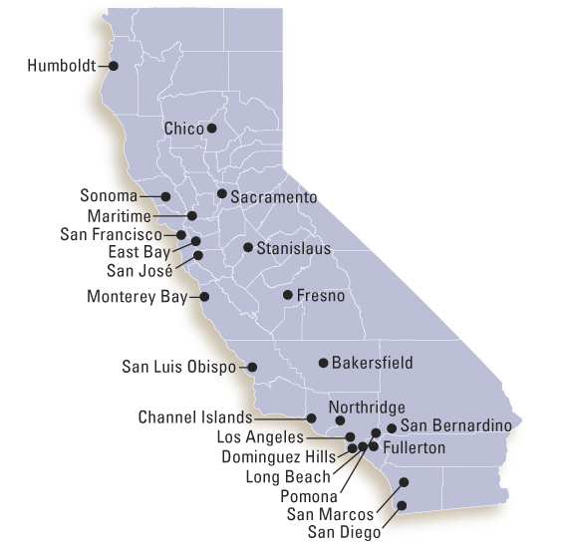

Did you know…
Loss Control and Training
Alliant Risk Control provides safety consulting services to all AORMA members at no additional charge.
Your primary contact at
Alliant Risk Control:
Brent Escoubas
(949) 260-5013
bescoubas@alliant.com
42

Slide 43
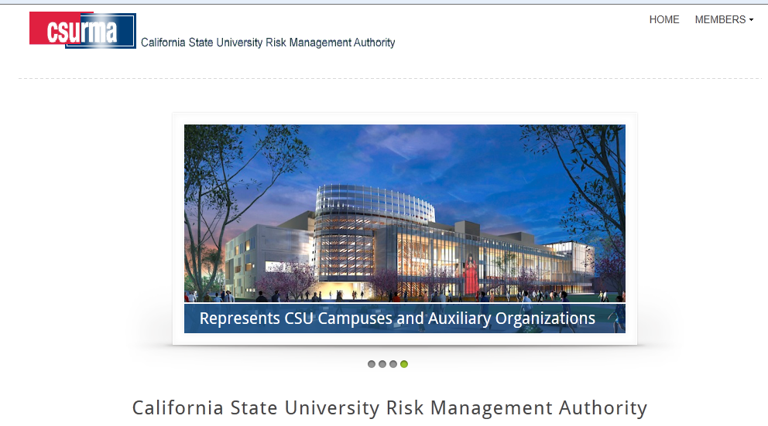
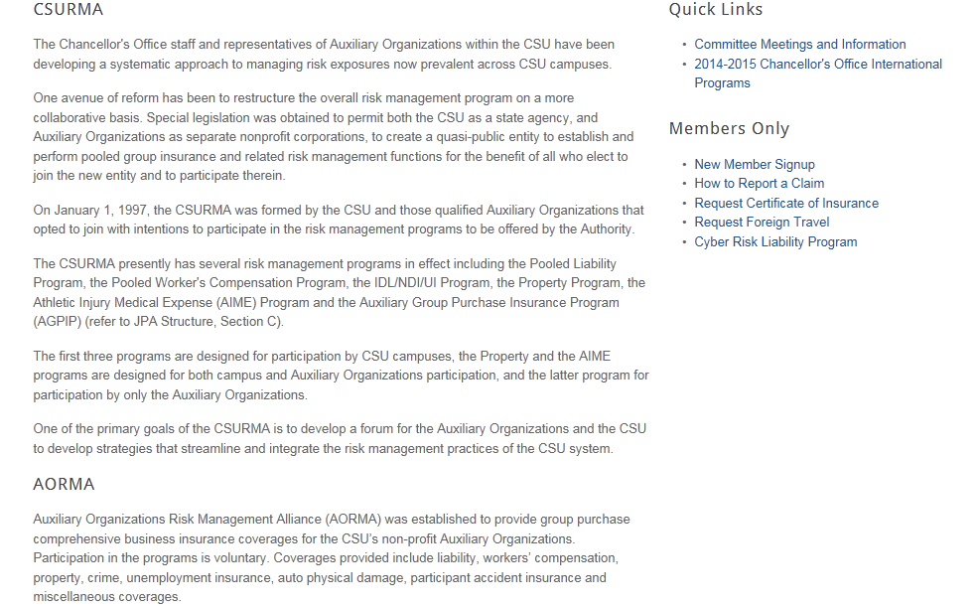
CSURMA Website
Log into the CSURMA website – www.CSURMA.org
Click on MEMBERS
Enter Username and Password
Click sign in
Notes:
ADD PICTURES

Slide 44

Risk Reduction Innovation Matching Incentive Program
$10,000
Innovative Risk Reduction Project
Application & guidelines located on www.csurma.org website
Reviewed and approved by MSLCTC
50% of your Project costs (up to $10,000) reimbursed
Inspire other Members with new safety ideas

Slide 45

How to Keep Up to Date
  “Fitting the Pieces Together” Conference
  CSURMA website
  Board meetings
  Committee meetings
  AORMA bulletins
  Quarterly AORMA Chair updates
  Talking to your Peers!

Slide 46

Conclusion and Questions
This presentation and much more can be downloaded at:
www.csurma.org

