Slide 1


Protecting Student Life
A Discussion on Information Security, Current Trends, Cyber Liability and Risk Management
January 10, 2017
10:45 AM to 12:00 PM
PRESENTED BY:
Ed Hudson, CSU Information Security Management
Daniel Howell, Alliant Insurance Services

Slide 2
Who’s Who of 2016
i-Dressup: 2.2 Million
DLH.Net: 3.3 Million
Leet: 5 Million
ClixSense: 6.6 Million
Lifeboat: 7 Million
DailyMotion: 18 Million
Mail.ru- 25 Million
Weebly: 43 Million
Vertical Scope: 45 Million
FriendFinder Networks: 412 Million
      Source: NetworkWorld
Notes:
i-Dressup- Social site for teenage girls. Vulnerablity let hacker extract user acct passwords and emails. Hacker said it took 3 weeks to download the info but that there was still 3.3 million left. Passwords not protected by encrpytion
Lesson: Don’t sign into a site without strong encryption
DLH.net Gaming site. Full names, user names, passwords. Were encrypted with weak algorithms. Facebook access tokens also stolen.
Leet- Cloud service enabling servers on smartphones to host gaming. Usernames, passwords, addresses, ip addresses. (Don’t use password for more than one site)
ClixSense- Paid users to fill online surveys and watch ads (students) Full names, emails, passwords, DOB, gender and home address
LifeBoat- another Minecraft site. Usernames and passwords for all members of community playing mobile version.
DailyMotion: Video streaming site similar to YouTube. Unknown hacker via unknown means Usernames and passwords 1 out of 5 had passwords associated but had strong encryption
Mail.ru- messaging forums tied to gaming. User names, passwords, email and DOB. Weak encryption.
Weebly Web hosting platform for personal web pages. Usernames passwords and IP addresses. Passwords protected by strong encryption
Vertical Scope- another messaging forum auto, sprots and tech. Usernames, passwords and IP addresses. Site was runnign an old version of software with well known vulns
FriendFinder- Adult FriendFinder dating site. May 2015 hacked for 3.5 million. Usernames, passwords, email addy DOB zip codes and sexual pref. 2016 had twenty years worth of acct info. Usernames,
passwords, email . Passwords for five of their sites including Adult Friend Finder and Penthouse.com were plaintext or securred with weak encyption.
Source: http://www.networkworld.com/article/3150815/security/10-biggest-hacks-of-user-data-in-2016.html?google_editors_picks=true

Slide 3
Notable Mention
MySpace: 427 Million
Yahoo: 1 Billion
Notes:
Reportedly hacked before 2016

Slide 4
Closer to home
Wire Fraud: 250K
HR Benefits
Ransom and Ransomware
Contentious Divorce
File Cabinets in Public
SCO Payroll Recycling
Phishing, Phishing and more Phishing
  Taxes, acct resets, wire transfers
Notes:
Payroll
Had to be cut before handling and forms. SCO misprint resulted in SSN data being printed on portions sent to recycle

Slide 5
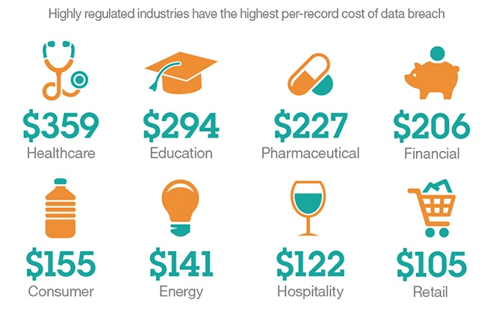
Cyber Risk Exposures – What’s Covered
How much is this going to cost me?

Slide 6
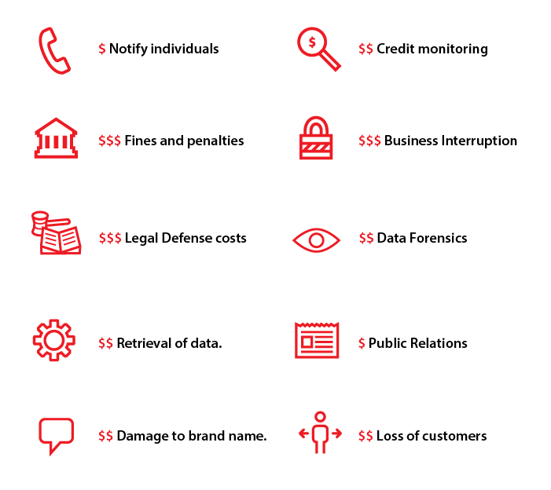
Cyber Risk Exposures – What’s Covered
What Costs Will I Incur?

Slide 7
Cyber Risk Exposures – What’s Covered
Information Security & Privacy Liability
Regulatory Defense & Penalties
Website Media Liability
Cyber Extortion Liability
First-Party Data Asset Liability
First-Party Network Business Interruption

Slide 8
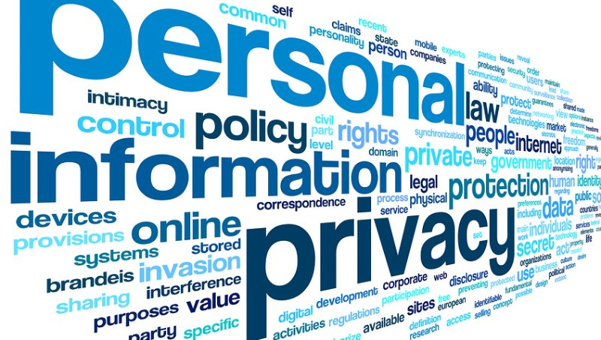
Cyber Risk Exposures – What’s Covered
Information Security & Privacy Liability
Violation of privacy law through failure of computer or network security
Breach Notification
Call Center Services
Legal Services
Credit Monitoring
ID Monitoring
Public Relations
Crisis Management

Slide 9
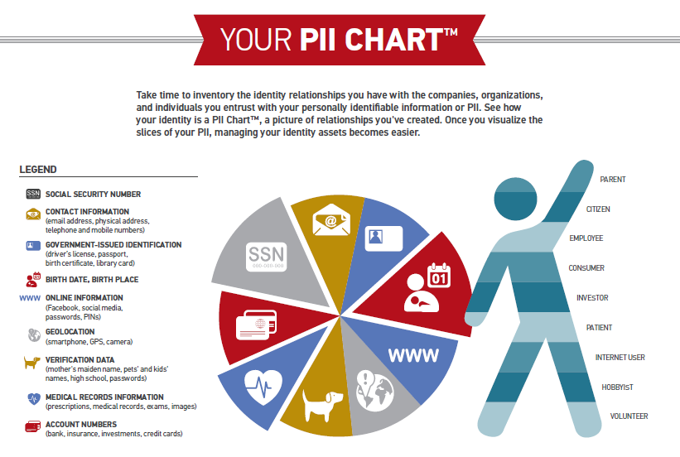
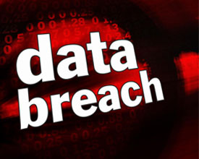
Cyber Risk Exposures – What’s Covered?
Breach Notifications - 2,000,000 Notified Individuals
Notification to State Attorney General, State and Federal Regulators
  Employees/HR Data
  Social Security Number
  Drivers License Number
  Credit Card Information
  Students / Alumni Information
  Protected Health Information

Slide 10
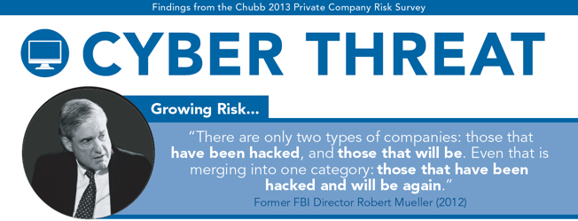
Cyber Risk Exposures – What’s Covered?
Regulatory Defense and Penalty
Legal Services
Fines and Penalties

Slide 11

Cyber Risk Exposures – What’s Covered?
Website Media Liability
Releases of media content displayed on websites or social media sites
Libel
Defamation
Slander
Interference with publicity
Copyright
Trademark infringement

Slide 12
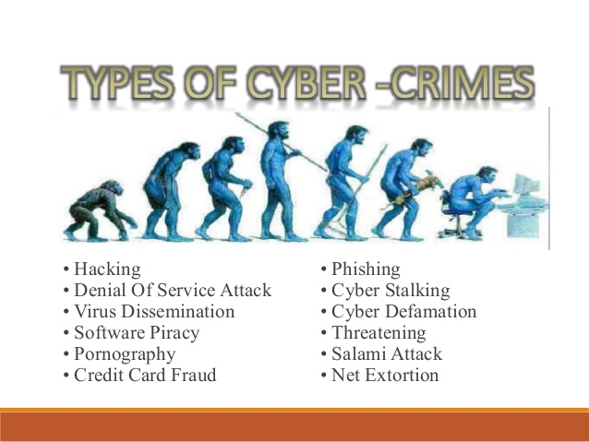
Cyber Risk Exposures – What’s Covered?
Cyber Extortion Liability

Slide 13
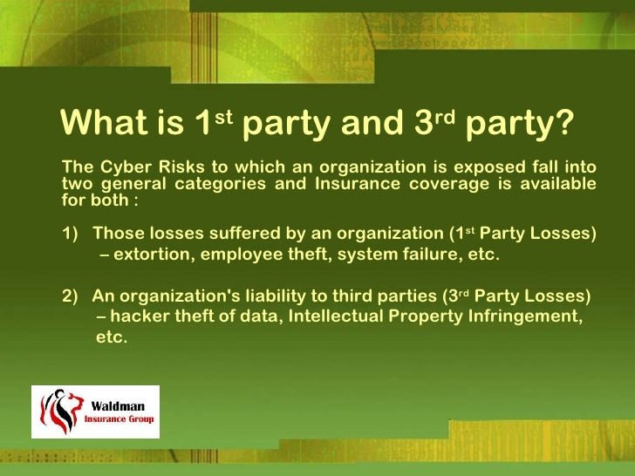
Cyber Risk Exposures – What’s Covered?
1st Party Damages vs. 3rd Party Liability

Slide 14
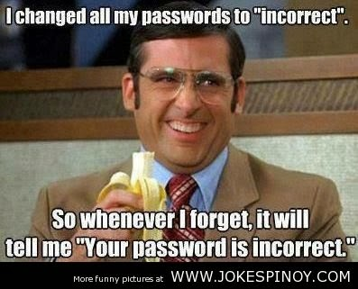
Cyber Risk Exposures – What’s Covered?
First Party Data Assets and Business Interruption
Replace or Upgrade Hardware / Software
Forensic Specialists
Public Relations
Extortion
Business Interruption

Slide 15
Cyber Risk Exposures – What’s Covered?
How much coverage do I have?
$12,000,000 (shared by all campuses and auxiliary organizations – which includes a $7,500,000 sublimit for legal/forensic/crisis management costs)
Plus
2,000,000 Notified Individuals
How much do I have to pay out of pocket?
  The first 250 individual notifications
  Eight hours waiting period for first party claims
  $25,000 for AO and $100,000 for Campuses

Slide 16
Cyber Risk Exposures – What’s Covered?
Who do I contact if I suspect a cyber breach?
1st Point of Contact: Office of Systemwide Risk Management
2nd Point of Contact: Alliant Insurance Services, Inc.
Copy to Beazley Breach Response Team:
Robert Frey
(415) 403-1445
rfrey@alliant.com
Elaine Kim
(415) 403-1458
ekim@alliant.com
bbr.claims@Beazley.com
24-hour hotline (866) 567-8570

Slide 17
Cyber Risk Exposures – What’s Covered?
What can the Beazley Breach Response Team do for me?
The BBR Team will help you successfully prepare for, investigate, and respond to privacy or security breaches
You will be assigned one BBR Team member as your point person
Beazley Breach Response Team:
1. Email bbr.claims@beazley.com
2. 24-hour hotline (866) 567-8570

Slide 18
Cyber Risk Exposures – What’s Covered?
Where can I go to learn more before a breach occurs? The Beazley Breach Solutions website!
www.beazleybreachsolutions.com
What’s on the website?
Breach Response Services
How to Prepare - Steps to take to minimize data breaches and their impact
Overview of an effective response, including a first responder guide and forensic tools
Look up breach notification laws in a specific state

Slide 19
Cyber Risk Exposures – What’s Covered?
Breach Preparation
Breach Response
Litigation and Regulatory Action
Breach Notification
Reputation and Loss Income
The Importance of Prompt Notification and Breach Response
Goal = Preserve reputation and get operations back to normal

Slide 20

Questions?

Slide 21
Thank You!
Questions? Please contact:
Ed Hudson
CSU Chancellor’s Office
Information Security Director & Information Security Officer
562-951-8431
ehudson@calstate.edu
Daniel Howell
CSURMA Program Director
Alliant Insurance Services, Inc.
415-403-1426
dhowell@alliant.com

