Slide 1

UNDERSTANDING THE ACTUARIAL REPORT
Fun With Numbers!
SCORE BOD Training
Thursday, November 1, 2018
Mike Harrington, FCAS, MAAA
President, Actuarial Consulting, Bickmore

Slide 2

Actuarial Disclaimer
I know you think you understand what you thought I said, but I'm not sure you realize that what you heard is not what I meant. Math is fun. Math should be enjoyed. All hail Mathematics. I know you think you understand what you thought I said, but I'm not sure you realize that what you heard is not what I meant. Math is fun. Math should be enjoyed. All hail Mathematics. I know you think you understand what you thought I said, but I'm not sure you realize that what you heard is not what I meant. Math is fun. Math should be enjoyed. All hail Mathematics. I know you think you understand what you thought I said, but I'm not sure you realize that what you heard is not what I meant. Math is fun. Math should be enjoyed. All hail Mathematics. I know you think you understand what you thought I said, but I'm not sure you realize that what you heard is not what I meant. Math is fun. Math should be enjoyed. All hail Mathematics. I know you think you understand what you thought I said, but I'm not sure you realize that what you heard is not what I meant. Math is fun. Math should be enjoyed. All hail Mathematics. I know you think you understand what you thought I said, but I'm not sure you realize that what you heard is not what I meant. Math is fun. Math should be enjoyed. All hail Mathematics. I know you think you understand what you thought I said, but I'm not sure you realize that what you heard is not what I meant. Math is fun. Math should be enjoyed. All hail Mathematics. I know you think you understand what you thought I said, but I'm not sure you realize that what you heard is not what I meant. Math is fun. Math should be enjoyed. All hail Mathematics. I know you think you understand what you thought I said, but I'm not sure you realize that what you heard is not what I meant. Math is fun. Math should be enjoyed. All hail Mathematics. I know you think you understand what you thought I said, but I'm not sure you realize that what you heard is not what I meant. Math is fun. Math should be enjoyed. All hail Mathematics. I know you think you understand what you thought I said, but I'm not sure you realize that what you heard is not what I meant. Math is fun. Math should be enjoyed. All hail Mathematics. I know you think you understand what you thought I said, but I'm not sure you realize that what you heard is not what I meant. Math is fun. Math should be enjoyed. All hail Mathematics. I know you think you understand what you thought I said, but I'm not sure you realize that what you heard is not what I meant. Math is fun. Math should be enjoyed. All hail Mathematics. I know you think you understand what you thought I said, but I'm not sure you realize that what you heard is not what I meant. Math is fun. Math should be enjoyed. All hail Mathematics. I know you think you understand what you thought I said, but I'm not sure you realize that what you heard is not what I meant. Math is fun. Math should be enjoyed. All hail Mathematics. I know you think you understand what you thought I said, but I'm not sure you realize that what you heard is not what I meant. Math is fun. Math should be enjoyed. All hail Mathematics. I know you think you understand what you thought I said, but I'm not sure you realize that what you heard is not what I meant. Math is fun. Math should be enjoyed. All hail Mathematics. I know you think you understand what you thought I said, but I'm not sure you realize that what you heard is not what I meant. Math is fun. Math should be enjoyed. All hail Mathematics. I know you think you understand what you thought I said, but I'm not sure you realize that what you heard is not what I meant. Math is fun. Math should be enjoyed. All hail Mathematics. I know you think you understand what you thought I said, but I'm not sure you realize that what you heard is not what I meant. Math is fun. Math should be enjoyed. All hail Mathematics. I know you think you understand what you thought I said, but I'm not sure you realize that what you heard is not what I meant. Math is fun. Math should be enjoyed. All hail Mathematics. I know you think you understand what you thought I said, but I'm not sure you realize that what you heard is not what I meant. Math is fun. Math should be enjoyed. All hail Mathematics. I know you think you understand what you thought I said, but I'm not sure you realize that what you heard is not what I meant. Math is fun. Math should be enjoyed. All hailnn
2

Slide 3


Why Are We Here?
3

Slide 4

Actuarial What?
Actuaries understand actuarial concepts and terminology.
Many clients do not!
How do we explain these concepts in
simple terms that can be easily understood by everyone, even those who hate numbers??
Let’s have some fun with it ☺
4

Slide 5

Topics of Discussion
Define Terms
  Data
  Ultimate Losses
Outstanding Liabilities
  IBNR
  Loss Development
Projected Losses
  Trends / Inflation
Discounting
Confidence Levels
5

Slide 6
Actuarial Report Uses
Reserving
Ratemaking
6

Slide 7



Seriously – How Are They Used?
Reserving
  How much money do you owe for old claims??
  i.e. Credit Card Bill
Ratemaking
  How much money do you need for new claims??
  i.e. Rate Forecast
7

Slide 8


Actuarial Lingo
What Does This Stuff Mean?
8

Slide 9
Actuaries Love Data!
Data needed for a P&C actuarial study:
  Losses (Paid, Incurred, Blue, Red, ...)
  Exposures (Payroll, Vehicles, SIRs, ...)
  Asset Info (Balance Sheet)
  Budget Info (Income Statement)
  Shoe Sizes, Favorite Ice Cream
  Anything that may be relevant to making loss estimates
9

Slide 10
Data is King!
GIGO….garbage in, garbage out…
Check the loss runs periodically:
  Look for anomalies, large claims
  Keep an eye out for trends
Reasonability Tests:
  Change from prior
  Tie loss runs to financial statements
  Adjustments – deductibles, SIR limits, enrollment shifts between plans or tier coverage, etc.
10

Slide 11
P&C Cost Components
  Loss – Medical/Indemnity, BI/PD
  ALAE – Allocated Loss Adjustment Expenses, which consist primarily of legal fees
  ULAE – Unallocated Loss Adjustment Expenses, which consist primarily of claims administration expenses (in-house or TPA),
  Insurance Costs
  Other Administrative Costs
11

Slide 12
P&C Ultimate Loss
Ultimate Loss is the total cost of claims occurring in a given year
Components of Ultimate Loss
    = Paid Loss
      The Accountant’s Number
    + Case Reserves
      The Adjuster’s Number
    + IBNR Reserves
      The Actuary’s Number
12

Slide 13
Actuarial Stereotypes
There are three kinds of actuaries.
  Those that can count.
  Those that can’t count.
How many actuaries does it take to
change a light bulb?
  How many did it take last year?
  The actuarial report says the light still works.
How does an actuary liven up a party?
  By not showing up!
13

Slide 14

Reserve Analysis
Looking Back!
14

Slide 15
Outstanding Liabilities
How much money do you owe for claims that have already happened?
Credit Card Bill
Case Reserves vs IBNR Reserves
  Good news vs Bad News
Need Reserve for Claims Administration since the claims don’t settle themselves
15

Slide 16

IBNR Reserves?
IBNR (the amount made up by the actuary)
Incurred But Not Really
Imaginary Because Not Real
It’s Big, Not Right
Incurred, But Not Reported!!
16

Slide 17

Loss Development
But Wait…
There’s More!
17

Slide 18
What is P&C Development?
Bad
News
Bad News Wins!
Good
News
18

Slide 19
Why Do P&C Losses Develop?
Claims that have occurred but have not been reported. (aka…pure IBNR)
Claims that have been reported but increase (or decrease) in cost. (aka…case reserve development)
These two comprise IBNR – Incurred But Not Reported.
19

Slide 20


Loss Development
Favorable or Adverse?
20

Slide 21

Favorable Development
21

Slide 22
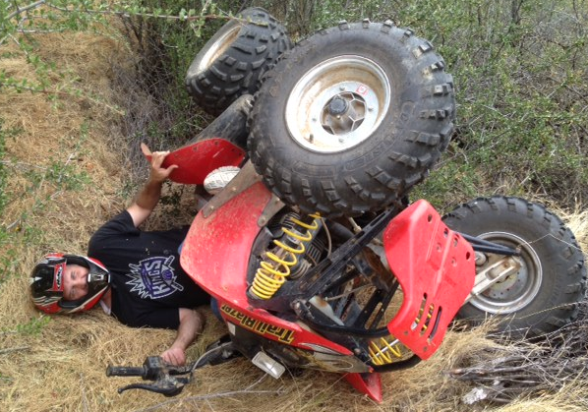
Adverse Development
22

Slide 23

Favorable Development
23

Slide 24

Adverse Development
24

Slide 25
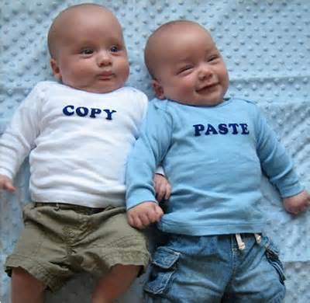
Favorable Development
25

Slide 26
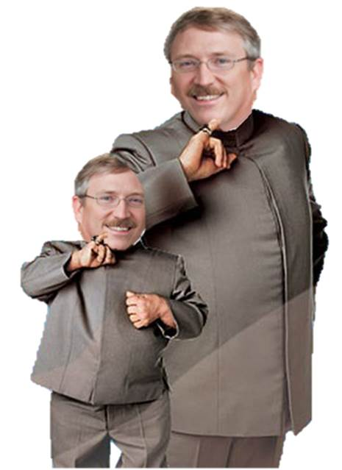
Adverse Development
26

Slide 27

Loss Development
OK. LET’S DO AN EXAMPLE.
P&C STYLE…
27

Slide 28
The Details
Consider 2012-13 workers’ compensation claims, which have dates of loss between 7/1/12 and 6/30/13.
At 6/30/13 (@1 year of development), there were 100 closed claims, each of which cost $5,000, total value $500,000
At 6/30/13 (@ 1 year of development), there were 5 open claims, whose total value was $193,421
Total Reported Losses at 6/30/09 = $500,000 + $193,421 = $693,421
28

Slide 29
P&C Open Claim # 1
Joe, a city employee was delivering office supplies on a city-owned bicycle, when he ran into a dumpster. Bystanders then threw Joe into the dumpster.
@ 6/30/13, some medical expenses and lost wages, value $8,421
@ 6/30/14, more medical expenses and claim closed, final value $13,309
@ 6/30/15, still closed, value $13,309
@ 6/30/16, still closed, value $13,309
@ 6/30/17, still closed, value $13,309
29

Slide 30
P&C Open Claim # 2
Sally was walking on the roof of a city building, trips and falls to the first floor roof, then gets up and trips again, falling to the ground, landing on Joe, the office supply delivery guy.
@ 6/30/13, medical expenses, value $55,000
@ 6/30/14, surgery needed, value $205,000
@ 6/30/15, more medical, value $330,000
@ 6/30/16, expenses added, value $380,000
@ 6/30/17, Sally not an employee, claim closed for expenses incurred only, final value $49,664
30

Slide 31
P&C Open Claim # 3
Joe, the office supply delivery guy, was biking in front of a city building, when Sally fell off the building, landing on Joe.
@ 6/30/13, medical expenses, value $40,000
@ 6/30/14, lower medical, value $5,000
@ 6/30/15, bike was Joe’s and being used on personal time, claim closed for expenses incurred only, final value $216
@ 6/30/16, still closed, value $216
@ 6/30/17, still closed, value $216
31

Slide 32
P&C Open Claim # 4
George, a public works employee, has a tree limb fall on him while doing maintenance, hurting his back and destroying Joe’s bicycle which George was standing on at the time.
@ 6/30/13, wages and medical, value $50,000
@ 6/30/14, more medical, value $100,000
@ 6/30/15, more medical, value $130,000
@ 6/30/16, claim closed, value $165,136
@ 6/30/17, still closed, value $165,136
32

Slide 33
P&C Open Claim # 5
Frank, a peace officer, becomes addicted to donut holes, rendering him unable to work and function in society. Claim is compensable for peace officers under the “Donut Presumption”. Joe now works at the donut shop.
@ 6/30/13, wages and medical, value $40,000
@ 6/30/14, no change, value $40,000
@ 6/30/15, no change, value $40,000
@ 6/30/16, no change, value $40,000
@ 6/30/17, adjuster realizes misplaced decimal point, claim still open, value $400,000
33

Slide 34
Let’s Add It All Up
34

Slide 35

Bottomline…
The Longer a Claim is Open, The More it Will Cost on Average!
35

Slide 36
P&C Loss Development
So now we can put 2012-13 into the development triangle…
Other years can be derived similarly…
36

Slide 37

Well…
What About
Ultimate Losses
and Reserves?
37

Slide 38
P&C Ultimate Loss Estimates
Using the development triangle,
we can project out ultimate losses
38

Slide 39
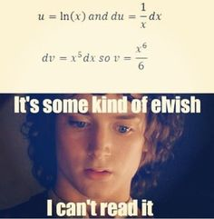
Actuarial Selections
How do we make ultimate loss selections?
Complex top-secret calculation involving differential calculus, which we are forbidden to share in full with non-actuaries
39

Slide 40

Actuarial Selections
Huh ????
40

Slide 41

Actuarial Selections
Sometimes we use complicated formulas involving addition, subtraction, multiplication, and division to make actuarial selections.
For example, we may
add up five different
estimates and divide
by five.
This is called an
…“average”!
    Select ultimate losses based on appropriate methods and actuarial judgment
41

Slide 42

P&C Reserve Estimates
Now that we have calculated ultimate losses, we can subtract paid losses to determine the reserves as of June 30, 2017…
42

Slide 43

Rate Analysis
Looking Ahead!
43

Slide 44
Projected Losses
How much money do you need for claims that will happen next year?
Budgeting
Use history to predict future
Adjust for changes between history and future (e.g. inflationary trends)
44

Slide 45
Forecasting
Estimate ultimate losses/incurred claims for each prior year.
Adjust prior year ultimate losses/incurred claims to the cost level for next year.
Adjust prior year exposure to the cost level for next year.
Calculate the ratio of trended ultimate losses/incurred claims to trended exposure for each prior year.
45

Slide 46
P&C Projected Loss Rate
Based on the trended ratios, we select a projected ratio for next year.
Selected
1.23
46

Slide 47
P&C Projected Ultimate Losses
Multiply this projected ratio times the projected payroll for next year, resulting in projected ultimate losses for next year.
Projected Loss Rate for 2017-18 = $1.23
Projected Payroll for 2017-18 = $1,300,000
Projected Ultimate Losses for 2017-18 = $1,599,000
So we need to collect $1,599,000 in premiums to cover next years expected ultimate losses.
(Note: Ignores discounting, confidence levels, wind speed, NFL strike status, etc.)
47

Slide 48
Projected Program Funding
Costs:
  Expected Ultimate Losses/Incurred Claims
    Discounted or full value
    Investment income anticipated
  Risk Margin
  Claims Administration
  Insurance
  Other Program Costs
Rates:
  Divide Costs by exposure,
  (e.g. per $100 payroll for WC)
Other Costs
Insurance
Claims
Admin
Risk Margin
Losses/Claims
48

Slide 49
Frequency
How Many Claims Are We Having?
-6.0% Annual
Trend
49

Slide 50
Severity
How Big is the Average Claim?
+4.5% Annual
Trend
50

Slide 51

Almost Done
Take a deep breath…
…It’s almost over.
51

Slide 52

Discounting
Making Investment Income Work For You!
52

Slide 53
Discounting
Since losses are paid out over an extended time period, actuarial estimates may be discounted” for expected investment income.
Discounted estimates are sometimes referred to as “net present value” (NPV) estimates.
e.g. You expect to pay losses of $105M in one year, and your one-year investments return 5%. So if you invest $100M today, you’ll have the $105M in a year to pay the loss…
  $105M is undiscounted or full-value estimate
  $100M is discounted or NPV estimate
53

Slide 54
Discounting
Liability – Typically paid out over 5-10 years, so investment income is large enough to reflect in calculations
WC – Claims may remain open more than 20 years, so investment income
is significant
54

Slide 55
Advice…
Choose a Reasonable
Discount Rate!
55

Slide 56

Confidence Levels
How Confident Are You?
56

Slide 57

More Lingo
The majority of actuarial calculations are done at the “Expected Level” (Average or Central Estimates).
“Confidence Level” estimates are also provided, which provide a safety margin above “Expected Level”.
Describes the probability that premiums collected will exceed the actual value of losses after all claims have been settled.
“Expected Level” is approximately “55% - 60% Confidence Level” for P&C
57

Slide 58
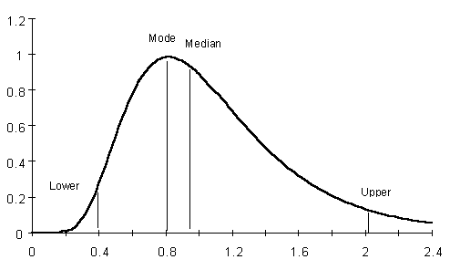
Distributions
Mode
Median
Mean
90% CL
Annual Losses ($Millions)
58

Slide 59

Common Errors
“You are funded at 120% Confidence Level, so you must release your surplus down to 100%!” (an actual quote from a State Auditor letter)
“Our funding is 70% of the actuarial estimate, so we are funded at 70% Confidence Level!” (an actual quote from a Board Member)
59

Slide 60

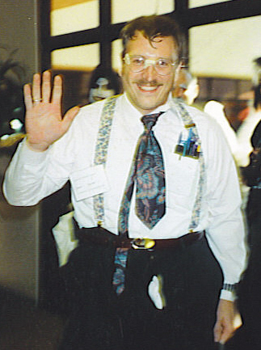

Questions…
Your Ad Here !
60

