Slide 1


Workers’ Compensation Overview

Slide 2

Agenda
What is Workers’ Compensation
Defenses and Presumptions
Benefits
Plan for Success
Questions/Answers/Discussion

Slide 3
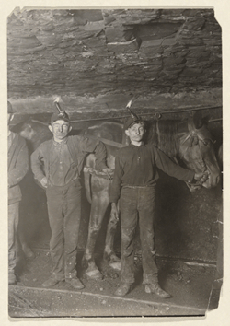
History of Workers’ Compensation
Previously known as: Workmans’ Comp
Before Workers’ Compensation
Employees Suing Employers
Civil Litigation was costly and adversely
affected the employer standing in business
1911 Workers’ Compensation Was Established
“No Fault” System – benefits cannot be denied due
to employee negligence
“Exclusive remedy” – employee can’t sue employer
Liberal laws and designed to provide benefits

Slide 4

What makes a Claim work related
Employment Relationship
Medically Substantiated “Injury”
Arise Out of Employment
Occur in the Course of Employment
Disability or Need for Medical Treatment

Slide 5

Types of injuries
Specific Injuries
  Struck by object, slip & fall, cuts, back strain while lifting, etc.
Cumulative Trauma
  Condition caused by repetitive activities developing over time.
Aggravation Injuries
  A pre-existing condition worsened by some aspect of employment--prior injury and medical records needed to determine apportionment.
    Back, psyche, heart, etc.
Exacerbation is same injury. Aggravation is a new injury.

Slide 6

What is not work related
Off-duty activities
Injury caused by drugs/alcohol
Intentionally self-inflicted
Initial physical aggressor
Suicide
Injured during regular commute to/from work – coming and going rule
Commission of a felony or misdemeanor in/during an accident

Slide 7

What may be work related
Presumption Injuries
  Specific conditions (hernia, TB, MRSA, pneumonia, bio-chemical, meningitis, heart disease, low back, and cancer) when affecting certain safety employees
  Some can be rebuttable
Psychiatric Injuries
  Employee must prove actual work events were predominant cause (51%)
  If violent act 35%
  Six months employed by employer unless sudden and extraordinary employment condition
  Not caused by “lawful, nondiscriminatory, good faith personnel actions”

Slide 8
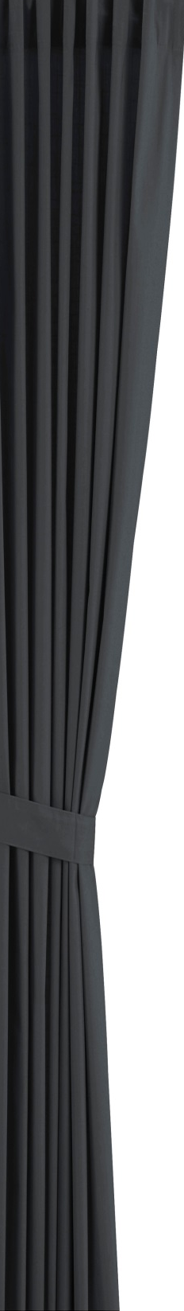

What happens behind the scenes
…HR/York
York reviews all new loss information and sets up a claim file
Contacts are made. Any questions? Any discrepancies? Investigation?
Initial letters are sent out
Medical treatment is authorized- as appropriate
Once employee is discharged from care, and all payments are made, claim is closed (MO Claim)
If employee loses time from work, other benefits may be due
If employee suffers permanent disability, or needs continuing medical care, the issues need to be resolved by a settlement (C&R)
Additional medical evaluations may be needed

Slide 9

Investigation
process
  90-days from date of notice to determine compensability
  AOE/COE Investigation
  Sub-rosa
  Medical/Employment Records
  Panel QME Process
  $10,000 Medical Treatment
  Accept or Deny

Slide 10

Employee benefits under workers’ compensation
  Medical Treatment to cure or relieve from effects of injury. Mandatory application of Utilization Review. Delayed claims covered up to $10,000.
  Temporary Disability (TD) and/or 4850 Benefits provided when unable to perform work.
  Permanent Disability (PD) to compensate for inability to compete in the labor market.
  Supplemental Job Displacement Benefit (SJDB).
  Death benefits.
Note: A “claim” may be accepted, though there may be a denial on a specific benefit issue.

Slide 11

Medical treatment under workers’ compensation
Utilization Review Process
Medical treatment including pharmacy, durable medical equipment, and mileage
Chiropractic, physical & occupational therapy capped at 24 visits (unless post surgical)
All treatment in line with MTUS (Medical Treatment Utilization Schedule)
Pharmacy/medications

Slide 12

Temporary Disability or LC 4850
Temporary Disability:
2/3 Average Weekly Wage payable every 14-days while medically disabled from work
3-day waiting period
104-week limitation
Minimum and maximum rates
Can be delayed even if claim accepted
LC 4850:
Full salary
52-week limitation
Wage loss

Slide 13
Labor Code Section 4850
Paid Leave of Absence
for Specified Public Employees
Whenever any person listed in subdivision (b) who is a member of PERS or a County Employees Retirement Laws is disabled, whether temporarily or permanently, injury or illness AOE/COE shall become entitled, regardless of his/her period of service with the City or County, to a leave of absence while so disabled without a loss of salary in lieu of TTD for the period of disability, but not to exceed one year or until that earlier date or is retired on PD Pension and is actually receiving disability pension payments or advance disability pension payments pursuant to Section 4850.3.
City Police Officers
City, County, or District Firefighters
Sheriffs
Officers or employees of any Sheriff’s office. In 1995 and 2000 this code section was amended to include County Probation Officers, Peace Officers, Designated Airport Law Enforcement Officers, Harbor or Port Police Officers, Wardens, and School District Police Officers. Reserve Police and Firefighters do not qualify for the special salary in lieu of compensation benefits.

Slide 14

Return to Work - Modified Duty
Modified duty refers to changing parts of the employee’s normal
duties to accommodate temporary physical limitations.
Employer Benefits
  Eliminates costs of hiring new employees and temporary replacements.
  No temporary disability payments.
  May reduce permanent disability.
  Medical savings (Employee recovers faster).
  Improves employee morale.
Employee Benefits
  Continues to be productive.
  Remains in touch with co-workers and works in familiar setting.
  Avoids feeling isolated and depressed.
  Avoids financial stress.
  Shows initiative and commitment to return to work.

Slide 15

Maximum Medical
Improvement (MMI)
Treating Physician or QME/AME Report
  Future medical treatment
  Permanent disability rating
  Permanent work restrictions
  Apportionment

Slide 16

Supplemental Job Displacement Benefit
Injuries after 1/1/13, $6,000 Voucher
Tuition, fees, books, vocational services, exam prep classes, computer, expenses
Injuries after 1/1/13, voucher expires if not used

Slide 17

Death Benefit
Burial
5 years from Date of Injury
Dependency Payments

Slide 18
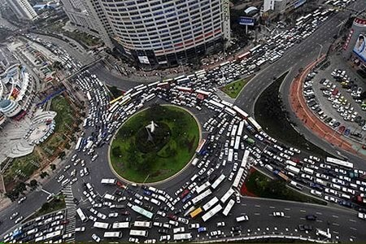
Litigation or
Appeal Process
IMR for medical disputes
Deposition
QME/AME
Trial
F&A

Slide 19

Types of claim settlements
Stipulations: Settles out Permanent Disability and is paid out in a schedule.
  Offers the injured worker lifetime future medical benefits for the affected body part.
Compromise & Release: Settles out permanent disability, future medical treatment, and the right to reopen the claim.
  Paid out in a lump sum payment less any previous advance made during the claim.

Slide 20
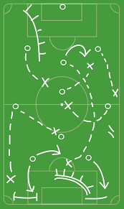
Plan for Success
Prevention
Communication
Modified Duty
Culture

Slide 21


